Slide 2
Deconstructed DBQ Skills Mini-Lesson
Unit 2- Grouping Sources and Thesis

Slide 3
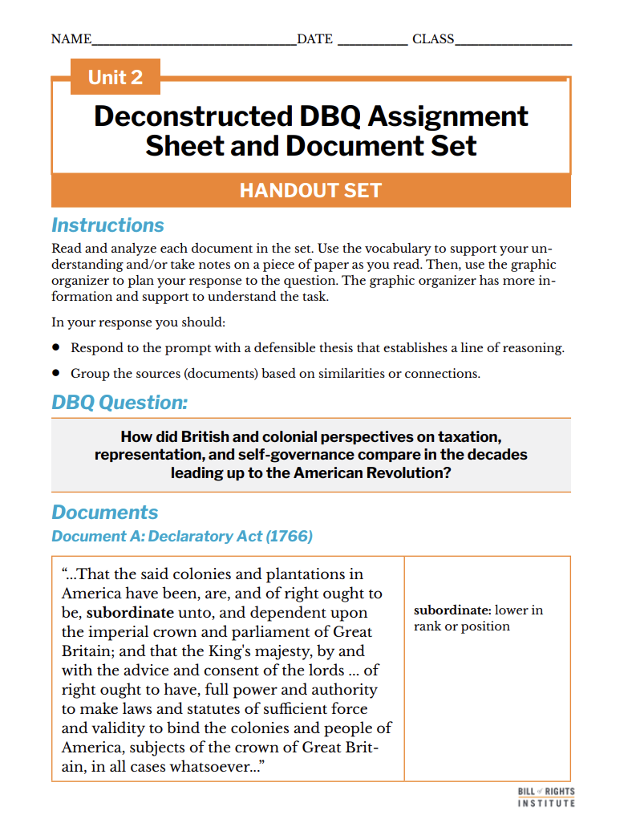
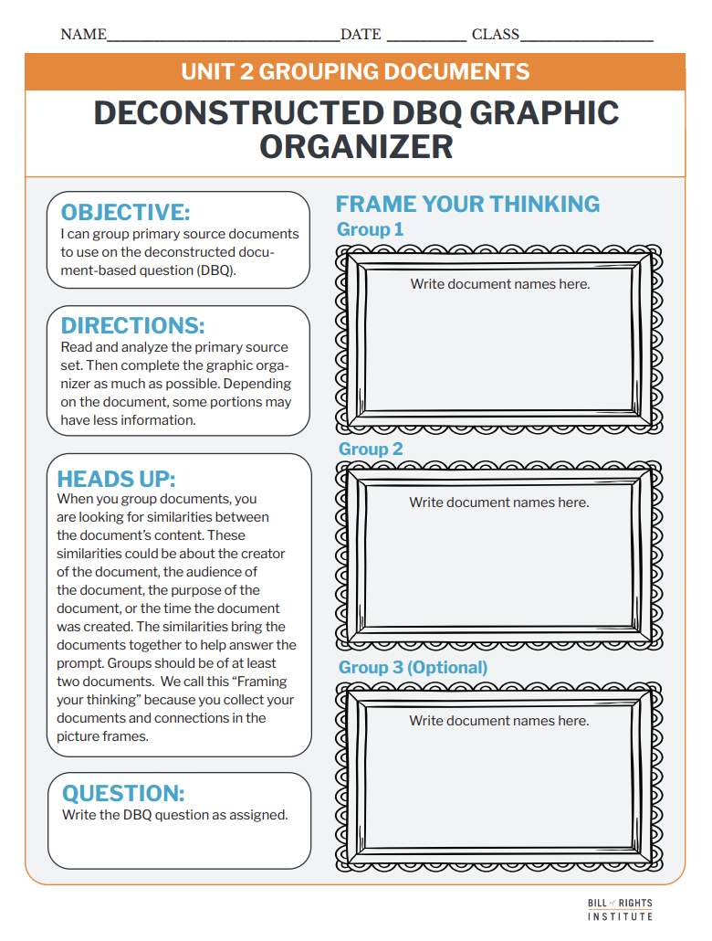
Student Materials Needed
Unit 2 Deconstructed DBQ Assignment Sheet and Document Set
Unit 2 Grouping Documents Deconstructed DBQ Graphic Organizer

Slide 4
How did British and colonial perspectives on taxation, representation, and self-governance compare in the decades leading up to the American Revolution?

Slide 5
Reading and Annotation
Notes:
Arrange students into groups of three.

Slide 6
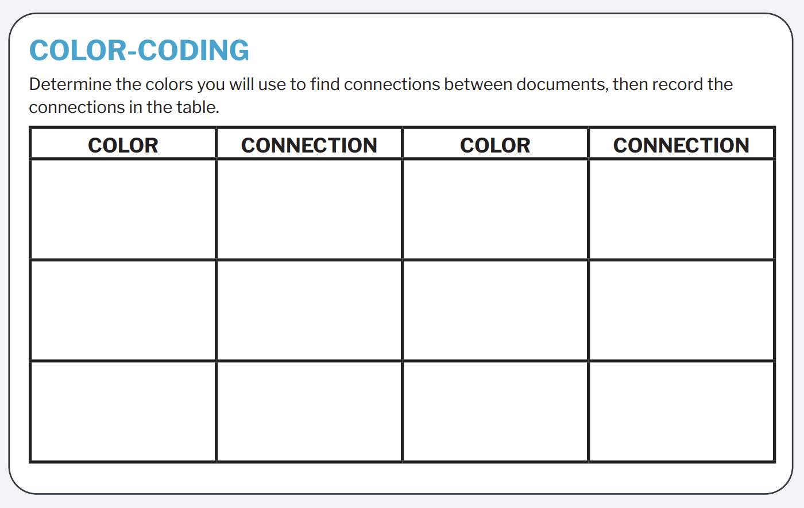
Color-coding and Annotation
Notes:
Overview the task with students. They will be viewing the deconstructed DBQ document set and color-coding their copies to find connections between the documents. They will record their colors and connections on their handout.

Slide 7
Document A: Declaratory Act (1766)
“...That the said colonies and plantations in America have been, are, and of right ought to be, subordinate unto, and dependent upon the imperial crown and parliament of Great Britain; and that the King's majesty, by and with the advice and consent of the lords ... of right ought to have, full power and authority to make laws and statutes of sufficient force and validity to bind the colonies and people of America, subjects of the crown of Great Britain, in all cases whatsoever...” | subordinate- lower in rank or position
Notes:
The next 4 slides are included if you would like to review the document set with students. More information is included in the teacher primary source slide deck.

Slide 8
Document B: The Patriot- Samuel Johnson (1774)
"...To suppose, that by sending out a colony, the nation established an independent power; that when, by indulgence and favour, emigrants are become rich, they shall not contribute to their own defence, but at their own pleasure; and that they shall not be included, like millions of their fellow-subjects, in the general system of representation; involves such an accumulation of absurdity, as nothing but the show of patriotism could palliate. He that accepts protection, stipulates obedience. We have always protected the Americans; we may, therefore, subject them to government..." | absurdity- unreasonableness or ridiculousness palliate- make less severe

Slide 9
Document C: Common Sense – Thomas Paine (1776)
"There is something very absurd in supposing a continent to be perpetually governed by an island. In no instance hath nature made the satellite larger than its primary planet... Everything that is right or natural pleads for separation. The blood of the slain, the weeping voice of nature cries, ’TIS TIME TO PART.” | absurd- wildly unreasonable perpetually- without end hath- has

Slide 10
Document D: Declaration of Independence (1776)
“...For imposing Taxes on us without our Consent: For depriving us in many cases, of the benefit of Trial by Jury: For transporting us beyond Seas to be tried for pretended offences: For abolishing the free System of English Laws in a neighbouring Province, establishing therein an Arbitrary government, and enlarging its Boundaries so as to render it at once an example and fit instrument for introducing the same absolute rule into these Colonies: For taking away our Charters, abolishing our most valuable Laws, and altering fundamentally the Forms of our Governments: For suspending our own Legislatures, and declaring themselves invested with power to legislate for us in all cases whatsoever..." | imposing- forcing depriving- denying or withholding abolishing- ending Arbitrary- unrestrained and tyrannical

Slide 11
Grouping

Slide 12
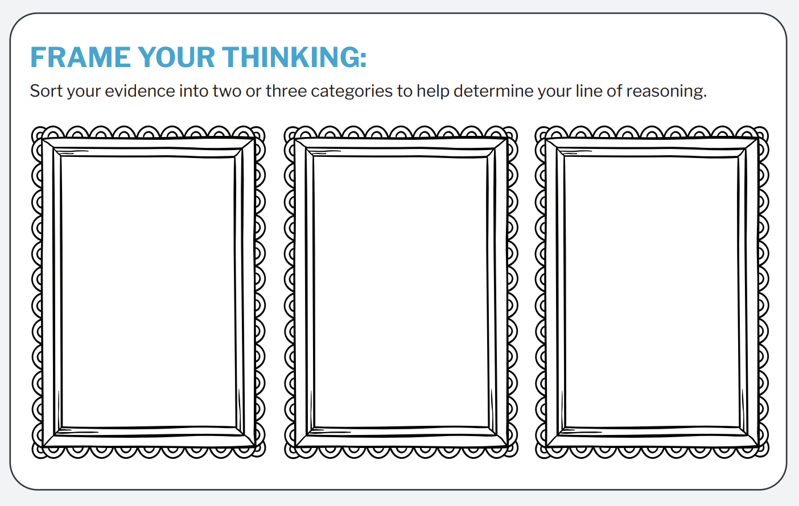
Frame your thinking
Notes:
Prompt students to group their sources into 2-3 categories on their deconstructed DBQ Grouping Documents organizer.

Slide 13

Frame your thoughts
British Perspective
Colonist Perspective
The Patriot
The Declaratory Act
Common Sense
The Declaration of Independence
Notes:
This slide is hidden. It contains one way to sort the sources based on the categories. Use this slide if you can not write on your classroom board or it suits your classroom.

Slide 14
Thesis Writing

Slide 15
A thesis is a defensible claim that establishes a line of reasoning.
A claim is a defensible statement that responds to the question.
A “line of reasoning” outlines your key points. It introduces the substance of the evidence for your claim.

Slide 16
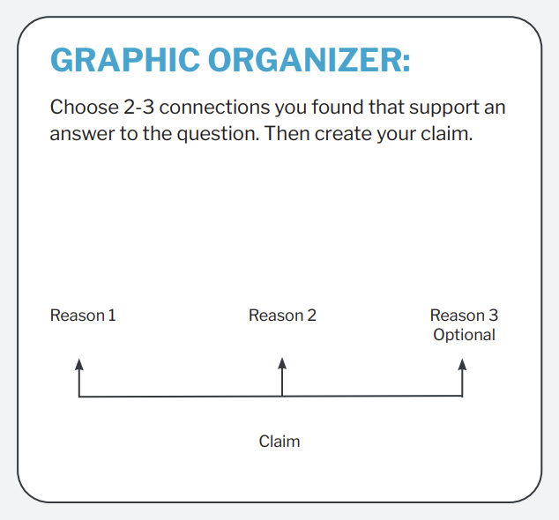
Graphic Organizer
These reasons will come from your groupings!
Notes:
Connect this to the groupings that students created in their first activity. Students' "reasons" for this thesis will be the connections they made between the documents.

Slide 17
Graphic Organizer
Documents like Common Sense and the Declaration of Independence show that the colonists felt unfairly taxed and denied self-government,
Whereas the British perspective, as seen in the Patriot and the Declaratory Act, was that the colonies were still part of the empire and subject to British rule.
British and colonial perspectives on taxation, representation, and self-governance differed in the decades leading up to the American Revolution.
Notes:
Example. This slide is hidden from the presentation. You can reveal it if an example is useful for your students.

Slide 18
Examples
Text Example
Graphic Organizer Example
Summer is the best season because the weather provides more opportunities for outdoor activities, people are more likely to travel to new places, and school is out.
Although summer is nice, fall is the best season because
the weather is less extreme
football season is in full swing
and holidays like Halloween and Thanksgiving provide opportunities for fun and family meetings.
Write your thesis statement.

Slide 19
Examples
Text Example
Graphic Organizer Example
British and colonial perspectives on taxation, representation, and self-governance differed in the decades leading up to the American Revolution. Documents like Common Sense and the Declaration of Independence show that the colonists felt unfairly taxed and denied self-government, whereas the British perspective, as seen in the Patriot and the Declaratory Act, was that the colonies were still part of the empire and subject to British rule.
British and colonial perspectives on taxation, representation, and self-governance differed in the decades leading up to the American Revolution.
Documents like Common Sense and the Declaration of Independence show that the colonists felt unfairly taxed and denied self-government,
whereas the British perspective, as seen in the Patriot and the Declaratory Act, was that the colonies were still part of the empire and subject to British rule.
Write your thesis statement.
Notes:
Example. This slide is hidden from the presentation. You can reveal it if an example is useful for your students.

Slide 20
Peer Review
Grouping Sources
What are the similarities or connections used to create groups or categorizes?
Do the groups match the sources?
Thesis
Does the thesis answer the question?
Is the claim clear and defensible?
Does it establish a logical line of reasoning?
Notes:
Allow the students a few minutes to review a peer's groupings and thesis with the questions on the slides as prompts for discussion.

