Slide 2
Deconstructed DBQ Skills Mini-Lesson
Unit 3- "VIEW"ing Documentss

Slide 3
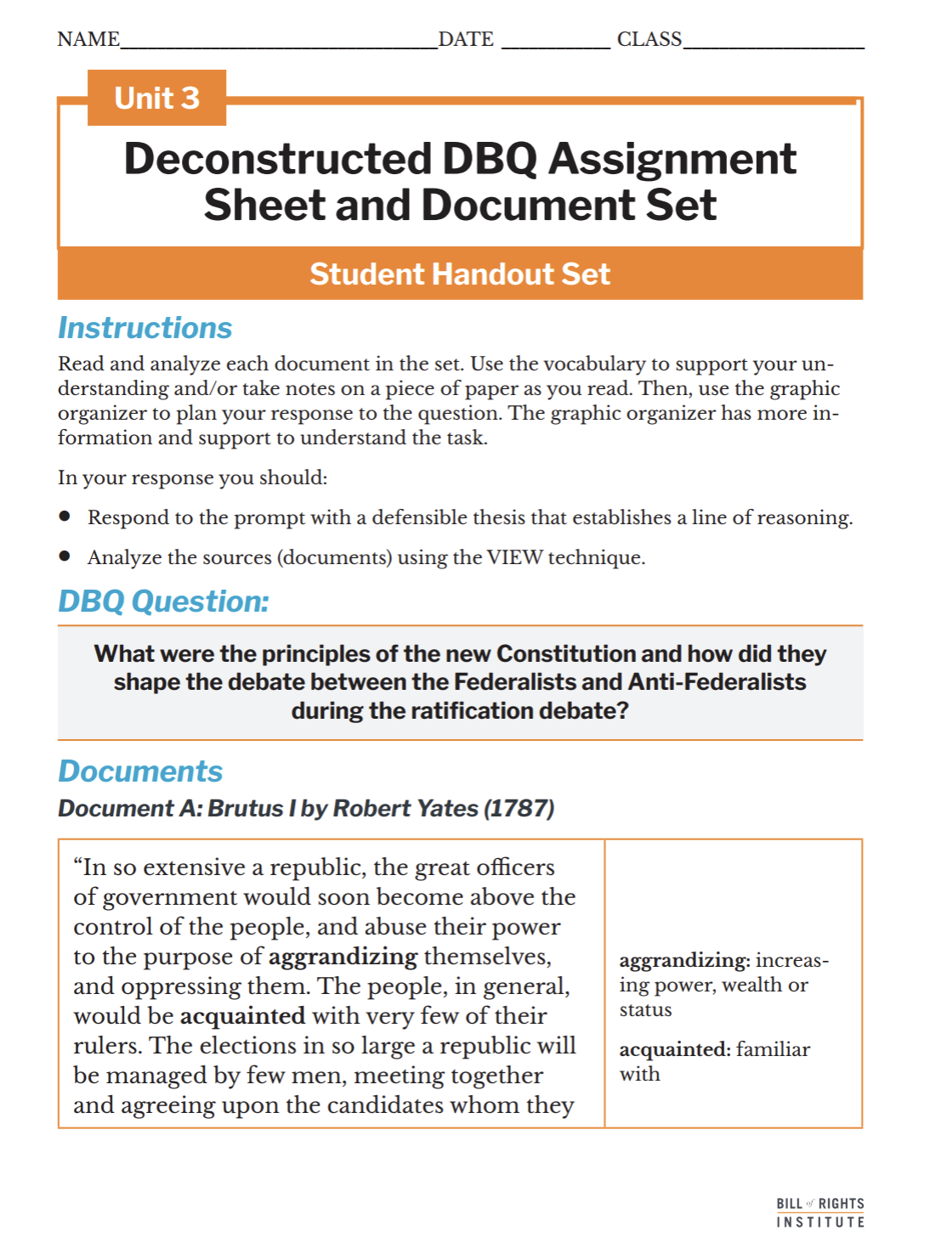
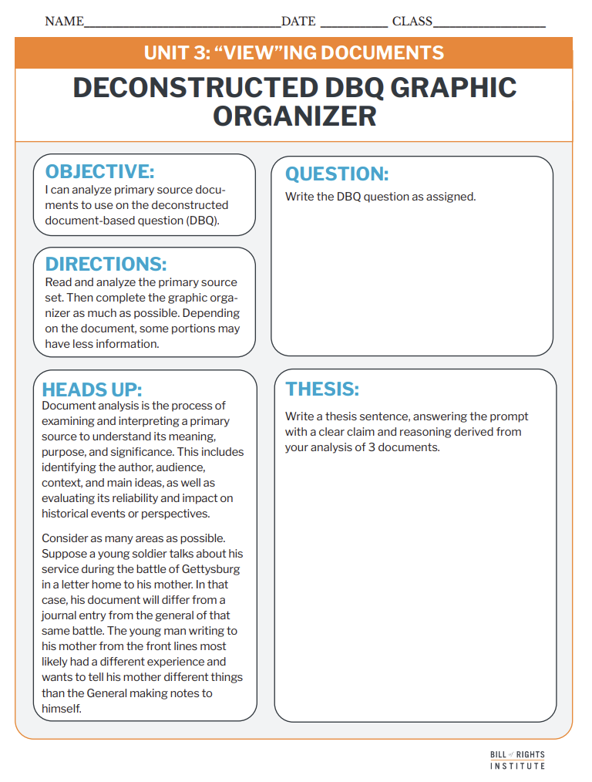
Student Materials Needed
Unit 3 Deconstructed DBQ Assignment Sheet and Document Set
Unit 3 "VIEW"ing Documents Deconstructed DBQ Graphic Organizer

Slide 4
What were the principles of the new Constitution and how did they shape the debate between the Federalists and Anti-Federalists during the ratification debate?
Notes:
Review from lesson 1- Give students instruction to:
Write the question on your organizer
Circle and define important and unfamiliar terms
Re-write the question in your own words
OR
Instruct students to write the DBQ prompt on their organizer.

Slide 5
Reading and Annotation

Slide 6
Document A: Brutus 1 by Robert Yates (1787)
“In so extensive a republic, the great officers of government would soon become above the control of the people, and abuse their power to the purpose of aggrandizing themselves, and oppressing them. The people, in general, would be acquainted with very few of their rulers. The elections in so large a republic will be managed by few men, meeting together and agreeing upon the candidates whom they please, and they will, by such means, always elect those who will be subservient to their views. This will be the case in a large republic; but in a small one, the interest of the public will be more readily perceived, better understood, and more within the reach of every citizen; abuses of power could be examined with more ease and be corrected sooner.” | aggrandizing- increasing power, wealth or status acquainted- familiar with subservient- obedient, submissive, obey without questioning
Notes:
The next 5 slides are included if you would like to review the document set with students. More information is included in the teacher primary source document.

Slide 7
Document B: Thomas Jefferson to James Madison (1787)
First the omission of a bill of rights providing clearly & without the aid of sophisms for freedom of religion, freedom of the press, protection against standing armies, restriction against monopolies, the eternal & unremitting force of the habeas corpus laws, and trials by jury in all matters of fact triable by the laws of the land & not by the law of Nations. To say, as Mr. Wilson does, that a bill of rights was not necessary because all is reserved in the case of the general government which is not given, while in the particular ones all is given which is not reserved, might do for the Audience to whom it was addressed, but is surely a gratis dictum, opposed by strong inferences from the body of the instrument, as well as from the omission of the clause of our present confederation which had declared that in express terms. . . . Let me add that a bill of rights is what the people are entitled to against every government on earth, general or particular, & what no just government should refuse or rest on inference. . . . | omission- lack of including sophisms- an argument used to deceive unremitting- never relaxing habeas corpus laws- laws that keep people from being held in prison without a trial Mr. Wilson-James Wilson, a Federalist that argued against the need for a Bill of Rights gratis dictum- an opinion

Slide 8
Document C: Constitution Preamble (1787)
We the People of the United States, in Order to form a more perfect Union, establish Justice, insure domestic Tranquility, provide for the common defence, promote the general Welfare, and secure the Blessings of Liberty to ourselves and our Posterity, do ordain and establish this Constitution for the United States of America. | Posterity- generations to come ordain- create officially

Slide 9
Document D: James Madison to Thomas Jefferson (1788)
What use then it may be asked can a bill of rights serve in popular Governments? I answer the two following which though less essential than in other Governments, sufficiently recommend the precaution. 1. The political truths declared in that solemn manner acquire by degrees the character of fundamental maxims of free Government, and as they become incorporated with the national sentiment, counteract the impulses of interest and passion. 2. Altho’ it be generally true as above stated that the danger of oppression lies in the interested majorities of the people rather than in usurped acts of the Government, yet there may be occasions on which the evil may spring from the latter sources; and on such, a bill of rights will be a good ground for an appeal to the sense of the community. Perhaps too there may be a certain degree of danger, that a succession of artful and ambitious rulers, may by gradual & well-timed advances, finally erect an independent Government on the subversion of liberty. Should this danger exist at all, it is prudent to guard agst. it, especially when the precaution can do no injury. At the same time I must own that I see no tendency in our governments to danger on that side. | acquire by degrees- gained over time maxims- truths national sentiment- feelings of the people usurped- illegal or by force subversion of liberty- act of undermining or destroying freedom agst- against precaution- done to prevent harm or danger

Slide 10
Document E: Federalist #51 James Madison (1788)
“Ambition must be made to counteract ambition. The interest of the man must be connected with the constitutional rights of the place. It may be a reflection on human nature, that such devices should be necessary to control the abuses of government. But what is government itself, but the greatest of all reflections on human nature? If men were angels, no government would be necessary. If angels were to govern men, neither external nor internal controls on government would be necessary. In framing a government which is to be administered by men over men, the great difficulty lies in this: you must first enable the government to control the governed; and in the next place oblige it to control itself.” | Ambition- strong desire to achieve counteract- to act against oblige- to make (someone or something) act

Slide 11
Game of Quotes

Slide 12
Game of Quotes
In this game, students will identify sections of text that fit specific prompts.
They could be silly or serious prompts.
Some examples:
Prompt | Text
Something you wouldn't want to overhear in the bathroom. | "...surely a gratis dictum, opposed by strong inferences from the body of the instrument, as well as from the omission" Document B
A sentence or passage that tells you something about the author. | "We the People of the United States" Document C

Slide 13
Rules
Everyone has the documents for the DBQ and will begin reading silently.
After about 10 minutes, the “Card” for round one will be revealed on the slide. Once the “Card” is revealed, everyone searches their document for a word, phrase, quote, or multiple sentences from the text to match the prompt.
When a reader states “I’ve Got It!” I will start a 1-minute timer.
When the timer runs out, each reader shares the text that they have found with the other readers at their table. Readers who didn't find text in time must randomly pick, point, and read a sentence from a document.
VOTING: I will count down, “3, 2, 1, vote,” and everyone at the table votes for their favorite submission by pointing to the reader. The reader with the most votes wins the round and shares their text with the whole class.
Then we will move on to the next "Card" with a 1-minute timer or each round.

Slide 14

Game of Quotes
A quote that sounds like something a grandma would say.
Notes:
Use or skip as needed. There are 9 slides to choose from for the Game of Quotes alternating between silly and DBQ related prompts.

Slide 15

Game of Quotes
A line that would sound better in a British accent.

Slide 16

Game of Quotes
A sentence or passage that tells you something about the author.

Slide 17

Game of Quotes
A line from a note passed in class you wouldn't want the teacher to read out loud.

Slide 18
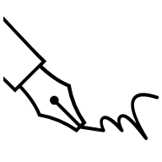
Game of Quotes
A passage that tells the author's purpose in writing.

Slide 19

Game of Quotes
A line that could be a superhero's catch phrase.

Slide 20

Game of Quotes
A section of text that gives a clue to what was happening in the world at the time of writing.
  For example, an event or another piece of writing that is referenced.

Slide 21

Game of Quotes
A word that sounds really cool if you read it backwards.

Slide 22

Game of Quotes
A passage that gives a clue to the audience of the writing. Who was this written for?

Slide 23
End of Game

Slide 24
VIEW Document Analysis Review
Notes:
The next three slides quickly review the skill: document analysis using "VIEW" sentences. These slides correspond to the graphic organizer.

Slide 25
Document Analysis
Document analysis is the process of examining and interpreting a primary source to understand its meaning, purpose, and significance.
This includes identifying:
  Author
  Audience
  Context
  Main ideas
Analysis also includes evaluating the source's reliability and impact on historical events or perspectives.
Notes:
Prepare for the task by defining the activity. Students will be using the VIEW acronym to help them analyze the primary sources, as historians do. Students will use the skills they used in Game of Quotes to find information that fits the organizer prompts.

Slide 26

Document Analysis
VIEW
Voice
This is also known as their perspective.
Intent
This is also called purpose.
Environment
This is also called context.
Who
What is the author’s voice?
How does the author’s job, social class, gender, race, age, experience, or other characteristics impact what they are saying?
What experiences has this person had?
Is the document intended to inform, persuade, remind, change?
How does that intention affect the question you are trying to answer?
What is the environment like surrounding the creation of the document?
What happened before the document was created?
How much time passed between the event and creating of the document?
This is also called audience.
Who was the document created for?
Is it a diary entry that was probably just for individual memory keeping?
Was it a newspaper article meant to be read by as many people as possible?
Notes:
Overview the task with students. They will be viewing the deconstructed DBQ document set and completing the organizer on their handout, not all boxes will be filled. Student instructions prompt them to complete at least one box in each column. Display this screen as students work so they can reference it.

Slide 27
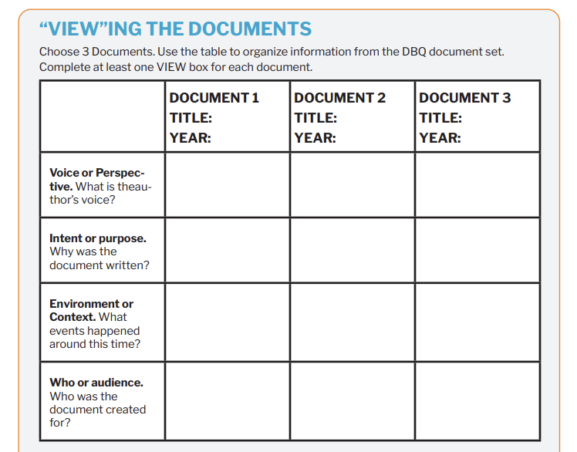
Doc E
1788
James Madison, Federalist
Persuade, the government needs to be strong.
Notes:
Example of how to fill in one column of the organizer.

Slide 28
Example VIEW Sentences
Federalist #51 was written to the people of New York as they were deciding to ratify the Constitution.
James Madison was a writer of the Federalist papers and a representative at the Second Continental Congress and had other political experience.
The Preamble's intent is to outline the goals of government under the Constitution.
The author of Brutus 1 is writing in response to essays written by Federalists or people in support of the Constitution.
V
I
E
W
W and E
Thomas Jefferson is writing to James Madison, a Federalist, and responding to writings of another Federalist called James Wilson.
Notes:
Examples for the boxes at the bottom of page 2 of the organizer.

Slide 29
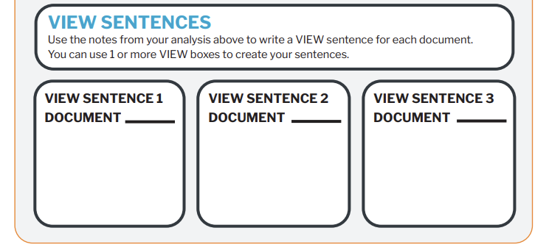
Example Organizer
B
Thomas Jefferson is writing to James Madison, a Federalist, and responding to writings of another Federalist called James Wilson.

Slide 30
Thesis Writing & Organizer Completion
Notes:
The next three slides quickly review the skill: writing a thesis. These slides correspond to the graphic organizer and thesis boxes on page 3 of the organizer.

Slide 31
A thesis is a defensible claim that establishes a line of reasoning.
A claim is a defensible statement that responds to the question.
A “line of reasoning” outlines your key points. It introduces the substance of the evidence for your claim.

Slide 32
Examples
Text Example
Graphic Organizer Example
Thursday is the best day of the week because the weekend is right around the corner, the cafeteria has pizza, and I have soccer practice.
Thursday is the best day of the week because
the weekend is right around the corner
the cafeteria has pizza
And I have soccer practice.
Write your thesis statement.

Slide 33
Examples
Text Example
Graphic Organizer Example
The Constitution established a strong central government with principles like checks and balances, but the debate over its ratification emerged because the Federalists believed it protected liberty through structure, while the Anti-Federalists feared it would lead to government overreach.
The Constitution established a strong central government with principles like checks and balances, but the debate over its ratification emerged because
Federalists believed it protected liberty through structure,
while the Anti-Federalists feared it would lead to government overreach.
Write your thesis statement.
Notes:
Example. This slide is hidden from the presentation. You can reveal it if an example is useful for your students.
Additional thesis examples:
The principles of the new Constitution, such as justice, general welfare, and domestic tranquility, were meant to unify the nation, but the lack of a bill of rights led to disagreements between the Federalists, who trusted the framework, and the Anti-Federalists, who wanted explicit protections for individual freedoms.
The debate between the Federalists and Anti-Federalists centered around the fear of tyranny, as the Federalists argued that checks and balances would prevent government abuse, while the Anti-Federalists worried that a large republic would take power away from the people.
The Constitution’s principle of limited government aimed to balance power, but the Anti-Federalists feared that without a bill of rights, the government could still violate people's freedoms, leading to a heated debate over ratification.
The Federalists believed the Constitution created a government strong enough to protect citizens’ rights, while the Anti-Federalists feared it gave too much power to the central government, demonstrating how different views on government shaped the ratification debate.

Slide 34
Peer Review
VIEW Sentences
What parts of VIEW does the sentence address?
Does the sentence examine and interpret a primary source to understand its meaning, purpose, or significance?
Thesis
Does the thesis answer the question?
Is the claim clear and defensible?
Does it establish a logical line of reasoning?
Notes:
Allow the students a few minutes to review a peer's view setences and thesis with the questions on the slides as prompts for discussion.

