Slide 2
Deconstructed DBQ Skills Mini-Lesson
Unit 4- Thesis, Grouping Sources, & Document Analysis

Slide 3
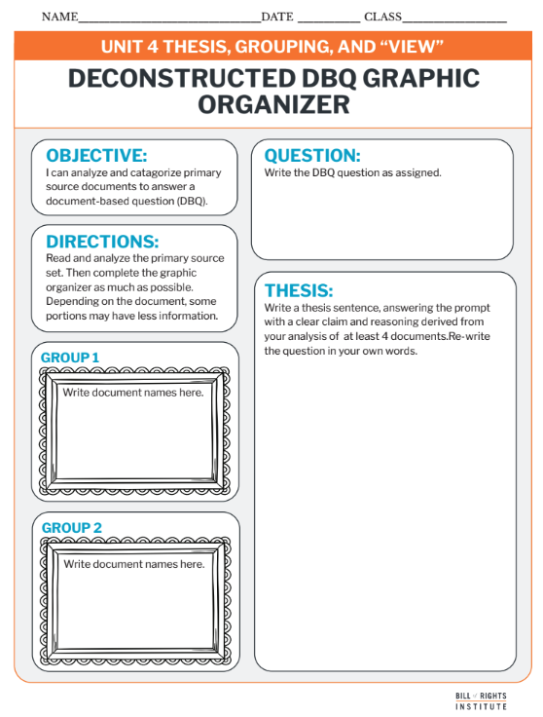

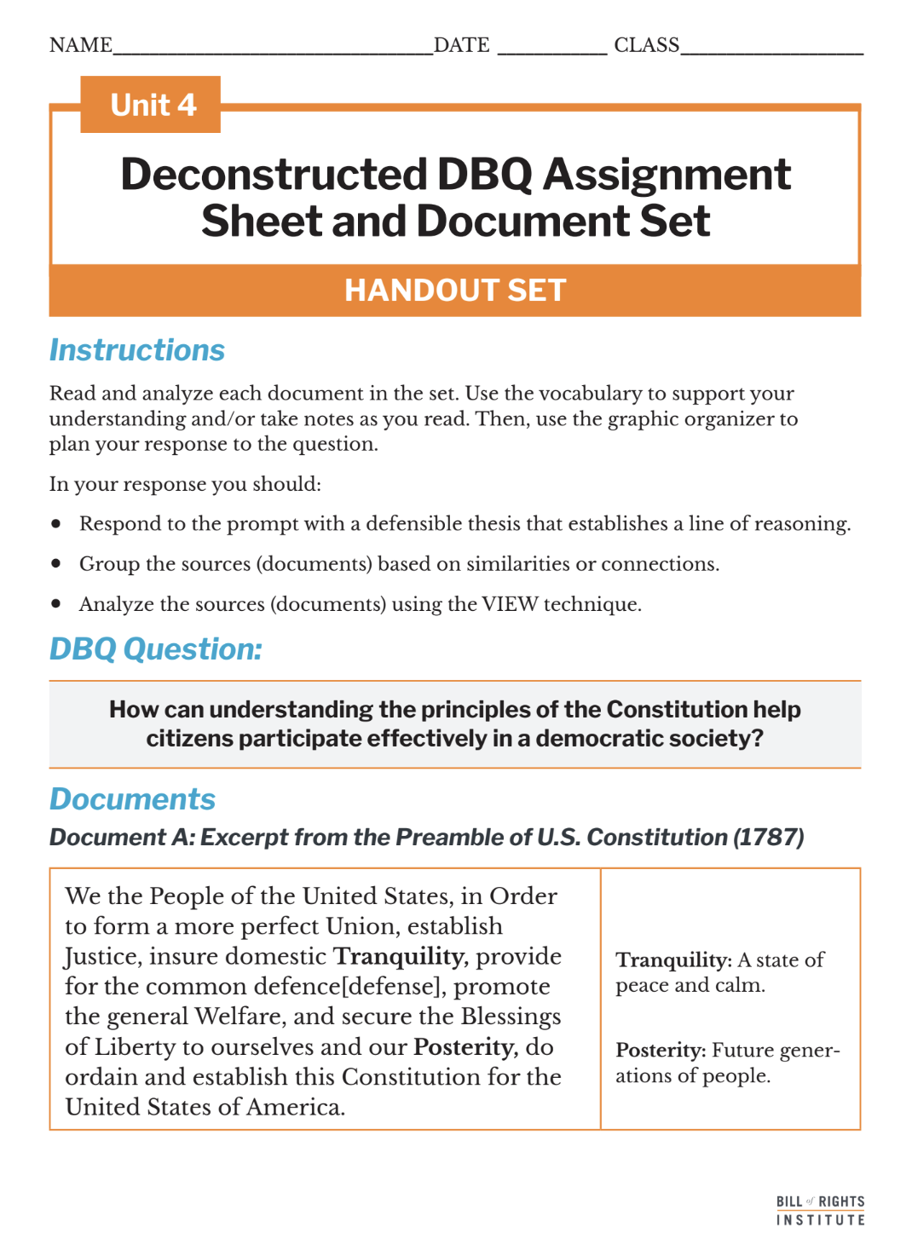
Student Materials Needed
Unit 4 Deconstructed DBQ Assignment Sheet and Document Set
Deconstructed DBQ: Graphic Organizer Documents Handout
Colored Marker

Slide 4
How can understanding the principles of the Constitution help citizens participate effectively in a democratic society?

Slide 5
Reading and Annotation

Slide 6
Document A: Excerpt from the Preamble of U.S. Constitution (1787)
We the People of the United States, in Order to form a more perfect Union, establish Justice, insure domestic Tranquility, provide for the common defence[defense], promote the general Welfare, and secure the Blessings of Liberty to ourselves and our Posterity, do ordain and establish this Constitution for the United States of America. | Tranquility: A state of peace and calm. Posterity: Future generations of people, especially those who come after the current generation.
Notes:
The following slides are included if you would like to review the document set with students. More information is included in the Deconstructed DBQ Document Set and Teacher Context Teacher Resource

Slide 7
Document B: Excerpt from First Amendment (1787)
Congress shall make no law respecting an establishment of religion, or prohibiting the free exercise thereof; or abridging the freedom of speech, or of the press; or the right of the people peaceably to assemble, and to petition the Government for a redress of grievances. | establishment: The act of officially creating or recognizing a religion (in this case, the government cannot establish a national religion). abridging: Limiting or reducing (in this case, limiting freedoms like speech or press). redress: A way to set right or fix a problem.

Slide 8
Document C: Excerpt from Tenth Amendment (1787)
The powers not delegated to the United States by the Constitution, nor prohibited by it to the States, are reserved to the States respectively, or to the people. | delegated: Given or assigned. reserved: Kept or set aside for a specific purpose.

Slide 9
Document D: Excerpt from Federalist #51, James Madison (1788)
Ambition must be made to counteract ambition. The interest of the man must be connected with the constitutional rights of the place. It may be a reflection on human nature that such devices should be necessary to control the abuses of government. But what is government itself, but the greatest of all reflections on human nature? If men were angels, no government would be necessary. If angels were to govern men, neither external nor internal controls on government would be necessary.

Slide 10
Document E: Miranda v. Arizona (1966) - U.S. Supreme Court Decision
The prosecution may not use statements, whether exculpatory or inculpatory, stemming from custodial interrogation of the defendant unless it demonstrates the use of procedural safeguards effective to secure the privilege against self-incrimination. [...] He must be warned prior to any questioning that he has the right to remain silent, that anything he says can be used against him in a court of law, that he has the right to the presence of an attorney, and that if he cannot afford an attorney, one will be appointed for him prior to any questioning if he so desires. | prosecution: The legal team trying to prove someone is guilty in a criminal case. exculpatory: Evidence or statements that show a person is not guilty of a crime. inculpatory: Evidence or statements that suggest a person is guilty of a crime. custodial interrogation: Questioning by police while a person is in custody (not free to leave). procedural safeguards: Legal protections to ensure fair treatment. self-incrimination: To not provide evidence against oneself. appointed: Officially assigned or provided (in this case, a lawyer for someone who cannot afford one).

Slide 11
Document F: Engel v. Vitale (1962) – U.S. Supreme Court Decision
It is neither sacrilegious nor anti-religious to say that each separate government in this country should stay out of the business of writing or sanctioning official prayers and leave that purely religious function to the people themselves and to those the people choose to look to for religious guidance. [...] When the power, prestige, and financial support of government is placed behind a particular religious belief, the indirect coercive pressure upon religious minorities to conform to the prevailing officially approved religion is plain. | sacrilegious: Disrespectful toward religion or religious beliefs. sanctioning: Officially approving or allowing something. coercive: Using pressure or force to make someone do something.

Slide 12
VIEW Document Analysis Review
Notes:
The next three slides quickly review the skill: document analysis using "VIEW" sentences. These slides correspond to the graphic organizer.

Slide 13
Document Analysis
Document analysis is the process of examining and interpreting a primary source to understand its meaning, purpose, and significance.
This includes identifying:
Author
Audience
Context
Main ideas
Analysis also includes evaluating the source's reliability and impact on historical events or perspectives.
Notes:
Prepare for the task by defining the activity. Students will be using the VIEW acronym to help them analyze the primary sources, as historians do.

Slide 14

Document Analysis
VIEW
Voice
This is also known as their perspective.
Intent
This is also called purpose.
Environment
This is also called context.
Who?
What is the author’s voice?
How does the author’s job, social class, gender, race, age, experience, or other characteristics impact what they are saying?
What experiences has this person had?
Is the document intended to inform, persuade, remind, change?
How does that intention affect the question you are trying to answer?
What is the environment like surrounding the creation of the document?
What happened before the document was created?
How much time passed between the event and creating of the document?
This is also called audience.
Who was the document created for?
Is it a diary entry that was probably just for individual memory keeping?
Was it a newspaper article meant to be read by as many people as possible?
Notes:
Overview the task with students. They will be viewing the deconstructed DBQ document set and completing the organizer on their handout, not all boxes will be filled. Student instructions prompt them to complete at least one box in each column. Display this screen as student work for reference.

Slide 15
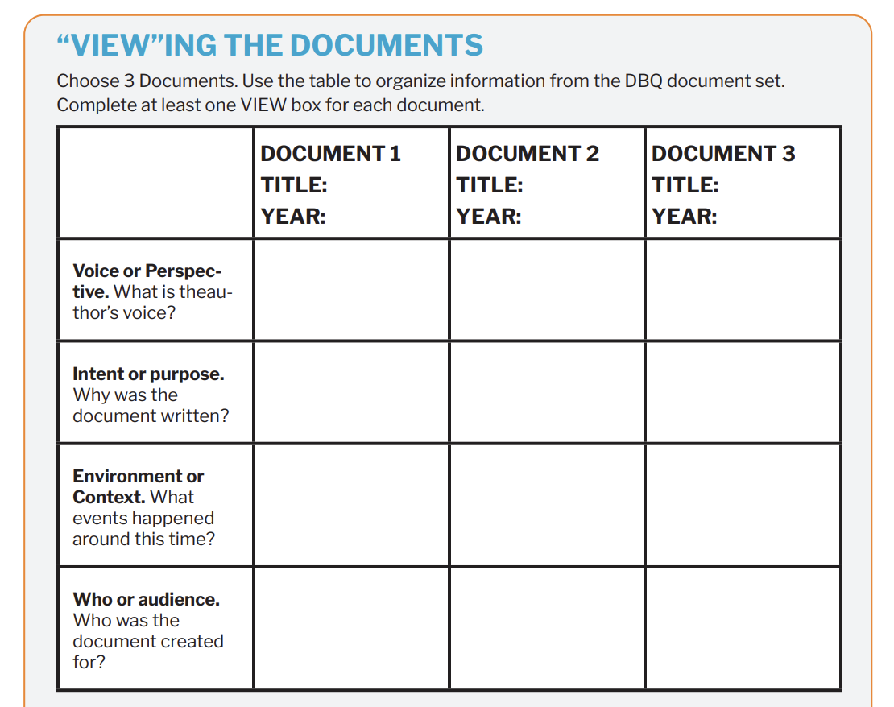
Doc E
1966
A judge
Issue a court ruling
Notes:
Example of how to fill in one column of the organizer.

Slide 16
Silent Discussions
Notes:
The next three slides quickly review the skill: document analysis using "VIEW" sentences. These slides correspond to the graphic organizer.

Slide 17



Silent Discussions
In this activity, students will consider and discuss the DBQ question in writing.
You will have three minutes to "discuss" the question in writing by using your markers to write.
Types of Responses | Meaning
 | I have a question.
 | I agree.
Line | These ideas connect.

Slide 18


Example
These two are connected because the separate branches check each other.
Separation of Powers
Three Branches of Government
Legislative
Checks and Balances
What are the principles in the Constitution?
Executive
Judicial
Doc D- Fed #51
Doc A- Preamble
Representative Government
Notes:
This slide shows an example of three students working together on the task. Each "student" has a different color marker and different handwriting. Students have checked ideas they agree with, added lines to connect ideas, and written out discussions on the chart paper.

Slide 19
Silent Discussions
Work in groups of 2-3 students in front of a piece of chart paper, with a question on it.
Each student has their own color of marker.
Start by responding silently to the question assigned to your group on your chart paper. Write your thoughts, ideas, or answers.
Once you finish writing, read what others have written. Respond to their ideas by:
Adding a question mark (if you're confused or want more information).
Drawing a line (if you agree or want to connect ideas).
Adding a check (if you think their point is really good).

Slide 20
Silent Discussions
After a few minutes, switch chart papers with another group.
Silently respond to the new question on the chart paper. Follow the same steps as before: write your thoughts and add symbols to others' ideas.

Slide 21
Silent Discussions
After the second round of silent responses, switch chart papers back to your original group.
Now, talk to your group about the responses and share your ideas.

Slide 22
Grouping Review
Notes:
The next three slides quickly review the skill: grouping. These slides correspond to the graphic organizer.

Slide 23
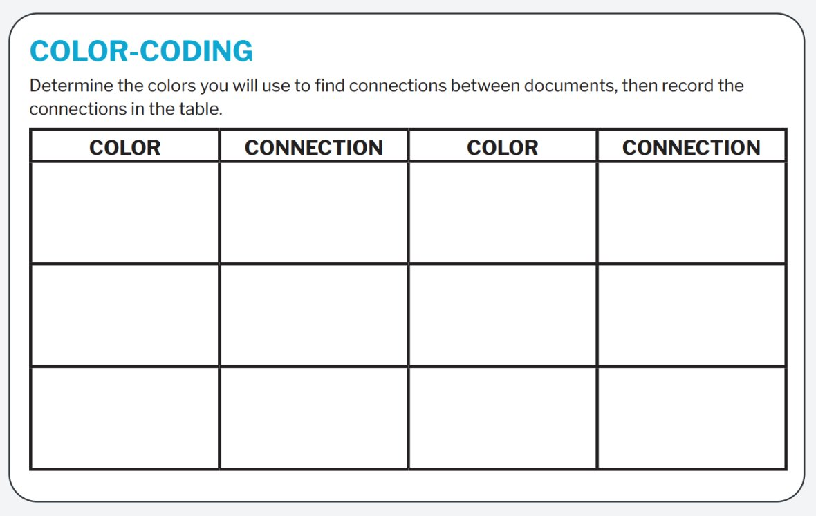
Color-coding and Annotation
Notes:
Use this slide if students need more practice finding connections to group sources. They will color-coding their copies of the DBQ document set to find connections between the sources. They will record their colors and connections on a plain piece of paper.

Slide 24
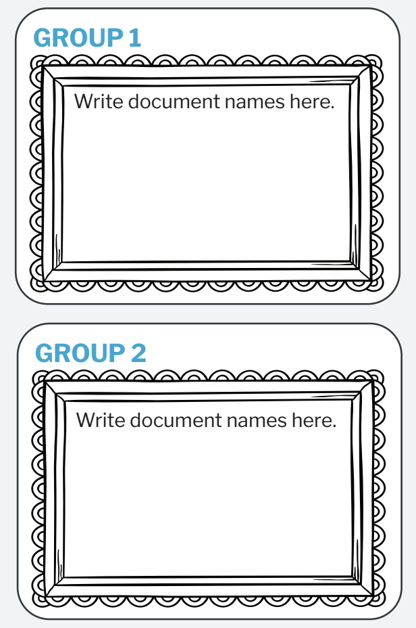
Frame your thinking
Notes:
Prompt students to group their sources into 2 categories on their deconstructed DBQ organizer.

Slide 25
Frame your thinking
Principles of the Constitution
Doc A- Preamble
Doc D- Fed #51
Doc F- Engel v. Vitale
Effective Citizenship
Doc B- First Amendment
Doc C- Tenth Amendment
Doc E- Miranda v. Arizona
Notes:
Example. This slide is hidden from the presentation. You can reveal it if an example is useful for your students.

Slide 26
Thesis Writing & Organizer Completion
Notes:
The next three slides quickly review the skill: writing a thesis. These slides correspond to the graphic organizer and thesis boxes on page 3 of the organizer.

Slide 27
A thesis is a defensible claim that establishes a line of reasoning.
A claim is a defensible statement that responds to the question.
A “line of reasoning” outlines your key points. It introduces the substance of the evidence for your claim.

Slide 28
Examples
Text Example
Graphic Organizer Example
Reading is my favorite activity because it helps me relax, improves my imagination, and teaches me new things.
Reading is my favorite activity because
it helps me relax,
improves my imagination,
and teaches me new things.
Write your thesis statement.

Slide 29
Examples
Text Example
Graphic Organizer Example
Understanding the principles of the Constitution, like checks and balances and popular sovereignty, helps citizens participate by holding leaders accountable and influencing government decisions.
Understanding the principles of the Constitution, like checks and balances and popular sovereignty, helps citizens participate by
holding leaders accountable
and influencing government decisions.
Write your thesis statement.
Notes:
Example. This slide is hidden from the presentation. You can reveal it if an example is useful for your students.
Additional thesis examples are located in the Model Organizer and Scoring Guide Teacher Resource

Slide 30
Peer Review
VIEW Sentences
What parts of VIEW does the sentence address?
Does the sentence examine and interpret a primary source to understand its meaning, purpose, or significance?
Thesis
Does the thesis answer the question?
Is the claim clear and defensible?
Does it establish a logical line of reasoning?
Notes:
Allow the students a few minutes to review a peer's groupings and thesis with the questions on the slides as prompts for discussion.

Slide 31
Peer Review
Grouping Sources
What are the similarities or connections used to create groups or categories?
Do the groups match the sources?
Notes:
Allow the students a few minutes to review a peer's groupings and thesis with the questions on the slides as prompts for discussion.

