Slide 1
Deconstructed DBQ Skills Mini-Lesson
Unit 5- Context, Thesis, Grouping Sources, and Document Analysis

Slide 2
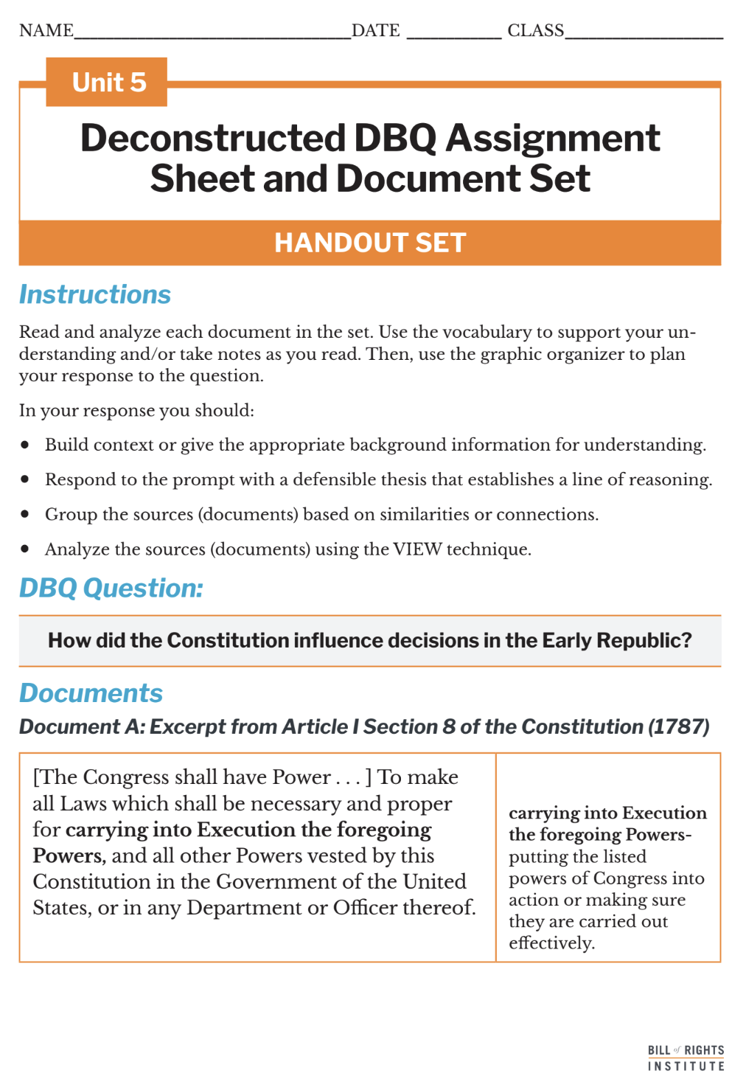
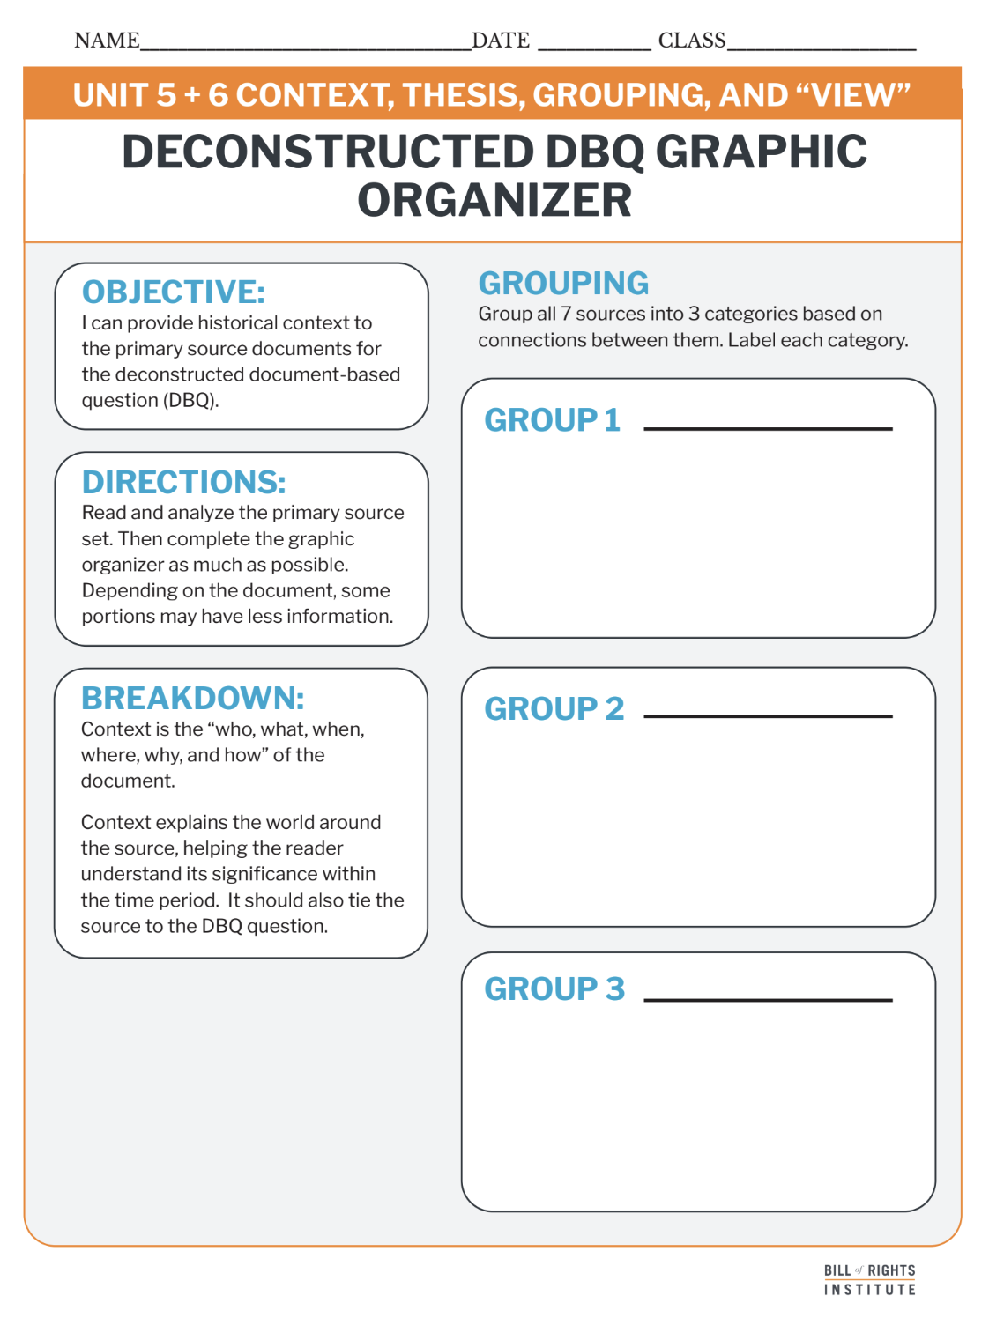
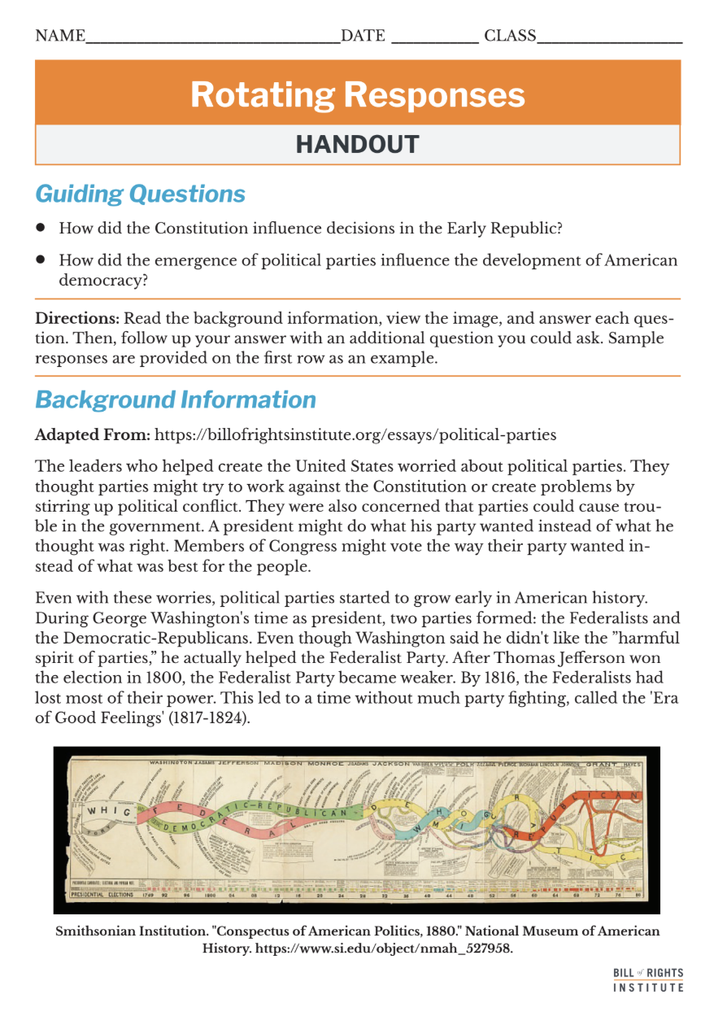
Student Materials Needed
Unit 5 Deconstructed DBQ Assignment Sheet and Document Set
Deconstructed DBQ: Graphic Organizer Documents Handout
Rotating Responses Handout

Slide 3
Rotating Responses
Notes:
Arrange students into groups of four.

Slide 4
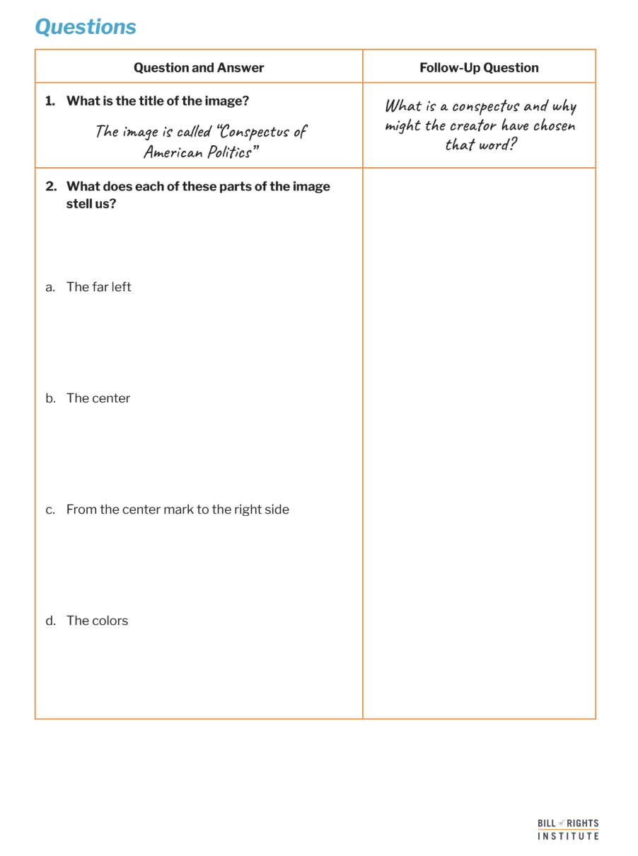
Rotating Responses
To prepare for rotating responses, complete the handout independently.
Notes:
Give students silent, independent work time to complete the handout. This is the first step of the rotating responses activity.

Slide 5
Rotating Responses
Question #1 | Student 1 | Student 2 | Student 3 | Student 4 | All Students
 | Reads Question | Answers Question | Praise and Encourage | Ask follow up question | Discuss the follow-up question
Question #2 | Student 2 | Student 3 | Student 4 | Student 1 | All Students
 | Reads Question | Answers Question | Praise and Encourage | Ask follow up question | Discuss the follow-up question
Question #3 | Student 3 | Student 4 | Student 1 | Student 2 | All Students
 | Reads Question | Answers Question | Praise and Encourage | Ask follow up question | Discuss the follow-up question
Question #4 | Student 4 | Student 1 | Student 2 | Student 3 | All Students
 | Reads Question | Answers Question | Praise and Encourage | Ask follow up question | Discuss the follow-up question
Notes:
This slide supports the activity instructions in the teacher lesson plan that accompanies this slide deck. Number students from 1 to 4, giving each student a group and a number within their group. Use one group, or volunteers to conduct a practice round demonstration before allowing groups to discuss on their own. If this is your first time using the Rotating Responses activity, you may want to do the whole activity as a demonstration with one group conducting the activity. Flex the method to fit your students.

Slide 6
Final Question
How did the emergence of political parties influence the development of American democracy?
Notes:
Use this question as an exit ticket or to complete the activity with a class discussion. The information students have gained from this activity will help students add contextual information to their deconstructed DBQ in the next section.

Slide 7
How did the Constitution influence decisions in the Early Republic?

Slide 8
Reading and Annotation

Slide 9
Document A: Excerpt from Article I Section 8 of the Constitution (1787)
[The Congress shall have Power . . . ] To make all Laws which shall be necessary and proper for carrying into Execution the foregoing Powers, and all other Powers vested by this Constitution in the Government of the United States, or in any Department or Officer thereof. | carrying into execution the foregoing powers- putting the listed powers of Congress into action or making sure they are carried out effectively.
Notes:
The next 7 slides are included if you would like to review the document set with students. More information is included in the teacher primary source support document.

Slide 10
Document B: Excerpt from Federalist #10 James Madison (1787)
The inference to which we are brought is, that the causes of faction cannot be removed; and that relief is only to be sought in the means of controlling its effects. | inference- using what is known to make a judgement or understanding faction- a smaller group within the population, brought together by a common interest
Notes:
The next 6 slides are included if you would like to review the document set with students. More information is included in the teacher primary source document.

Slide 11
Document C: Excerpt from George Washington’s First Inaugural Address (1789)
The preservation of the sacred fire of liberty, and the destiny of the republican model of government, are justly considered as deeply, perhaps as finally, staked on the experiment entrusted to the hands of the American people. | preservation- maintenance, care, or keeping entrusted- to put into someone’s care
Notes:
The next 5 slides are included if you would like to review the document set with students. More information is included in the teacher primary source document.

Slide 12
Document D: Excerpt from Alexander Hamilton’s Opinion on the National Bank (1791)
It is not denied that there are implied, as well as express powers, and that the former are as effectually delegated as the latter. Then it follows, that as a power of [creating] a corporation is not expressly granted, so neither is it forbidden. | former and latter- "The former" and "the latter" are used to refer to two things previously mentioned in a sentence or context: • "the former" refers to the first of the two. • “the latter” refers the second of the two effectually- thoroughly
Notes:
The next 4 slides are included if you would like to review the document set with students. More information is included in the teacher primary source document.

Slide 13
Document E: Excerpts from Thomas Jefferson opinion on the National Bank (1791)
I consider the foundation of the Constitution as laid on this ground: That 'all powers not delegated to the United States, by the Constitution, nor prohibited by it to the states, are reserved to the states or to the people.' To take a single step beyond the boundaries thus specially drawn around the powers of Congress, is to take possession of a boundless field of power, no longer susceptible of any definition. | susceptible- capable or open to
Notes:
The next 3 slides are included if you would like to review the document set with students. More information is included in the teacher primary source document.

Slide 14
Document F: Excerpt from George Washington’s Farewell Address (1796)
The unity of government, which constitutes you one people, is also now dear to you. It is justly so; for it is a main pillar in the edifice of your real independence, the support of your tranquility at home, your peace abroad; of your safety; of your prosperity; of that very liberty which you so highly prize. | The unity of government- the states under one government as a country which constitutes you one people- the people together as Americans main pillar in the edifice- key support in the structure tranquility- safety
Notes:
The next 2 slides are included if you would like to review the document set with students. More information is included in the teacher primary source document.

Slide 15
Document G: Excerpt from the Sedition Act (1798)
That if any person shall write, print, utter or publish... any false, scandalous and malicious writing or writings against the government of the United States, or either house of the Congress... or the President... with intent to defame... or to bring them into contempt or disrepute... then such person shall be punished by a fine not exceeding two thousand dollars, and by imprisonment not exceeding two years. | false, scandalous and malicious- untrue, offensive, immoral or otherwise improper defame or to bring them into contempt or disrepute- make them look bad or bring them into low status
Notes:
The next slide is included if you would like to review the document set with students. More information is included in the teacher primary source document.

Slide 16
Grouping Review
Notes:
The next three slides quickly review the skill: grouping. These slides correspond to the graphic organizer.

Slide 17
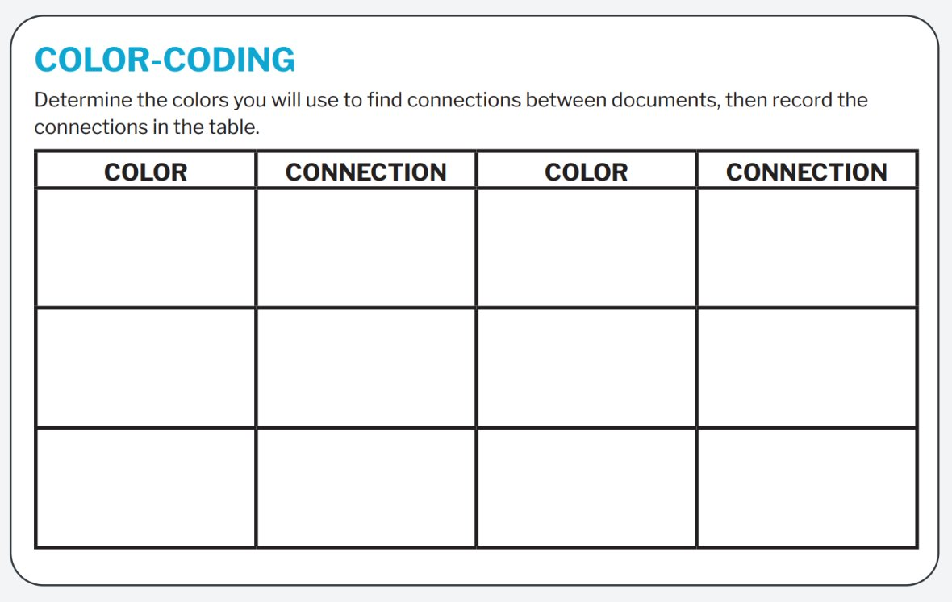
Color-coding and Annotation
Notes:
Use this slide if students need more practice finding connections to group sources. They will be color-coding their copies of the DBQ document set to find connections between the sources. They will record their colors and connections on a plain piece of paper.

Slide 18
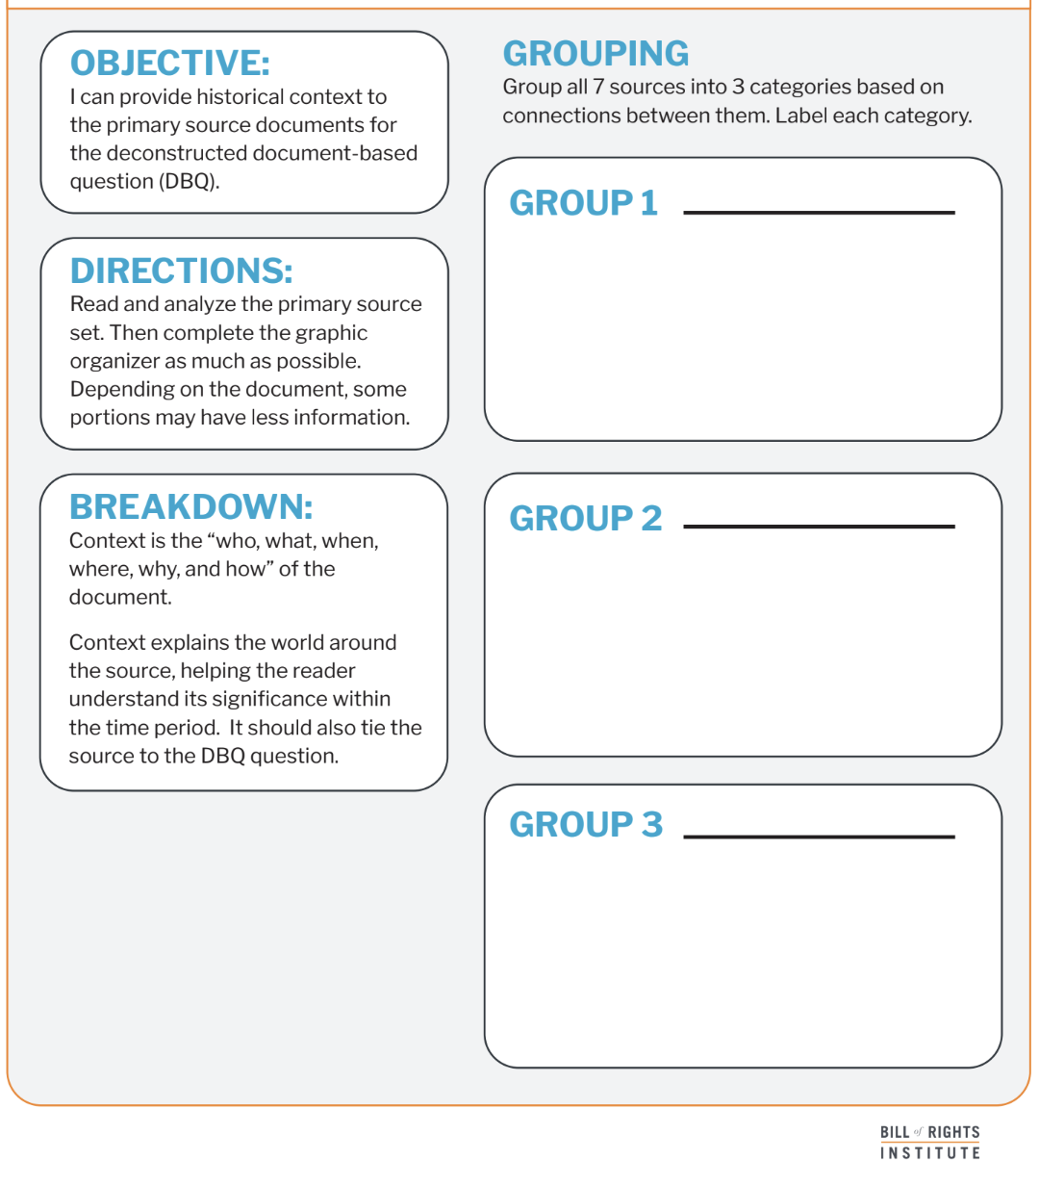
Grouping Documents
Notes:
Prompt students to group their sources into 2-3 categories on their deconstructed DBQ organizer.

Slide 19
Grouping Documents
Federalist Vision: Strong National Government
Document A
Document B
Document D
Document F
The Shared Republican Experiment
Document C
Democratic-Republican Vision: States' Rights
Document E
Document G
Notes:
An answer example. This slide is hidden, but can be revealed if it is useful for your students.
1. Federalist Vision: Strong National Government
Document A (Article I, Section 8) – Provides a constitutional basis for a powerful central government.
Document B (Federalist #10) – Madison supports a large republic to control factions.
Document D (Hamilton’s Opinion on the National Bank) – Uses implied powers to justify a national bank.
Document F (Washington’s Farewell Address) – Encourages national unity and warns against political divisions.
2. Democratic-Republican Vision: States' Rights and Limited Government
Document E (Jefferson’s Opinion on the National Bank) – Argues for strict constitutional limits on federal power.
Document G (Sedition Act) – Demonstrates Federalist overreach, which Democratic-Republicans saw as a violation of free speech.
3. The Shared Republican Experiment
Document C (Washington’s First Inaugural Address) – Expresses the ideal of republican government, which both sides claimed to support.

Slide 20
Providing Context
Notes:
The next three slides introduce the skill of: providing context. These slides correspond to "context" section of the graphic organizer, which is located on page 2.

Slide 21
Providing Context
Context is:
The “who, what, when, where, why, and how” of the document.
It explains the world around the source, helping the reader understand its significance within the time period.
It should also tie the source to the DBQ question.

Slide 22
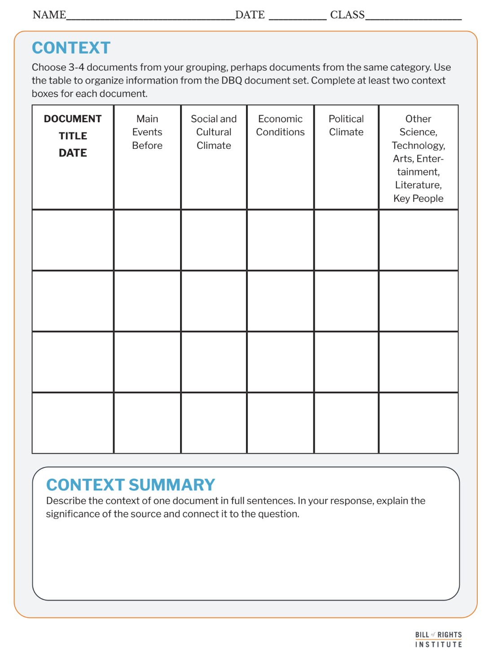
Analyzing Sources for Context
Choose 3-4 sources.
Use the graphic organizer to collect and organize information about the context surrounding the document.
This can come from the source, your knowledge, or research.
Notes:
More information about the sources is available in the teacher support document.

Slide 23
VIEW Document Analysis Review
Notes:
The next three slides quickly review the skill: document analysis using "VIEW" sentences. These slides correspond to the graphic organizer.

Slide 24
Document Analysis
Document analysis is the process of examining and interpreting a primary source to understand its meaning, purpose, and significance.
This includes identifying:
Author
Audience
Context
Main ideas
Analysis also includes evaluating the sources reliability and impact on historical events or perspectives.
Notes:
Reveal this slide if needed to re-teacher document analysis.

Slide 25

Document Analysis
VIEW
Voice
This is also known as their perspective.
Intent
This is also called purpose.
Environment
This is also called context.
Who?
What is the author’s voice?
How does the author’s job, social class, gender, race, age, experience, or other characteristics impact what they are saying?
What experiences has this person had?
Is the document intended to inform, persuade, remind, change?
How does that intention affect the question you are trying to answer?
What is the environment like surrounding the creation of the document?
What happened before the document was created?
How much time passed between the event and creating of the document?
This is also called audience.
Who was the document created for?
Is it a diary entry that was probably just for individual memory keeping?
Was it a newspaper article meant to be read by as many people as possible?
Notes:
Overview the task with students. They will be viewing the deconstructed DBQ document set and completing the organizer on their handout, not all boxes will be filled. Student instructions prompt them to complete at least three boxes in each column. Display this screen as student work for reference.

Slide 26
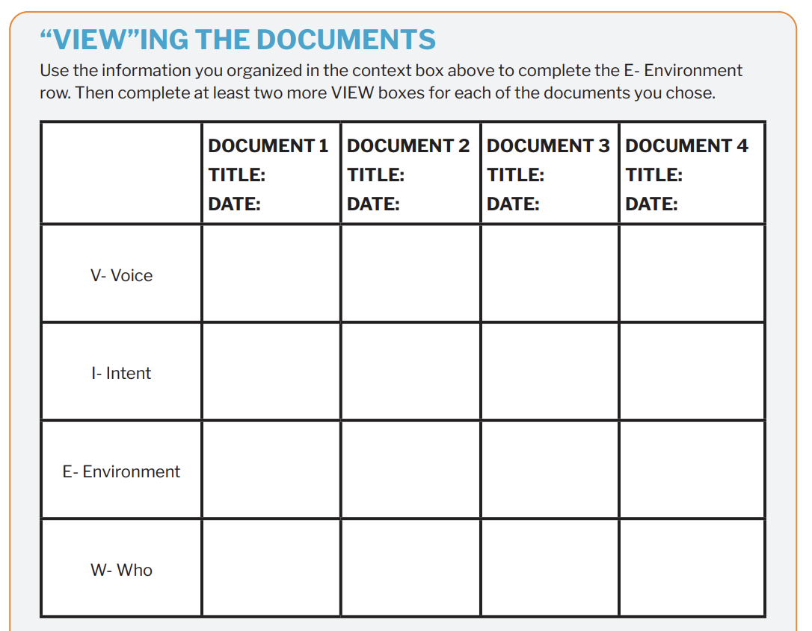
VIEW

Slide 27
Thesis Writing & Organizer Completion
Notes:
The next three slides quickly review the skill: writing a thesis. These slides correspond to the graphic organizer and thesis boxes on page 3 of the organizer.

Slide 28
A thesis is a defensible claim that establishes a line of reasoning.
A claim is a defensible statement that responds to the question.
A “line of reasoning” outlines your key points. It introduces the substance of the evidence for your claim.

Slide 29
Examples
Text Example
Graphic Organizer Example
Reading is my favorite activity because it helps me relax, improves my imagination, and teaches me new things.
Reading is my favorite activity because
it helps me relax,
improves my imagination,
and teaches me new things.
Write your thesis statement.

Slide 30
Examples
Text Example
Graphic Organizer Example
The Constitution’s broad language on federal power led to early debates over its interpretation, as seen in the conflict between Hamilton and Jefferson over the National Bank, shaping the divide between Federalists and Democratic-Republicans.
The Constitution’s broad language on federal power led to early debates over its interpretation,
as seen in the conflict between Hamilton and Jefferson over the National Bank,
shaping the divide between Federalists
and Democratic-Republicans.
Write your thesis statement.
Notes:
Example. This slide is hidden from the presentation. You can reveal it if an example is useful for your students.
Additional thesis examples:
The Constitution’s protection of republican government guided Washington and Madison’s efforts to maintain order, balance factions, and preserve liberty, but the Sedition Act revealed tensions between federal authority and individual rights.
The Constitution shaped early U.S. policies by providing a framework for balancing national unity, individual rights, and government power, as reflected in Washington’s warnings against division, Madison’s arguments against factions, and the controversies over federal economic policies and free speech.
The Constitution’s ambiguous division of power sparked early political debates over the federal government’s authority, as seen in the dispute between Hamilton and Jefferson over the National Bank, Madison’s warnings about factions, and Washington’s call for unity in his Farewell Address.
Early leaders interpreted the Constitution in ways that expanded or limited federal power, as seen in Hamilton’s defense of implied powers for the National Bank, Jefferson’s strict interpretation favoring states' rights, and Washington’s broader vision of national unity as a pillar of the republic.
The Constitution’s commitment to both stability and individual liberty created early tensions over free speech and government power, as reflected in Madison’s warning about factions, Washington’s appeals for national unity, and the passage of the Sedition Act, which restricted political opposition.
The Constitution’s flexible framework allowed leaders to shape the new government while grappling with competing interpretations of its powers, leading to Hamilton’s argument for implied powers, Jefferson’s defense of strict constructionism, and Washington’s attempt to maintain unity in a divided nation.

Slide 31
Peer Review
Thesis
Does the thesis answer the question?
Is the claim clear and defensible?
Does it establish a logical line of reasoning?
Notes:
Allow the students a few minutes to review a peer's groupings and thesis with the questions on the slides as prompts for discussion.

Slide 32
Peer Review
Grouping Sources
What are the similarities or connections used to create groups or categorizes?
Do the groups match the sources?
Context
Is the context accurate and detailed?
Does the context summary explain the significance of the source and connect it to the question?
Notes:
Allow the students a few minutes to review a peer's groupings and thesis with the questions on the slides as prompts for discussion.

