Slide 1
Deconstructed DBQ Skills Mini-Lesson
Unit 7- Providing Evidence

Slide 2
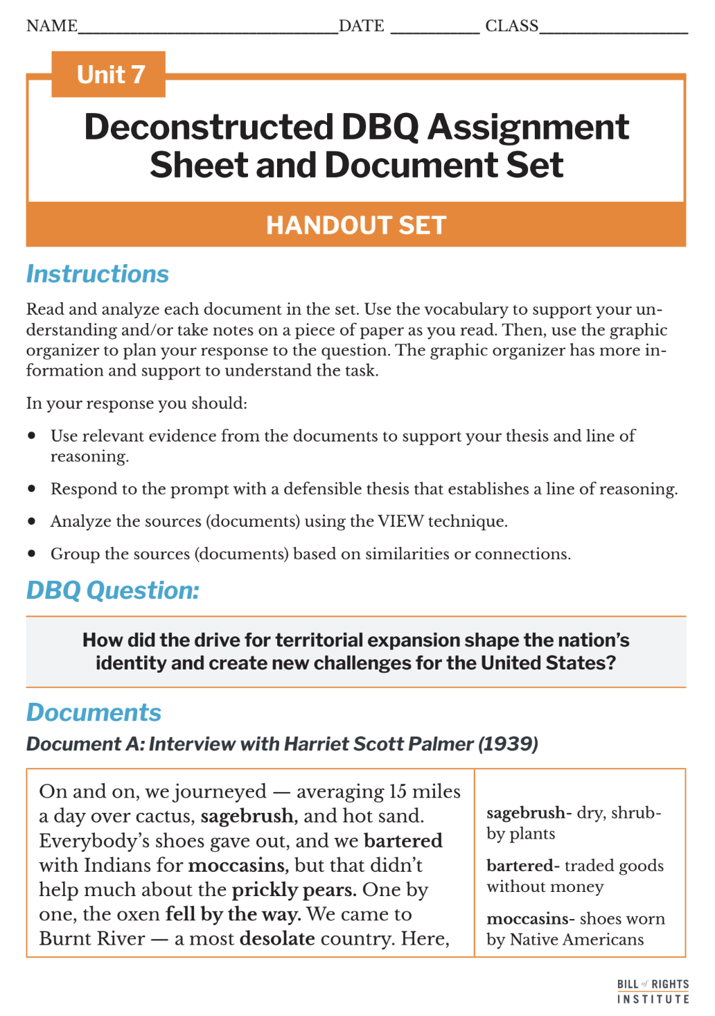
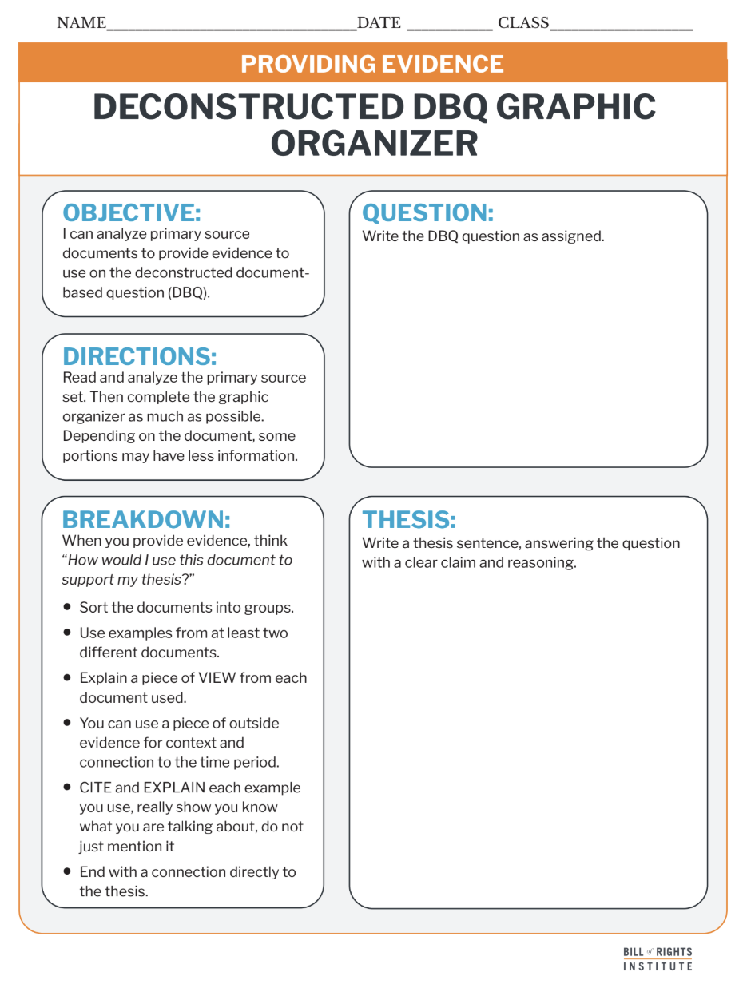
Student Materials Needed
Unit 7 Deconstructed DBQ Assignment Sheet and Document Set
Deconstructed DBQ: Providing Evidence Graphic Organizer Handout
Chart paper for Placemat

Slide 3
How did the drive for territorial expansion shape the nation’s identity and create new challenges for the United States?

Slide 4
Idependent Work
Read and analyze the documents.
Highlight, circle, or underline as needed.
Use the vocabulary column to help you understand the source.
Take notes on another piece of paper if needed.
Consider what the documents have to say about the DBQ question.

Slide 5
Document A: Interview with Harriet Scott Palmer (1939)
On and on, we journeyed — averaging 15 miles a day over cactus, sagebrush, and hot sand. Everybody’s shoes gave out, and we bartered with Indians for moccasins, but that didn’t help much about the prickly pears. One by one, the oxen fell by the way. We came to Burnt River — a most desolate country. Here, our baby brother, Willie, fell sick. It was in the heat of August. The train was halted so that the darling child of four years could be better cared for, but he became unconscious and passed away. | sagebrush- dry, shrubby plants bartered- traded goods without money moccasins- shoes worn by Native Americans prickly pears- a type of cactus fell by the way- died desolate- deserted, empty
Notes:
The next 7 slides are included if you would like to review the document set with students. More information is included in the teacher primary source support document.

Slide 6
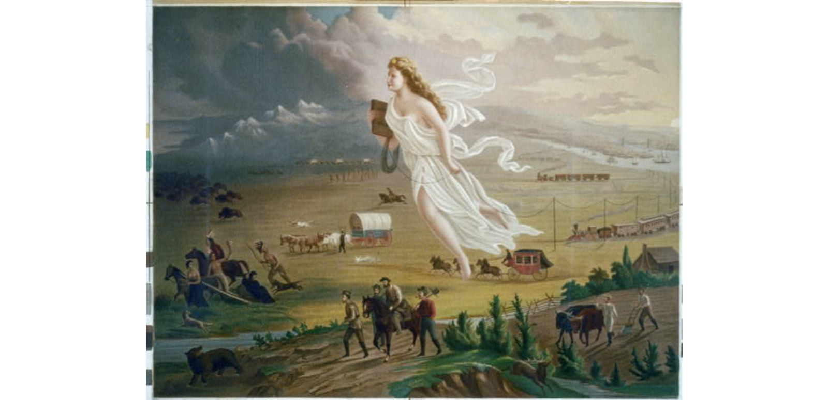
Document B: American Progress by John Gast (1872)
Notes:
https://www.loc.gov/resource/cph.3b49232/
In American Progress, painter John Gast portrays Manifest Destiny by showing Columbia, a symbol of the United States, floating westward with settlers, trains, and telegraph wires following her. As she moves into the dark frontier, Native Americans and wild animals flee.

Slide 7
Document C: Excerpt from the Gadsden Treaty (1853)
The Republic of Mexico and the United States of America desiring to remove every cause of disagreement which might interfere in any manner with the better friendship and intercourse between the two countries, and especially in respect to the true limits which should be established... In consideration of the foregoing stipulations, the Government of the United States agrees to pay to the government of Mexico... the sum of ten millions of dollars, of which seven millions shall be paid immediately upon the exchange of the ratifications of this treaty, and the remaining three millions as soon as the boundary line shall be surveyed, marked, and established.. | intercourse- foregoing stipulations- conditions or agreements already mentioned ratifications-approvals
Notes:
The next 5 slides are included if you would like to review the document set with students. More information is included in the teacher primary source document.

Slide 8
Document D: Excerpt from the Indian Removal Act (1830)
Be it enacted by the Senate and House of Representatives of the United States of America, in Congress assembled, That it shall and may be lawful for the President of the United States to cause so much of any territory belonging to the United States, west of the river Mississippi, not included in any state or organized territory, and to which the Indian title has been extinguished, as he may judge necessary, to be divided into a suitable number of districts, for the reception of such tribes or nations of Indians... | enacted- made law extinguished- ended
Notes:
The next 4 slides are included if you would like to review the document set with students. More information is included in the teacher primary source document.

Slide 9
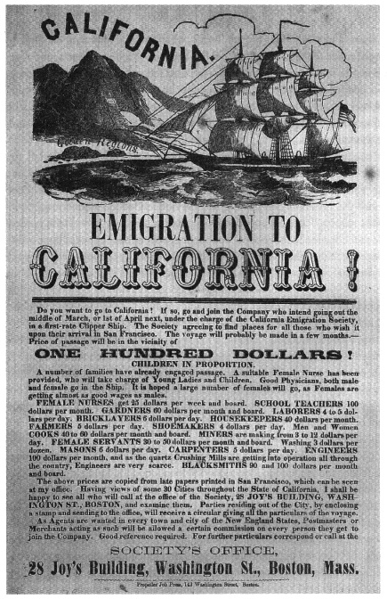
Document E: Handbill from the California Emigration Society, Boston (1856)
Notes:
https://commons.wikimedia.org/wiki/File:Gold_Rush_flyer.jpg
Gold was discovered in California in 1848. Afterward, getting to California to strike it rich was a pull factor for many people. Once the gold miners arrived, others were needed to join to make cities. This handbill features information for people, including families, interested in moving west to California for reasons other than gold.

Slide 10
Document F: Excerpt from President James Polk’s Message to Congress (1845)
...The terms of annexation which were offered by the United States having been accepted by Texas, the public faith of both parties is solemnly pledged to the compact of their union... This accession to our territory has been a bloodless achievement. No arm of force has been raised to produce the result. The sword has had no part in the victory. We have not sought to extend our territorial possessions by conquest, or our republican institutions over a reluctant people. It was the deliberate homage of each people to the great principle of our federative union. If we consider the extent of territory involved in the annexation, its prospective influence on America, the means by which it has been accomplished, springing purely from the choice of the people themselves to share the blessings of our union, the history of the world may be challenged to furnish a parallel. | annexation- the taking of land where one party voluntarily gives it up public faith- promise or commitment solemnly- in a formal manner accession- to add reluctant-hesitant homage- acknowledgement prospective- future effect furnish a parallel- provide an equal

Slide 11
Document G: Alexis de Tocqueville, Democracy in America (1848)
“The state of Kentucky was founded in 1775, the state of Ohio only twelve years later…Today the population of Ohio already exceeds that of Kentucky by 250,000 inhabitants… These diverse effects of slavery and freedom are easily understood…. On the left bank of the Ohio work is blended with the idea of slavery; on the right bank, with that of well-being and progress; there it is degraded, here they honor it; on the left bank of the river, one cannot find workers belonging to the white race; on the right bank one would seek in vain for an idle man…. The whites on the right bank, obliged to live by his own efforts, has placed in material well-being the principal goal of his existence….The American on the left bank scorns not only work, but all the undertakings that work makes successful; living in idle ease.” | inhabitants- people who live in an area diverse- varied When looking at the Ohio River from the East, Ohio is on the right bank and Kentucky is on the left. degraded- lowered in value idle- not working, without purpose obliged- morally bound principal- main or most important scorns- to feel or express distaste

Slide 12
Providing Evidence Placemat
Notes:
Arrange students into groups of three.

Slide 13
Creation
Divide your paper into four equal quadrants by drawing one vertical line and one horizontal line that intersect in the center.
In the center of the page where the lines cross, create a box—this will be where you place your topic.
Write your name in the quadrant closest to you.
Student 1
Student 2
Student 3
Student 4
Notes:
Instruct students to work together to create a Providing Evidence Placemat on the chart paper in the middle of the table.

Slide 14
Possible Supporting Details from Primary Sources
How did the drive for territorial expansion shape the nation’s identity and create new challenges for the United States?
Teacher collects ideas here...
Notes:
Students will collect evidence for one and place it in the middle of their placemat.
This slide is for you to create your own examples, collect examples from groups, or write on a smart board.
Example hidden on the next slide. Reveal it if needed.

Slide 15
Possible Supporting Details from Primary Sources Examples
How did the drive for territorial expansion shape the nation’s identity and create new challenges for the United States?
Indian Removal Act:
The drive for more territory led to the removal of Native American tribes from their ancestral lands to the west.
Discovery of gold in California:
Inspired people to move west, fueling the idea of Manifest Destiny.
Annexation of Texas and Gadsen Treaty:
New lands created new challenges in governing a larger country.
Notes:
Create a list together of supporting details to answer the DBQ question. Students will collect evidence for one and place it in the middle of their placemat.

Slide 16
Topic Selection
Student 1
Manifest Destiny
Student 2
Student 3
Student 4
Notes:
The group of students will choose an item from the list and write it in the center of their placemat. Then each student finds a piece of evidence (quote, summary or interpretation of art) to put in their own square of the placemat.
When the activity is complete, the group will have compiled four pieces of evidence that can be used to support a detail of a possible thesis.

Slide 17
Optional: Grouping Review
Notes:
The next three slides quickly review the skill: grouping. These slides correspond to the graphic organizer.

Slide 18
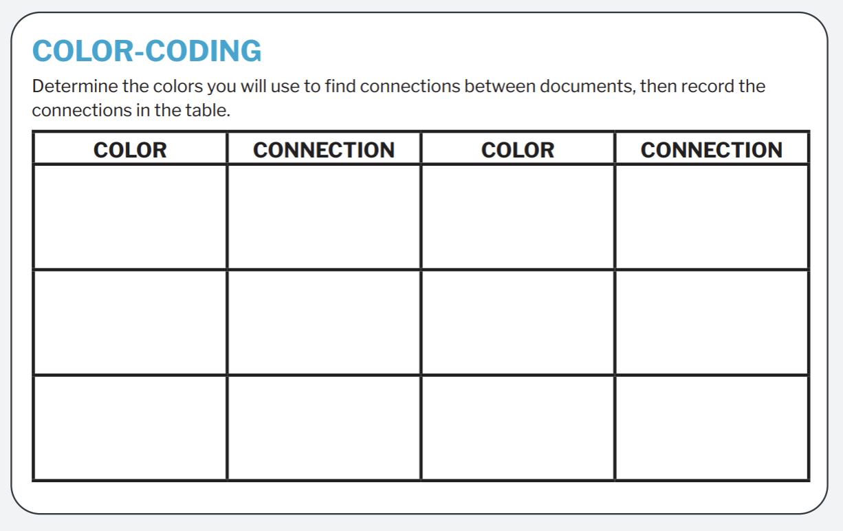
Color-coding and Annotation
Notes:
Use this slide if students need more practice finding connections to group sources. They will be color-coding their copies of the DBQ document set to find connections between the sources. They will record their colors and connections on a plain piece of paper.

Slide 19
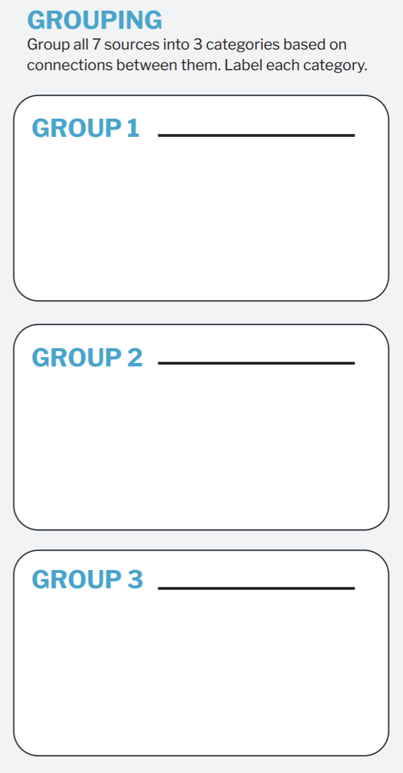
Grouping Documents
Notes:
Then, students group documents based on shared themes, common attributes, constitutional principles (e.g., separation of powers, individual rights), or any other categories they decide.

Slide 20
Grouping Documents
Manifest Destiny and Economic Growth
Document B: American Progress by John Gast (1872)
Document F: President James Polk’s Message to Congress (1845)
Document E: Handbill from the California Emigration Society (1856)
Document C: Excerpt from the Gadsden Treaty (1853)
Conflicts and Challenges of Expansion
Document A: Interview with Harriet Scott Palmer (1939)
Document D: Excerpt from the Indian Removal Act (1830)
Document G: Alexis de Tocqueville, Democracy in America (1848)
Notes:
An answer example. This slide is hidden, but can be revealed if it is useful for your students.
1. Manifest Destiny and Economic Growth
These documents reflect the belief in Manifest Destiny—the idea that Americans were destined to expand across the continent—and how that belief helped shape a sense of national purpose and identity.
Document B: American Progress by John Gast (1872) – Symbolizes Manifest Destiny with Columbia leading settlers west, representing progress and American ideals.
Document F: President James Polk’s Message to Congress (1845) – Polk's message emphasizes the annexation of Texas as part of America's rightful expansion.
Document E: Handbill from the California Emigration Society (1856) – Highlights the lure of economic opportunity (Gold Rush) that motivated Americans to move westward.
Document C: Excerpt from the Gadsden Treaty (1853) – The U.S. acquisition of land for economic and transportation development (railroads).
2. Conflicts and Challenges of Expansion
These documents reveal the darker side of territorial expansion, including conflict with Native Americans, displacement, and debates over slavery.
Document A: Interview with Harriet Scott Palmer (1939) – Illustrates the harsh realities of travel and loss on the western frontier.
Document D: Excerpt from the Indian Removal Act (1830) – Shows the forced displacement of Native Americans as part of western expansion.
Document G: Alexis de Tocqueville, Democracy in America (1848) – Describes the difference between states shaped by slavery and those driven by free labor and economic progress.

Slide 21
Optional: Providing Context Review
Notes:
The next three slides introduce the skill of: providing context. These slides correspond to "context" section of the graphic organizer, which is located on page 2.

Slide 22
Providing Context
Context is:
The “who, what, when, where, why, and how” of the document.
It explains the world around the source, helping the reader understand its significance within the time period.
It should also tie the source to the DBQ question.

Slide 23
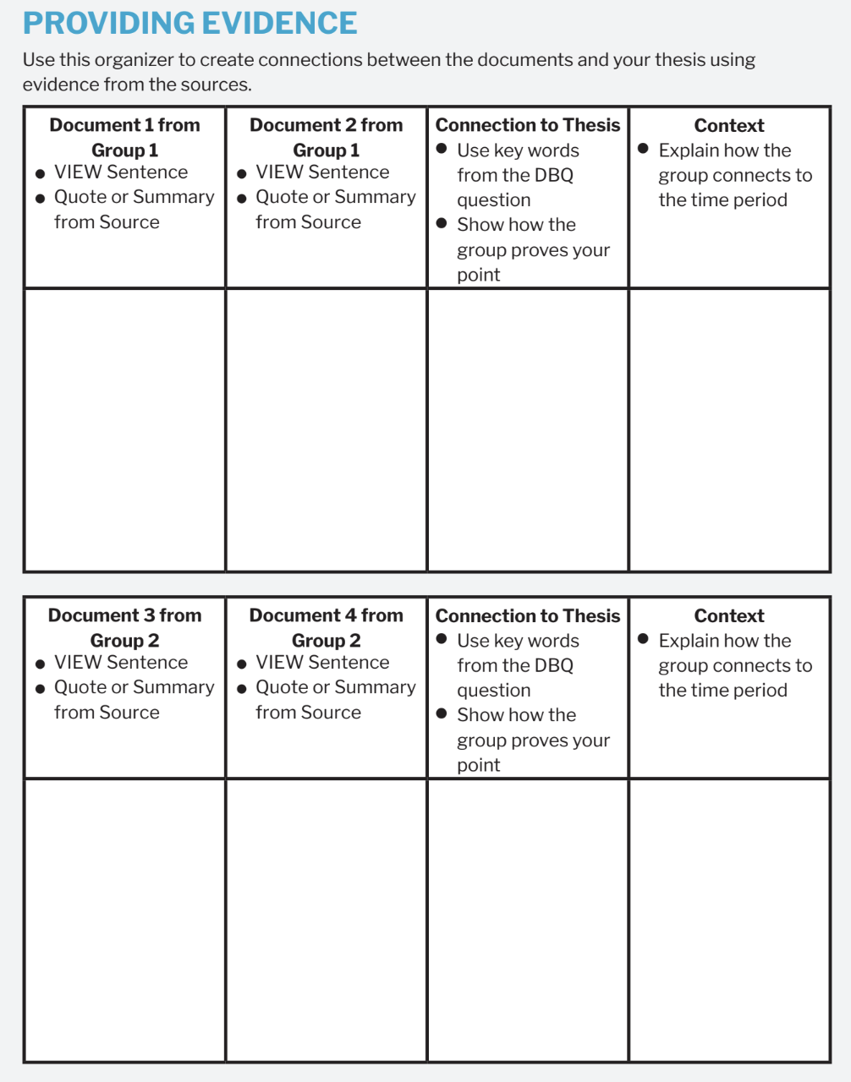
Analyzing Sources for Context
Choose 3-4 sources.
Use the graphic organizer to collect and organize information about the context surrounding the document groups.
This can come from the source, your knowledge, or research.
Notes:
More information about the sources is available in the teacher support document.

Slide 24
Optional: VIEW Document Analysis Review
Notes:
The next three slides quickly review the skill: document analysis using "VIEW" sentences. These slides correspond to the graphic organizer.

Slide 25
Document Analysis
Document analysis is the process of examining and interpreting a primary source to understand its meaning, purpose, and significance.
This includes identifying:
Author
Audience
Context
Main ideas
Analysis also includes evaluating the sources' reliability and impact on historical events or perspectives.
Notes:
Reveal this slide if needed to re-teacher document analysis.

Slide 26

Document Analysis
VIEW
Voice
This is also known as their perspective.
Intent
This is also called purpose.
Environment
This is also called context.
Who?
What is the author’s voice?
How does the author’s job, social class, gender, race, age, experience, or other characteristics impact what they are saying?
What experiences has this person had?
Is the document intended to inform, persuade, remind, change?
How does that intention affect the question you are trying to answer?
What is the environment like surrounding the creation of the document?
What happened before the document was created?
How much time passed between the event and creating of the document?
This is also called audience.
Who was the document created for?
Is it a diary entry that was probably just for individual memory keeping?
Was it a newspaper article meant to be read by as many people as possible?
Notes:
Overview the task with students. They will be viewing the deconstructed DBQ document set and completing the organizer on their handout, not all boxes will be filled. Student instructions prompt them to complete at least three boxes in each column. Display this screen as student work for reference.

Slide 27
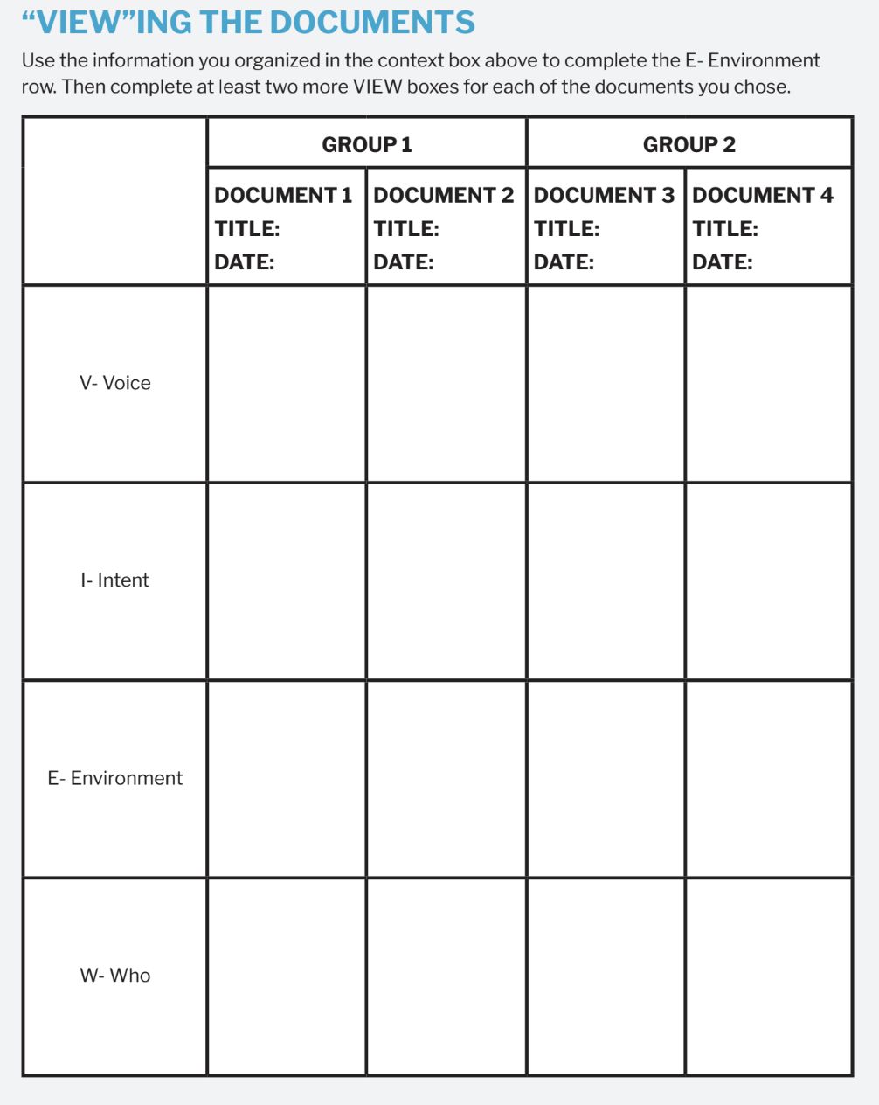
VIEW
Notes:
This slide is hidden, but can be revealed if you plan to review this skill with your students. It makes a great work area on a smart board.

Slide 28
Optional: Thesis Writing & Organizer Completion
Notes:
The next three slides quickly review the skill: writing a thesis. These slides correspond to the graphic organizer and thesis boxes on page 3 of the organizer.

Slide 29
A thesis is a defendable claim that establishes a line of reasoning.
A claim is a defensible statement that responds to the question.
A “line of reasoning” outlines your key points. It introduces the substance of the evidence for your claim.

Slide 30
Examples
Text Example
Graphic Organizer Example
Having chores at home helps kids learn responsibility, just like citizens have duties to help their community run smoothly.
Having chores at home
just like citizens have duties to help their community run smoothly.
helps kids learn responsibility
Write your thesis statement.
Notes:
This thesis implies that having chores is good for students, although it does not explicitly state it. This is the defendable statement.
The line of reasoning explains that 1. chores help students learn responsibility and that 2. this helps them become good citizens.

Slide 31
Examples
Text Example
Graphic Organizer Example
The drive for territorial expansion shaped the nation’s identity by promoting ideas of Manifest Destiny and economic opportunity, but it also created challenges like displacement of Native Americans and conflicts over slavery.
The drive for territorial expansion shaped the nation’s identity by
promoting ideas of Manifest Destiny and economic opportunity,
but it also created challenges like displacement of Native Americans and conflicts over slavery.
Write your thesis statement.
Notes:
Example. This slide is hidden from the presentation. You can reveal it if an example is useful for your students.

Slide 32
Peer Review
Thesis
Does the thesis answer the prompt?
Is the claim clear and defensible?
Does it establish a logical line of reasoning?
Notes:
Allow the students a few minutes to review a peer's groupings and thesis with the questions on the slides as prompts for discussion.

Slide 33
Peer Review
Grouping Sources
What are the similarities or connections used to create groups or categories?
Do the groups match the sources?
Context
Is the context accurate and detailed?
Does the context summary explain the significance of the source and connect it to the question?
Notes:
Allow the students a few minutes to review a peer's groupings and thesis with the questions on the slides as prompts for discussion.

