Slide 2
Deconstructed DBQ Skills Mini-Lesson
Unit 8- All Skills

Slide 3
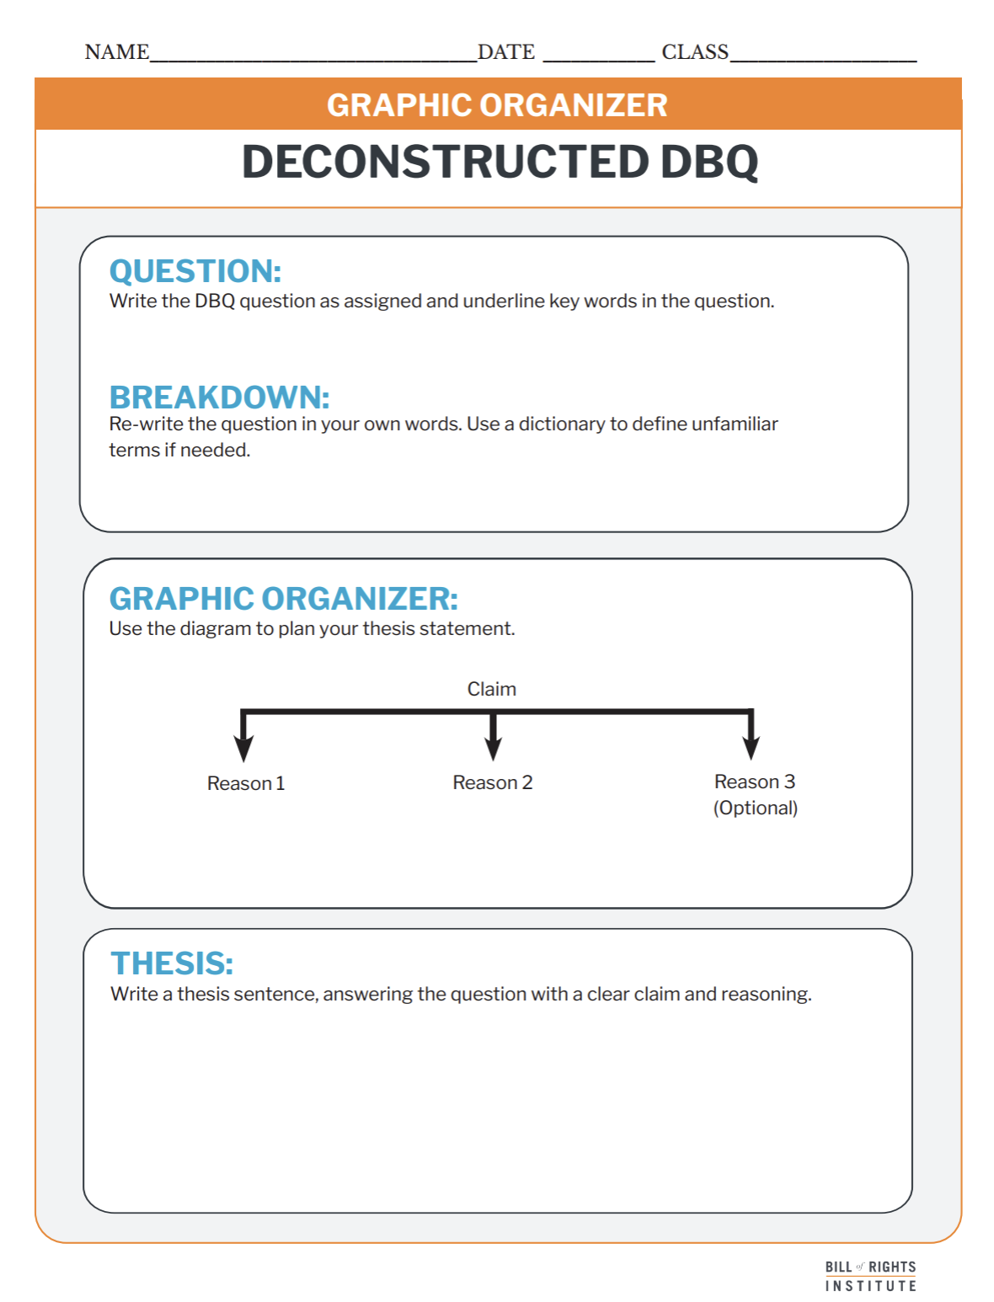
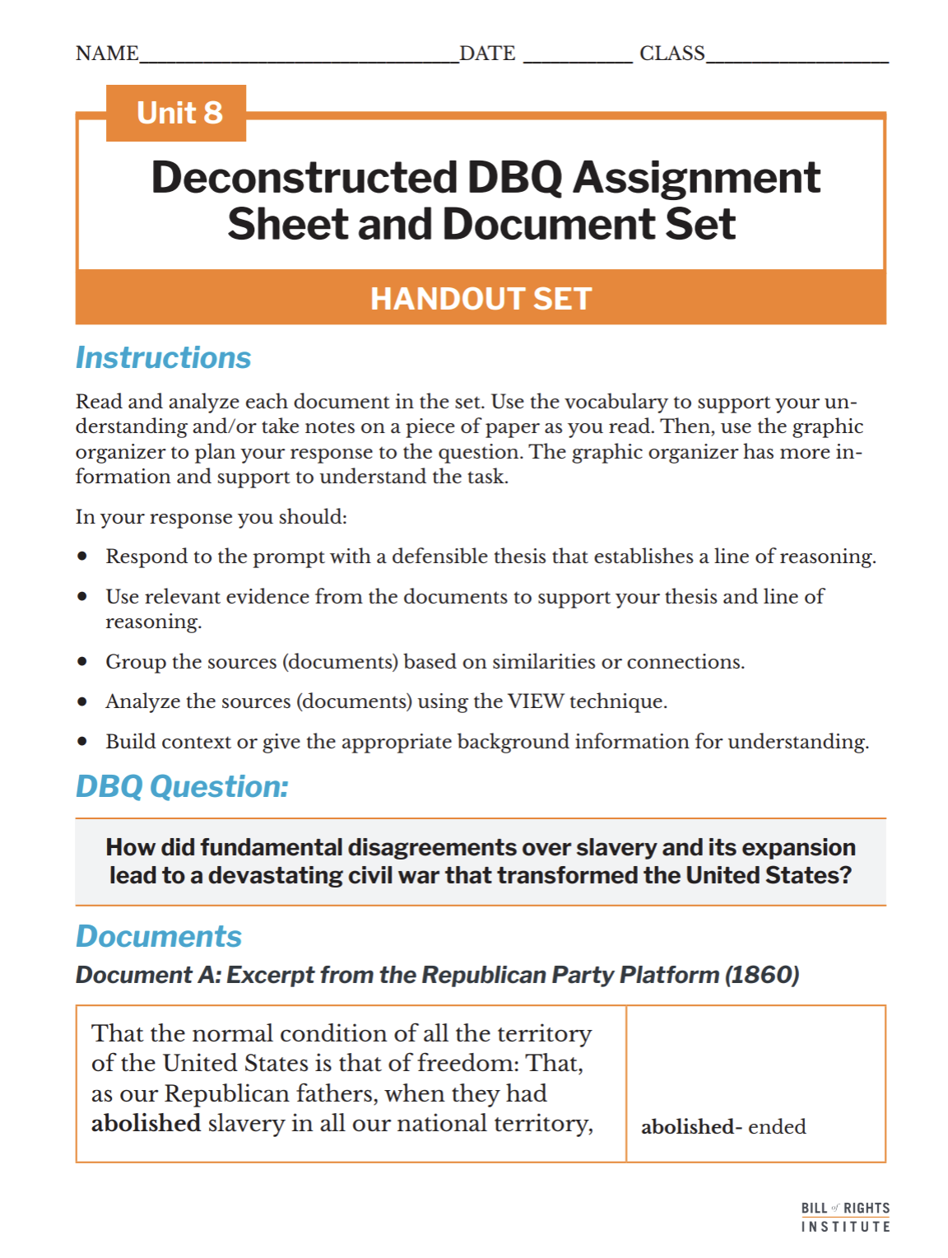
Student Materials Needed
Unit 8 Deconstructed DBQ Assignment Sheet and Document Set
Deconstructed DBQ: Graphic Organizer Handout

Slide 4
How did fundamental disagreements over slavery and its expansion lead to a devastating civil war that transformed the United States?

Slide 5
Reading and Annotation

Slide 6
Document A: Excerpt from the Republican Party Platform (1860)
That the normal condition of all the territory of the United States is that of freedom: That, as our Republican fathers, when they had abolished slavery in all our national territory, ordained that "no persons should be deprived of life, liberty or property without due process of law," it becomes our duty, by legislation, whenever such legislation is necessary, to maintain this provision of the Constitution against all attempts to violate it; and we deny the authority of Congress, of a territorial legislature, or of any individuals, to give legal existence to slavery in any territory of the United States | abolished- ended ordained- officially established provision- part of, section
Notes:
The next 7 slides are included if you would like to review the document set with students. More information is included in the teacher support document.

Slide 7
Document B: Excerpt from Daniel Webster “7th of March” Speech (1850)
Mr. President, three things are quite clear as historical truths. One is, that there was an expectation that, on the ceasing of the importation of slaves from Africa, slavery would begin to run out here. That was hoped and expected. Another is, that, as far as there was any power in Congress to prevent the spread of slavery in the United States, that power was executed in the most absolute manner, and to the fullest extent. . . . [The] Ordinance prohibiting slavery for ever northwest of the Ohio has the hand and seal and every Southern member in Congress. It was therefore no aggression of the North on the South. The other and third clear historical truth is, that the Convention meant to leave slavery in the State as they found it, entirely under the authority and control of the States themselves. . . . | ceasing- stopping importation- to bring in Ordinance- law aggression- hostility Convention- the Constitutional Convention

Slide 8
Document C: Excerpt from the Secession Statement from South Carolina (December 24, 1860)
...We affirm that these ends for which this Government was instituted have been defeated, and the Government itself has been made destructive of them by the action of the non-slaveholding States. Those States have assume the right of deciding upon the propriety of our domestic institutions; and have denied the rights of property established in fifteen of the States and recognized by the Constitution; they have denounced as sinful the institution of slavery; they have permitted open establishment among them of societies, whose avowed object is to disturb the peace and to eloign the property of the citizens of other States. They have encouraged and assisted thousands of our slaves to leave their homes; and those who remain, have been incited by emissaries, books and pictures to servile insurrection... | propriety of our domestic institutions- status of institutions such as slavery eloign- to remove incited-encouraged emissaries- people on special missions

Slide 9
Document D: Excerpt from the Secession Statement from Georgia (January 29, 1861)
The people of Georgia having dissolved their political connection with the Government of the United States of America, present to their confederates and the world the causes which have led to the separation. For the last ten years we have had numerous and serious causes of complaint against our non-slave-holding confederate States with reference to the subject of African slavery. They have endeavored to weaken our security, to disturb our domestic peace and tranquility, and persistently refused to comply with their express constitutional obligations to us in reference to that property... | Similar to the Declaration of Independence, Georgia is announcing they are leaving the United States and the reasons why. endeavored- to try hard to achieve

Slide 10
Document E: Excerpt from Jefferson Davis Inaugural Address (February 18, 1861)
...As a necessity, not a choice, we have resorted to the remedy of separation; and henceforth our energies must be directed to the conduct of our own affairs, and the perpetuity of the Confederacy which we have formed. If a just perception of mutual interest shall permit us peaceably to pursue our separate political career, my most earnest desire will have been fulfilled. But, if this be denied to us, and the integrity of our territory and jurisdiction be assailed, it will but remain for us, with firm resolve, to appeal to arms and invoke the blessings of Providence on a just cause... | remedy- solution perpetuity- continuation assailed- attacked

Slide 11
Document F: Excerpts from Abraham Lincoln’s First Inaugural Address (March 4, 1861)
But if destruction of the Union by one or by a part only of the States be lawfully possible, the Union is less perfect than before the Constitution, having lost the vital element of perpetuity. …It follows from these views that no State upon its own mere motion can lawfully get out of the Union; that resolves and ordinances to that effect are legally void, and that acts of violence within any State or States against the authority of the United States are insurrectionary or revolutionary, according to circumstances. | perpetuity-continuation insurrectionary- an act of revolt or rebellion
In your hands, my dissatisfied fellow-countrymen, and not in mine, is the momentous issue of civil war. The Government will not assail you. You can have no conflict without being yourselves the aggressors. You have no oath registered in heaven to destroy the Government, while I shall have the most solemn one to “preserve, protect, and defend” it. | assail- assault or attack

Slide 12
Document G: Excerpts from Alexander Stephens’ Cornerstone Address (March 21, 1861)
Part 1
Our new government is founded upon exactly the opposite idea [of the Declaration of Independence]; its foundations are laid, its corner-stone rests, upon the great truth that the negro is not equal to the white man; that slavery subordination to the superior race is his natural and normal condition. This, our new government, is the first, in the history of the world, based upon this great physical, philosophical, and moral truth. This truth has been slow in the process of its development, like all other truths in the various departments of science... | opposite idea [of the Declaration of Independence]- The Confederacy proclaims itself in opposition to the principle that “all men are created equal” from the Declaration of Independence. cornerstone- the key building block of something; here, it symbolizes the most important idea supporting their government subordination- the state of being lower in status or under someone else's control

Slide 13
Document G: Excerpts from Alexander Stephens’ Cornerstone Address (March 21, 1861)
Part 2
They assume that the negro is equal, and hence conclude that he is entitled to equal privileges and rights with the white man. If their premises were correct, their conclusions would be logical and just but their premise being wrong, their whole argument fails... They were attempting to make things equal which the Creator had made unequal... | premises- basic statement upon whose truth an argument is based
With us, all of the white race, however high or low, rich or poor, are equal in the eye of the law. Not so with the negro. Subordination is his place... | subordination- the state of being lower in status or under someone else's control

Slide 14
Pass-Pass-Synthesize
Notes:
Arrange students into groups of three.

Slide 15
Pass-Pass-Synthesize
Write your response to the question or topic for a set amount of time.
Pass your paper to a partner.
Your partner writes their response for another set amount of time.
Pass the paper a second time to a new partner.
Read the two previous responses on the paper.
Synthesize (combine and summarize) the main ideas from both responses.

Slide 16

Pass-Pass-Synthesize
Write your response to the question or topic for a set amount of time.
Pass your paper to a partner.
Your partner writes their response for another set amount of time.
Pass the paper a second time to a new partner.
Read the two previous responses on the paper.
Synthesize (combine and summarize) the main ideas from both responses.
Topic
What were the "fundamental disagreements" about slavery in 1830-1860?

Slide 17
Pass-Pass-Synthesize
Write your response to the question or topic for a set amount of time.
Pass your paper to a partner.
Your partner writes their response for another set amount of time.
Pass the paper a second time to a new partner.
Read the two previous responses on the paper.
Synthesize (combine and summarize) the main ideas from both responses.
Topic
What were the "fundamental disagreements" about slavery in 1830-1860?

Slide 18
Pass-Pass-Synthesize
Write your response to the question or topic for a set amount of time.
Pass your paper to a partner.
Your partner writes their response for another set amount of time.
Pass the paper a second time to a new partner.
Read the two previous responses on the paper.
Synthesize (combine and summarize) the main ideas from both responses.
Topic
What were the "fundamental disagreements" about slavery in 1830-1860?

Slide 19
Pass-Pass-Synthesize
Write your response to the question or topic for a set amount of time.
Pass your paper to a partner.
Your partner writes their response for another set amount of time.
Pass the paper a second time to a new partner.
Read the two previous responses on the paper.
Synthesize (combine and summarize) the main ideas from both responses.
Topic
What were the "fundamental disagreements" about slavery in 1830-1860?

Slide 20

Pass-Pass-Synthesize
Write your response to the question or topic for a set amount of time.
Pass your paper to a partner.
Your partner writes their response for another set amount of time.
Pass the paper a second time to a new partner.
Read the two previous responses on the paper.
Synthesize (combine and summarize) the main ideas from both responses.
Topic
What were the "fundamental disagreements" about slavery in 1830-1860?

Slide 21
Possible Supporting Details from Primary Sources
How did fundamental disagreements over slavery and its expansion lead to a devastating civil war that transformed the United States?
Notes:
Create a list together of supporting details from the documents/sources to answer the DBQ question.
Example hidden on the next slide. Reveal it if needed.

Slide 22
Possible Supporting Details from Primary Sources
How did fundamental disagreements over slavery and its expansion lead to a devastating civil war that transformed the United States?
Moral and Political Divide
States' Powers vs. Federal Authority
The Question of New Territories
Attempts to Expand Slavery Westward
Secession and the Formation of the Confederacy

Slide 23
Thesis Writing

Slide 24
Deconstructed DBQ Question
Question
Write the DBQ question as assigned
Breakdown
Re-write the question in your own words. Use a dictionary to define unfamiliar terms if needed.

Slide 25
Examples
Text Example
Graphic Organizer Example
Completing group projects in class mirrors the way communities work together to solve problems and achieve common goals.
Completing group projects in class
mirrors the way communities work together
to solve problems
and achieve common goals.
Notes:
This thesis implies that doing group projects is good for students, although it does not explicitly state it. This is the defensible statement.

Slide 26
Examples
Text Example
Graphic Organizer Example
Disagreements over slavery and its expansion created deep divides between the North and the South, ultimately leading to the Civil War as tensions over the powers of the states and economic interests grew stronger.
Disagreements over slavery and its expansion created deep divides between the North and the South, ultimately leading to the Civil War as tensions over
the powers of the states
and economic interests grew stronger.
Notes:
Example. This slide is hidden from the presentation. You can reveal it if an example is useful for your students.

Slide 27
A thesis is a defendable claim that establishes a line of reasoning.
A claim is a defendable statement that responds to the question.
A “line of reasoning” outlines your key points. It introduces the substance of the evidence for your claim.

Slide 28
Grouping and Document Analysis
Notes:
The next three slides quickly review the skills: grouping and document analysis using "VIEW". These slides correspond to the graphic organizer.

Slide 29
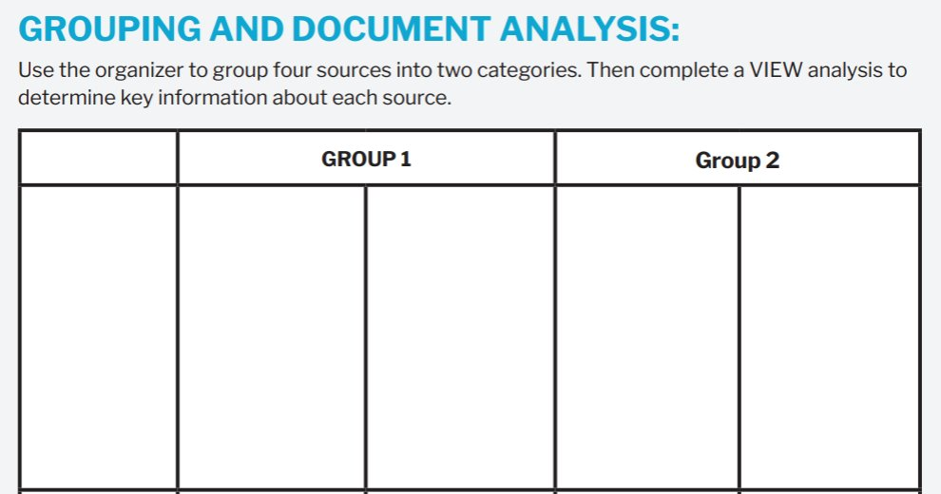
Grouping

Slide 30
Grouping
Group 1: Tensions over the Powers of the States
Group 2: Economic Interests
Document B - Secession Statement from South Carolina Argues that non-slaveholding states are infringing upon South Carolina's authority to maintain its ' domestic institutions,' specifically slavery.
Document C - Secession Statement from Georgia
Claims that Northern states are refusing to uphold constitutional obligations regarding slavery, threatening Georgia's sovereignty.
Document A - Republican Party Platform (1860)
Argues that slavery's expansion threatens economic opportunities for free labor and contradicts constitutional protections.
Document F -Alexander Stephens' Cornerstone Address
Emphasizes the economic justification for slavery, claiming it as the 'cornerstone' of the Southern economy and society.

Slide 31
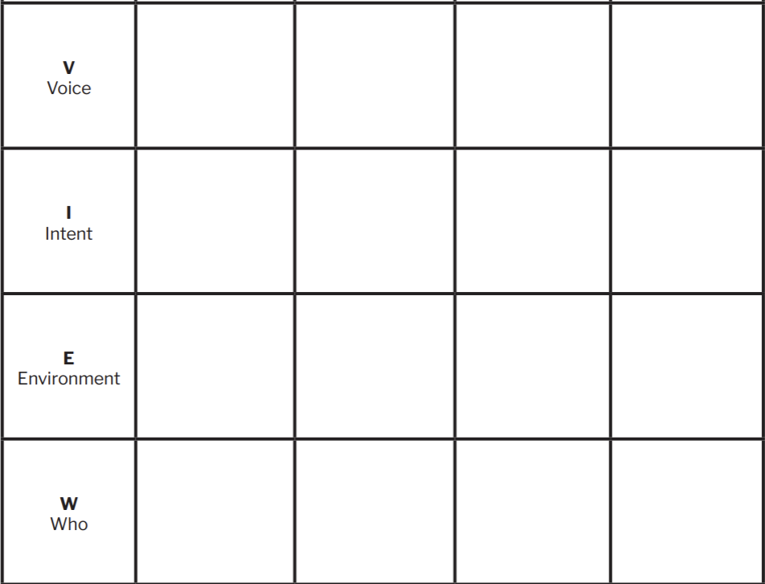
Document Analysis

Slide 32
Document Analysis
Document B: Secession Statement from South Carolina
Document C: Secession Statement from Georgia
Document A: Republican Party Platform 1860
Document F: Alexander Stephens' Cornerstone Address
Voice: Leaders of South Carolina
Voice: Leaders of Georgia
Voice: Republican Party leadership
Voice: Alexander Stephens, Vice President of the Confederacy
Intent: To justify secession by arguing that Northern states violated Southern sovereignty over slavery.
Intent: To declare grievances against Northern states for not respecting agreements about slavery, pushing for secession.
Intent: To argue against the expansion of slavery, citing its contradiction with economic opportunity for free labor.
Intent: To justify the Confederate government’s economic structure, explicitly stating slavery as foundational to its economy.
Environment: Passed right after the Civil War ended, when the country needed to rebuild and deal with the issue of slavery.
Environment: Rising tensions between North and South, with Georgia asserting its right to protect its economy and institutions.
Environment: Political campaign platform highlighting economic differences between free and slave states.
Environment: Early days of the Confederacy, solidifying its social and economic principles.
Who: Fellow Southern states and the broader nation, appealing for unity and justification of their choice.
Who: Other Southern states and international observers to validate their decision to secede.
Who: Northern voters and political supporters, appealing for unity against slavery's spread.
Who: Southerners, supporters, and observers to articulate the ideological foundation of the Confederacy.

Slide 33
Providing Evidence

Slide 34
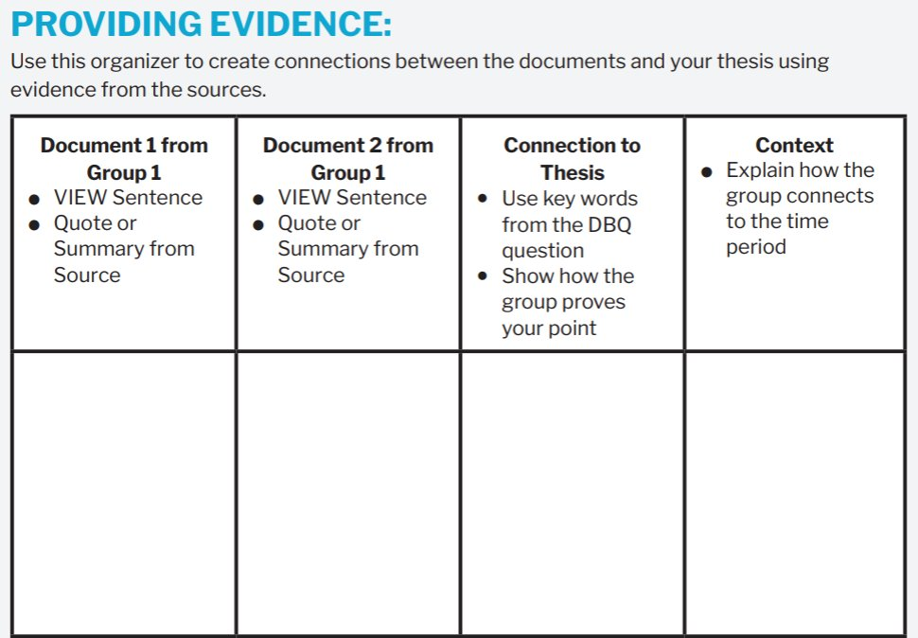
Providing Evidence

Slide 35
Providing Evidence
Document B: Secession Statement from South Carolina
Document C: Secession Statement from Georgia
VIEW Sentence: ​
Southern leaders express their belief that Northern states violated their right to manage slavery, which justified their decision to secede.​
​
Quote: ​
"The non-slaveholding States... have assumed the right of deciding upon the propriety of our domestic..."
VIEW Sentence: ​
Georgia claims that Northern states violated their constitutional obligations, threatening Southern economic stability and prompting secession​.
​
Quote: ​
"They have endeavored to weaken our security, to disturb our domestic peace and tranquility..."
These documents demonstrate how disagreements over the powers of the states—specifically, the right to maintain slavery—fueled conflict that led to secession.
South Carolina and Georgia's secessions in 1860 marked the beginning of a wave of Southern states leaving the Union, driven by fears that slavery would be restricted by Northern influence.

Slide 36
Peer Review: Choose 3
Thesis Alignment: Does the evidence provided clearly connect back to the thesis? Is it obvious how the document supports the student's argument?
VIEW Analysis: Does the VIEW sentence accurately reflect the main argument of the document? Are Voice, Intent, Environment, and Who appropriately identified?
Quote Selection: Is the chosen quote effective in supporting the main idea? Would another part of the document work better?
Context Sentence: Does the context sentence help the reader understand the historical background? Is it specific enough to be meaningful?
Clarity and Logic: Is the explanation logical and easy to follow? Are there any parts that seem confusing or need more development?
Suggestions for Improvement: What is one thing your peer could do to strengthen their analysis? This could be adding more evidence, clarifying an argument, or rephrasing for clarity.
Grammar and Spelling: Are there any grammatical or spelling issues that need to be addressed?
Overall Effectiveness: Did the analysis convince you of the argument? Why or why not?
Next Steps: If you were to suggest one next step for the writer to improve their draft, what would it be.

