Slide 1
Deconstructed DBQ Skills Mini-Lesson
Unit 8- All Skills

Slide 2
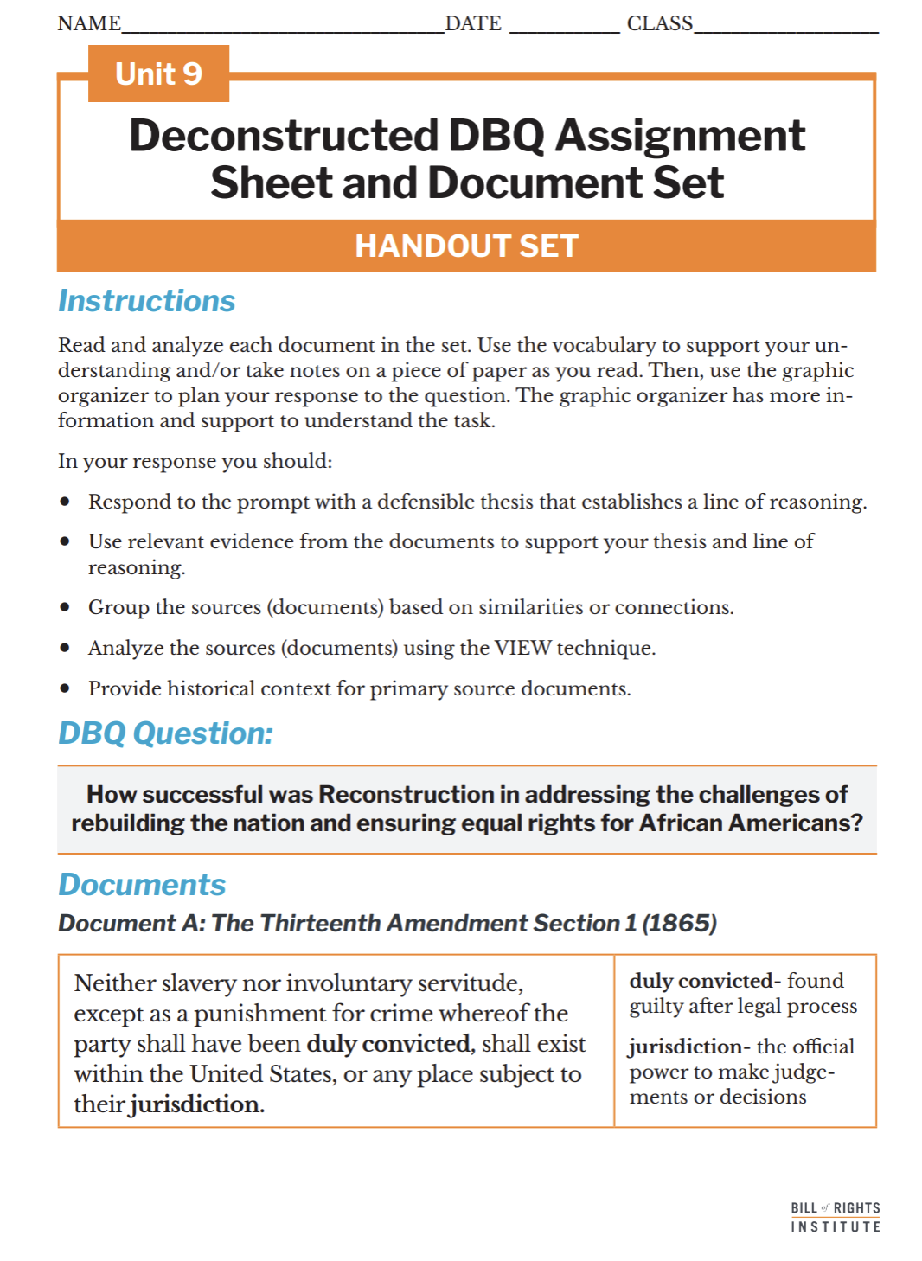
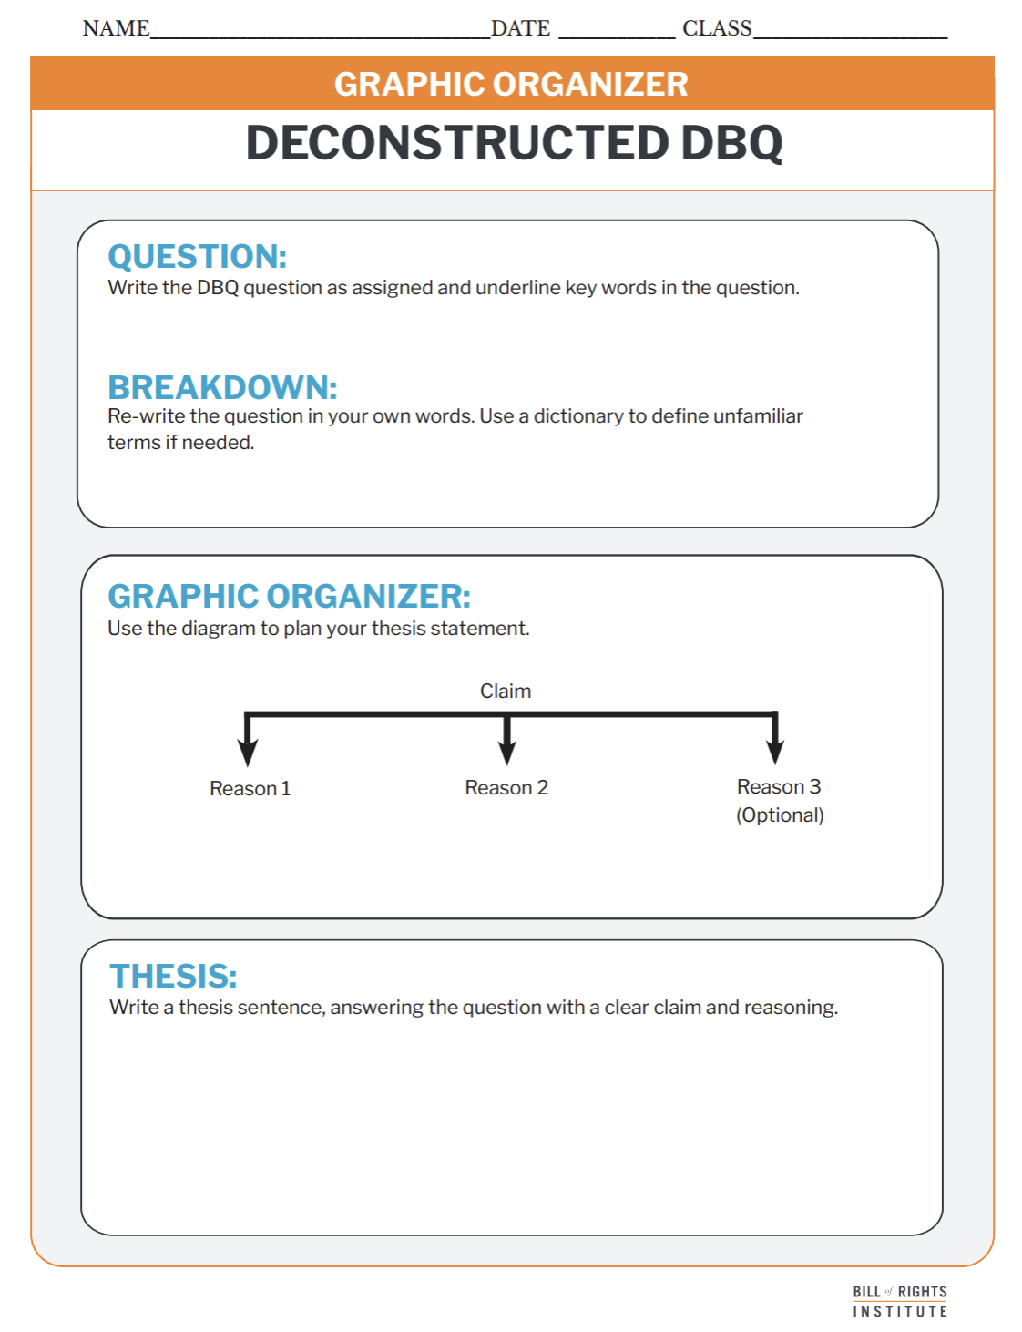
Student Materials Needed
Unit 9 Deconstructed DBQ Assignment Sheet and Document Set
Deconstructed DBQ: Graphic Organizer Handout

Slide 3
How successful was Reconstruction in addressing the challenges of rebuilding the nation and ensuring equal rights for African Americans?

Slide 4
Reading and Annotation
Notes:
Arrange students into groups of three.

Slide 5
Document A: The Thirteenth Amendment Section 1 (1865)
Neither slavery nor involuntary servitude, except as a punishment for crime whereof the party shall have been duly convicted, shall exist within the United States, or any place subject to their jurisdiction. | duly convicted- found guilty after legal process jurisdiction- the official power to make judgements or decisions
Notes:
The next 7 slides are included if you would like to review the document set with students. More information is included in the teacher support document.

Slide 6
Document B: The Fourteenth Amendment Section 1 (1868)
All persons born or naturalized in the United States, and subject to the jurisdiction thereof, are citizens of the United States and of the State wherein they reside. No State shall make or enforce any law which shall abridge the privileges or immunities of citizens of the United States; nor shall any State deprive any person of life, liberty, or property, without due process of law; nor deny to any person within its jurisdiction the equal protection of the laws. | naturalized- to become a citizen through a process jurisdiction- the official power to make judgements or decisions privileges and immunities-fundamental rights and protections
Notes:
The next 7 slides are included if you would like to review the document set with students. More information is included in the teacher support document.

Slide 7
Document C: The Fifteenth Amendment Section 1 (1870)
“The right of citizens of the United States to vote shall not be denied or abridged by the United States or by any State on account of race, color, or previous condition of servitude | abridged- reduced
Notes:
The next 7 slides are included if you would like to review the document set with students. More information is included in the teacher support document.

Slide 8
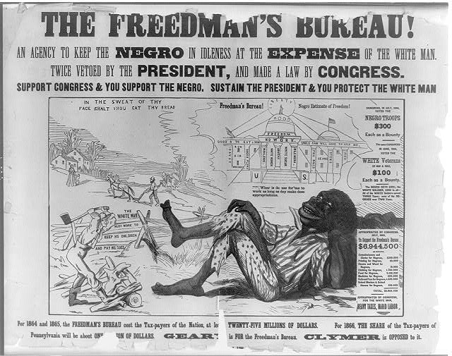
Document D: The Freedmen’s Bureau! (1866)
 | “The Freedman’s Bureau- An agency to keep the negro in idleness at the expense of the white man. Twice vetoed by the president, and made law by Congress. Support Congress and you support the negro. Sustain the president & you protect the white man.”
Notes:
The next 7 slides are included if you would like to review the document set with students. More information is included in the teacher support document.

Slide 9
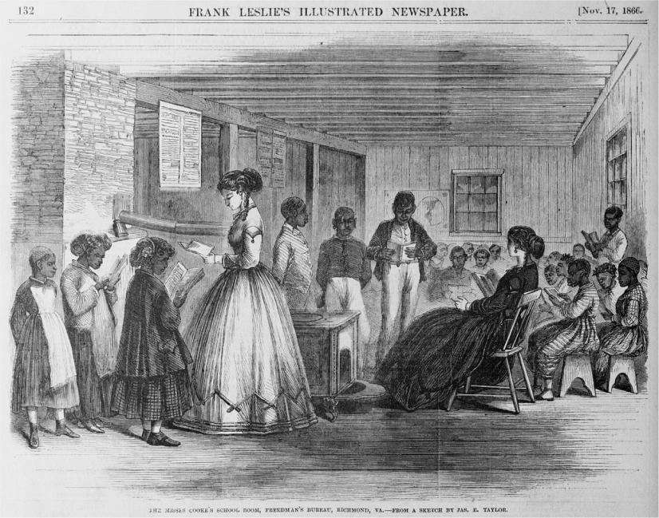
Document E: Classrooms for Black Children (1866)
Notes:
The next 7 slides are included if you would like to review the document set with students. More information is included in the teacher support document.

Slide 10
Document F: President Johnson Veto Message of the Civil Rights Act of 1866
Part 1
Four millions of them have just emerged from slavery into freedom. Can it be reasonably supposed that they possess the requisite qualifications to entitle them to all the privileges and immunities of citizens of the United States? Have the people of the several States expressed such a conviction? It may also be asked whether it is necessary that they should be declared citizens in order that they may be secured in the enjoyment of the civil rights proposed to be conferred by the bill. | requisite- required privileges and immunities-fundamental rights and protections conferred- granted
Notes:
The next 7 slides are included if you would like to review the document set with students. More information is included in the teacher support document.

Slide 11
Document F: President Johnson Veto Message of the Civil Rights Act of 1866
Part 2
Those rights are, by Federal as well as State laws, secured to all domiciled aliens and foreigners, even before the completion of the process of naturalization; and it may safely be assumed that the same enactments are sufficient to give like protection and benefits to those for whom this bill provides special legislation. Besides, the policy of the Government from its origin to the present time seems to have been that persons who are strangers to and unfamiliar with our institutions and our laws should pass through a certain probation, at the end of which, before attaining the coveted prize, they must give evidence of their fitness to receive and to exercise the rights of citizens as contemplated by the Constitution of the United States. | domiciled aliens- people from a foreign country naturalization- to become a citizen through a process the coveted prize- citizenship
Notes:
The next 7 slides are included if you would like to review the document set with students. More information is included in the teacher support document.

Slide 12
Document F: President Johnson Veto Message of the Civil Rights Act of 1866
Part 3
The bill in effect proposes a discrimination against large numbers of intelligent, worthy, and patriotic foreigners, and in favor of the Negro, to whom, after long years of bondage, the avenues to freedom and intelligence have just now been suddenly opened. | bondage- enslavement
He must of necessity, from his previous unfortunate condition of servitude, be less informed as to the nature and character of our institutions than he who, coming from abroad, has, to some extent at least, familiarized himself with the principles of a Government to which he voluntarily intrusts "life, liberty, and the pursuit of happiness." | unfortunate condition of servitude- enslavement
Notes:
The next 7 slides are included if you would like to review the document set with students. More information is included in the teacher support document.

Slide 13
Document F: President Johnson Veto Message of the Civil Rights Act of 1866
Part 4
Yet it is now proposed, by a single legislative enactment, to confer the rights of citizens upon all persons of African descent born within the extended limits of the United States, while persons of foreign birth who make our land their home must undergo a probation of five years, and can only then become citizens upon proof that they are "of good moral character, attached to the principles of the Constitution of the United States, and well disposed to the good order and happiness of the same. | legislative enactment- law or act
Notes:
The next 7 slides are included if you would like to review the document set with students. More information is included in the teacher support document.

Slide 14
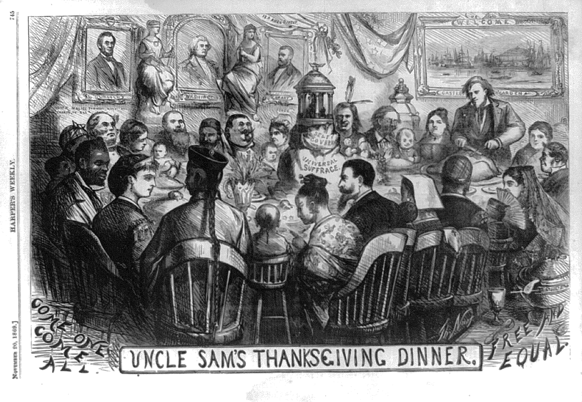
Document G: Uncle Sam’s Thanksgiving (1869)
 | “Come One, Come All” “Free and Equal”
Notes:
The next 7 slides are included if you would like to review the document set with students. More information is included in the teacher support document.

Slide 15
Give One, Get One, Move On
Notes:
Arrange students into groups of three.

Slide 16
Get one, give one, move on
Step 1: Prepare Your Ideas
After analyzing the sources, write 3 possible answers to the DBQ question on a blank piece of paper:
How successful was Reconstruction in addressing the challenges of rebuilding the nation and ensuring equal rights for African Americans?
Each answer should be a thesis statement with a clear claim and reasoning.
Be ready to explain your thinking!

Slide 17
Get one, give one, move on
Step 2: Let’s Move!
Stand up and find a partner.
Take turns:
Give one of your thesis ideas.
Get one of theirs (write it down if it’s new!).
Say thanks, then move on to a new partner.
Repeat this process with at least 2 different classmates.
💡 Tip: If you already heard an idea, ask for a different one!

Slide 18
Get one, give one, move on
Step 3: Add New Ideas
Return to your seat and use what you heard to write 2 more thesis statements.
Try combining strong ideas or rewording them to make them clearer.

Slide 19
Get one, give one, move on
Step 4: Go Again!
Get up and repeat Give One, Get One, Move On
Share one of your new thesis ideas and collect a few more!
By the end, you should have at least 5–6 thoughtful thesis statements to choose from for your final answer.

Slide 20
Thesis Writing

Slide 21
Deconstructed DBQ Question
Question
Write the DBQ question as assigned
Breakdown
Re-write the question in your own words. Use a dictionary to define unfamiliar terms if needed.

Slide 22
A thesis is a defensible claim that establishes a line of reasoning.
A claim is a defensible statement that responds to the question.
A “line of reasoning” outlines your key points. It introduces the substance of the evidence for your claim.

Slide 23
Examples
Text Example
Graphic Organizer Example
Following classroom rules helps students build good habits for citizenship by teaching respect, fairness, and responsibility.
Following classroom rules helps students build good habits for citizenship by teaching
fairness
respect
and responsibility.

Slide 24
Examples
Text Example
Graphic Organizer Example
Reconstruction made progress by ending slavery and granting citizenship and voting rights to African Americans, but those gains were often undermined by racism and political resistance.
Reconstruction made progress
by ending slavery and granting citizenship and voting rights to African Americans,
but those gains were often undermined by racism and political resistance.
Notes:
Example. This slide is hidden from the presentation. You can reveal it if an example is useful for your students.

Slide 25
Grouping and Document Analysis

Slide 26
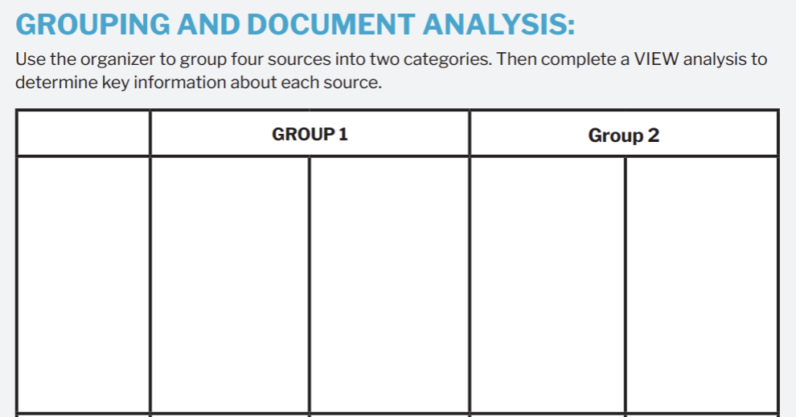
Grouping

Slide 27
Grouping
Group 1: Legal Protections and Efforts Toward Equality (Successes)
Group 2: Resistance and Limitations (Failures or Incomplete Success)
Document A – 13th Amendment (1865) ​ Ended slavery throughout the U.S., which was a major step toward freedom.
Document G – Classrooms for Black Children (1866) ​ Shows efforts to educate Black children.
Document D – The Freedmen’s Bureau! (1866) ​ A racist poster mocking the Freedmen’s Bureau and portraying Black Americans as lazy. It reflected efforts to turn white voters against Reconstruction.
Document F – President Johnson’s Veto Message (1866) ​ Argued that African Americans weren’t ready for citizenship and equal rights, showing resistance from the president to Reconstruction laws.

Slide 28
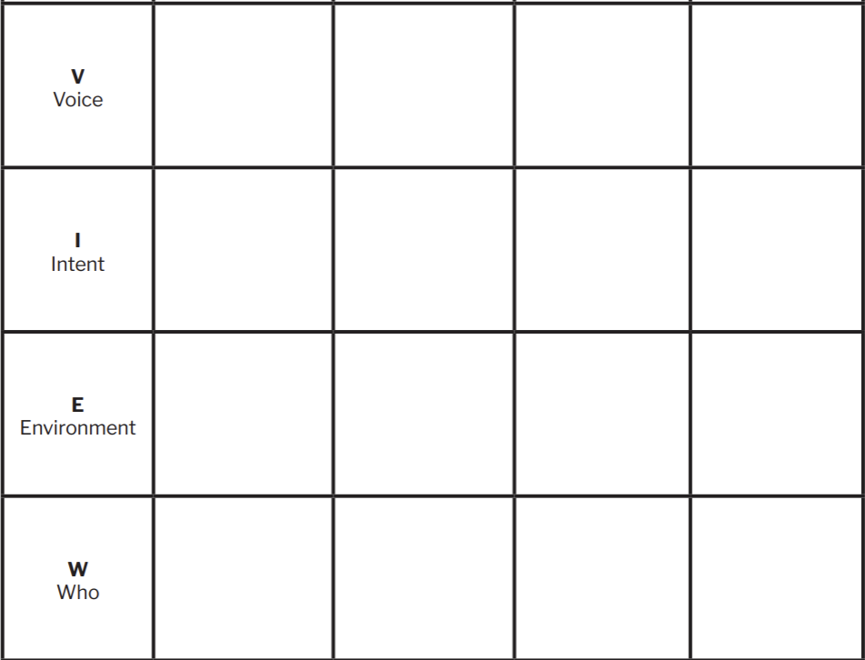
Document Analysis

Slide 29
Document Analysis
Document A: The Thirteenth Amendment (1865)
Document G: Uncle Sam’s Thanksgiving Dinner (1869)
Document D: The Freedmen’s Bureau! Poster (1866)
Document F: President Johnson’s Veto Message (1866)
Voice: Congress, through the U.S. Constitution.
Voice: Thomas Nast, a political cartoonist and supporter of Radical Republicans.
Voice: Opponents of Reconstruction.
Voice: President Andrew Johnson.
Intent: To end slavery in all parts of the United States.
Intent: To celebrate a vision of equality and inclusion in America after the Civil War. ​
Intent: To turn white voters against the Freedmen’s Bureau and equal rights for Black Americans.
Intent: To argue that African Americans weren’t ready for full citizenship and to stop Congress from passing the Civil Rights Act.
Environment: Passed right after the Civil War ended, when the country needed to rebuild and deal with the issue of slavery.
Environment: Near the end of Reconstruction, when people debated what kind of country America should become. ​
Environment: A time of strong political division over how to handle freedom and race after the Civil War.
​Environment: A time when Congress was trying to pass laws to protect Black rights and Johnson was trying to stop them.
Who: All people in the U.S., especially formerly enslaved African Americans.
Who: A diverse group of Americans—Black, white, immigrant, Native, and more. ​
Who: White voters in Pennsylvania and the general public.
Who: Congress, African Americans, and the American public.

Slide 30
Providing Evidence

Slide 31
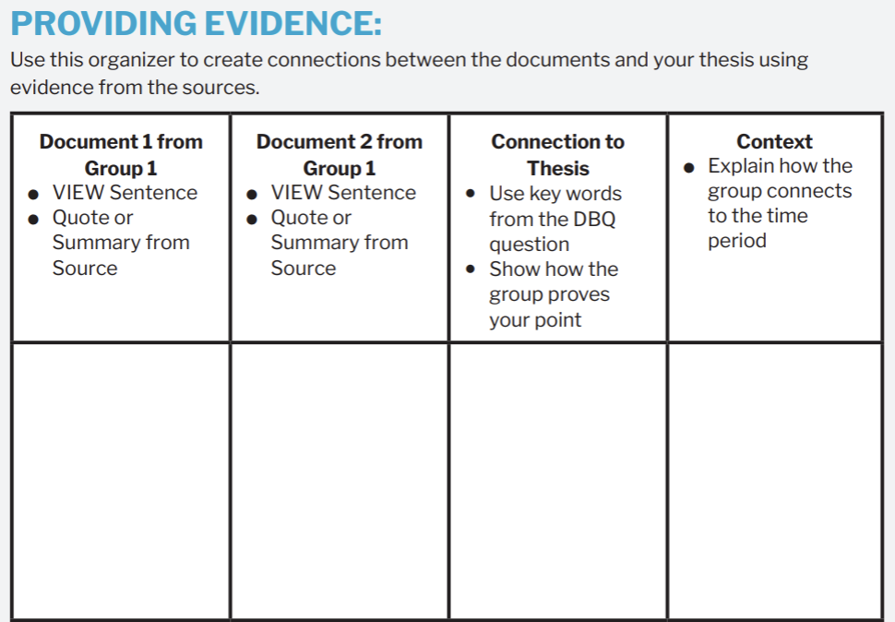
Providing Evidence

Slide 32
Providing Evidence
Document A: The Thirteenth Amendment (1865)
Document G: Uncle Sam’s Thanksgiving Dinner (1869)
VIEW Sentence: In 1865, Congress passed the Thirteenth Amendment to legally abolish slavery in the United States.
Quote/Detail: “Neither slavery nor involuntary servitude... shall exist within the United States.”
VIEW Sentence: In 1869, Thomas Nast created a political cartoon that imagined an inclusive America where people of all races and backgrounds could participate equally. ​
​
Quote/Detail: “Come One, Come All, Free and Equal.”
These documents show that Reconstruction made real progress toward equality and reflected hopes for an even more inclusive society in the future.
The end of the Civil War in 1865 marked a turning point in American history, as the nation faced the enormous task of rebuilding and redefining itself without slavery. This period was known as Reconstruction.

Slide 33
Peer Review: Choose 3
Thesis Alignment: Does the evidence provided clearly connect back to the thesis? Is it obvious how the document supports the student's argument?
VIEW Analysis: Does the VIEW sentence accurately reflect the main argument of the document? Are Voice, Intent, Environment, and Who appropriately identified?
Quote Selection: Is the chosen quote effective in supporting the main idea? Would another part of the document work better?
Context Sentence: Does the context sentence help the reader understand the historical background? Is it specific enough to be meaningful?
Clarity and Logic: Is the explanation logical and easy to follow? Are there any parts that seem confusing or need more development?
Suggestions for Improvement: What is one thing your peer could do to strengthen their analysis? This could be adding more evidence, clarifying an argument, or rephrasing for clarity.
Grammar and Spelling: Are there any grammatical or spelling issues that need to be addressed?
Overall Effectiveness: Did the analysis convince you of the argument? Why or why not?
Next Steps: If you were to suggest one next step for the writer to improve their draft, what would it be.

