Slide 2
Deconstructed DBQ Skills Mini-Lesson
Unit 1- Thesis

Slide 3
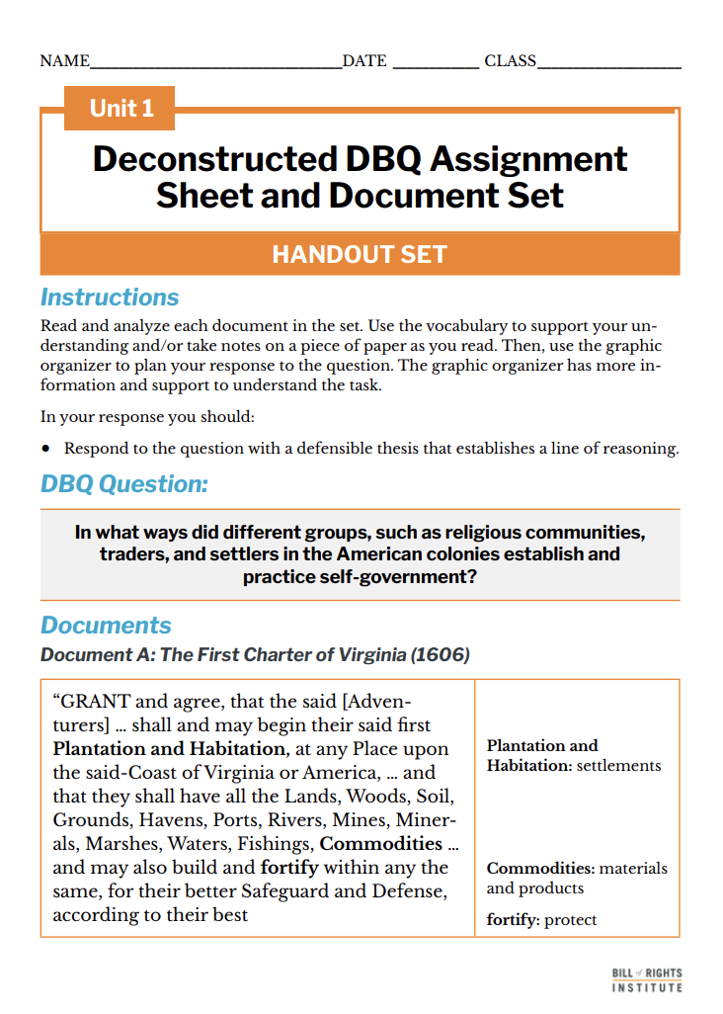
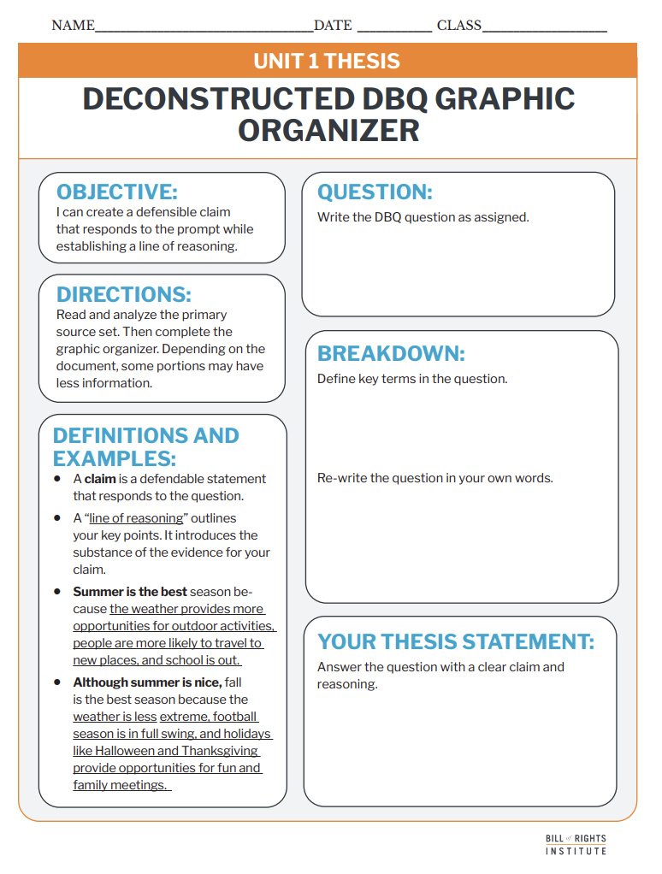
Student Materials Needed
Unit 1 Deconstructed DBQ Assignment Sheet and Document Set
Unit 1 Thesis Deconstructed DBQ Graphic Organizer

Slide 4
How did different groups, such as religious communities, traders, and settlers in the American colonies, establish and practice self-government?
Notes:
Give students instruction to fill in their organizer to:
Write the question on your thesis organizer
Circle and define important and unfamiliar terms
Re-write the question in your own words

Slide 5
Thesis Writing

Slide 6
A thesis is a defensible claim that establishes a line of reasoning.
A claim is a defensible statement that responds to the question.
A “line of reasoning” outlines your key points. It introduces the substance of the evidence for your claim.

Slide 7
Examples
Text Example
Graphic Organizer Example
Summer is the best season because the weather provides more opportunities for outdoor activities, people are more likely to travel to new places, and school is out.
Although summer is nice, fall is the best season because
the weather is less extreme
football season is in full swing
and holidays like Halloween and Thanksgiving provide opportunities for fun and family meetings.

Slide 8
Reading and Annotation
Notes:
Arrange students into groups of three.

Slide 9
Document A: The First Charter of Virginia (1606)
“GRANT and agree, that the said [Adventurers] ... shall and may begin their said first Plantation and Habitation, at any Place upon the said-Coast of Virginia or America, . . . and that they shall have all the Lands, Woods, Soil, Grounds, Havens, Ports, Rivers, Mines, Minerals, Marshes, Waters, Fishings, Commodities . . . and may also build and fortify within any the same, for their better Safeguard and Defense, according to their best Discretion... And we do also ordain, establish, and agree ... that each of the said Colonies shall have a Council, which shall govern and order all Matters ... according to such Laws, Ordinances, and Instructions, as shall be, in that behalf, given and signed with Our [the king’s] Hand” | Plantation and Habitation: settlements fortify: protect Discretion: decision or choice ordain: to make official
Notes:
The First Charter of Virginia, issued by King James I on April 10, 1606, was a royal document that established the legal framework for English colonization in North America. It granted permission to the Virginia Company of London to establish a settlement along the east coast of what is now the United States. This document laid the foundation for the Jamestown Colony, which was founded in 1607.
The First Charter of Virginia (1606) reflects and helps establish self-government in several ways, even though it ultimately kept authority under the English crown.
1. Local Governance in the Colony
The charter created a local council in Virginia, responsible for managing the colony’s affairs. While this council was still under the oversight of the Virginia Company and the king, it was an early form of colonial self-governance, allowing decision-making at the local level rather than direct rule from England.
2. Rights of Englishmen
The document promised that settlers would have the same rights and liberties as English citizens, even though they were across the Atlantic. This set the expectation that colonists had a say in their governance, just as English subjects did under common law.
3. Precedent for Future Colonial Government
While the charter itself did not create a fully independent government, it established a model that later expanded into more representative forms of self-rule. For example:
The House of Burgesses (1619) in Virginia was the first elected legislative assembly in the New World.
Later colonies followed similar governance structures, reinforcing the idea that colonists should have a voice in their laws and policies.
4. Economic and Decision-Making Autonomy
The charter encouraged the Virginia Company to govern the colony in a way that would ensure its economic success. Although the company had to answer to the king, it had considerable freedom in decision-making regarding trade, land use, and resource management.

Slide 10
Document B: The Mayflower Compact (1620)
"We, whose names are underwritten, ... having undertaken, ... a voyage to plant the first colony in the Northerne parts of Virginia, doe by these presents solemnly and mutually in the presence of God and one of another, covenant and combine ourselves together into a civill body politick, for our better ordering and preservation, ...constitute, and frame such just and equall laws, ordinances, acts, constitutions, and offices, from time to time, as shall be thought most meete and convenient for the generall good of the Colonie unto which we promise all due submission and obedience. | doe: do covenant: contract or solemn promise civill body politick- a community or society under a government
Notes:
The Mayflower Compact was a foundational document of self-government in colonial America. Signed on November 11, 1620, by 41 male passengers aboard the Mayflower before they disembarked at Plymouth, Massachusetts, it established a temporary government based on majority rule.
How It Established Self-Government
It was the first written agreement for self-rule in the New World.
It laid the foundation for future democratic institutions, including town meetings and representative assemblies.
It influenced later governing documents like the Fundamental Orders of Connecticut (1639) and even aspects of the U.S. Constitution.
Legacy of the Mayflower Compact
The Mayflower Compact demonstrated that colonists could create their own government based on mutual consent, reinforcing the idea that government derives its power from the people. It set a precedent for self-governance in the American colonies and contributed to the broader tradition of democratic governance that shaped American political thought.

Slide 11
Document C: The Charter of Maryland (1632)
“We [King Charles] ... do grant unto the said now Baron[of Baltimore],... and to his Heirs, for the good and happy Government of the said Province, free, full, and absolute Power..., to Ordain, Make, and Enact Laws, of what Kind soever, according to their sound Discretions...of and with the Advice, Assent, and Approbation of the Free-Men of the same Province." | soever: of any kind Advice, Assent, and Approbation: approval
Notes:
The Charter of Maryland, issued by King Charles I on June 20, 1632, granted George Calvert, Lord Baltimore, the right to establish a proprietary colony in what is now Maryland. This document was unique compared to earlier colonial charters because it gave Lord Baltimore almost complete control over the colony, allowing for a significant degree of self-governance.
How It Established Self-Government:
The proprietor (Lord Baltimore) had near-sovereign authority, but the settlers participated in governance through an elected assembly.
Maryland’s General Assembly, established in 1635, gave freemen a voice in legislation, reinforcing representative government in the colonies.
The colony became one of the earliest places in North America to experiment with religious tolerance, later formalized in the Maryland Toleration Act (1649).
Historical Significance:
Maryland’s self-governing structure influenced the development of American democracy by allowing settlers to have a say in their laws.
It set an early precedent for religious freedom, which would later shape American values.
It demonstrated the flexibility of English colonial governance, showing that a colony could thrive under a proprietary system rather than direct royal or corporate control.

Slide 12
Document D: The Frame of Government of Pennsylvania (1682)
“Now know..., that for the well-being and government of the said province...I, the said William Penn, have declared...all the freemen, planters and adventurers of...the said province, these liberties, franchises, and properties, to be held, enjoyed and kept by the freemen, planters, and inhabitants of the said province of Pensilvania [Pennsylvania] for ever. . . .That the freemen of the said province shall . . . chuse out of themselves seventy-two persons of most note for their wisdom, virtue and ability, who shall meet, on the tenth day of the first month...and act as, the provincial Council of the said province.... | chuse: choose
Notes:
The Frame of Government of Pennsylvania, written by William Penn in 1682, was the founding governmental document for the Pennsylvania colony. It established a framework for self-government, religious freedom, and democratic principles, reflecting Penn’s Quaker ideals and commitment to a fair, just society.
How It Established Self-Government:
Power was shared between the governor and elected representatives, setting a model for later American democracy.
Ordinary citizens had a role in making laws, rather than just a small elite or corporate officials.
It influenced the Constitution, particularly ideas about checks and balances and religious liberty.
Historical Significance:
It was one of the most democratic colonial charters of its time.
Pennsylvania became a model for freedom of religion and representative government.
Many of its principles, including elected government, individual rights, and religious tolerance, later shaped American political thought.

Slide 13
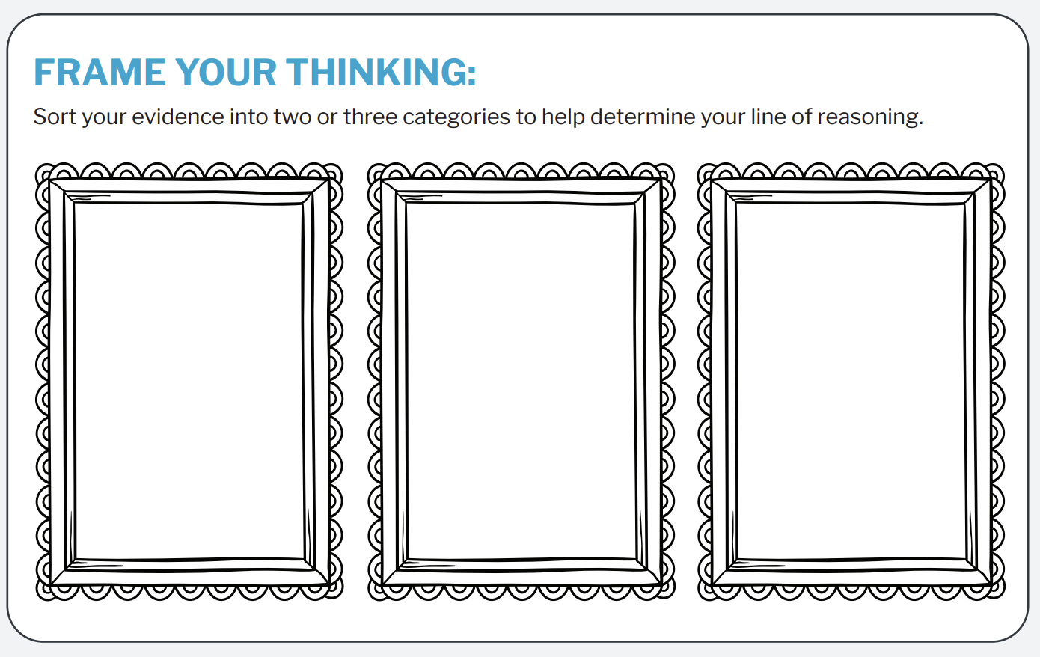
Frame your thoughts
Establish Self-government
Practice Self-government
Notes:
Say: “The question asks us to look specifically for evidence of establishing and practicing self-government. Let’s sort our sources into these two categories from the DBQ question.”
Use this slide to sort the sources with your students. The next slide is hidden, but contains one way to sort the sources if it suits your classroom.

Slide 14
Frame your thoughts
Establish Self-government
Practice Self-government
First Charter of Virginia​
Charter of Maryland
Mayflower Compact​
Frame of Government of Pennsylvania
Notes:
This slide is hidden. It contains one way to sort the sources based on the categories. Use this slide if you can not write on your classroom board or it suits your classroom.

Slide 15
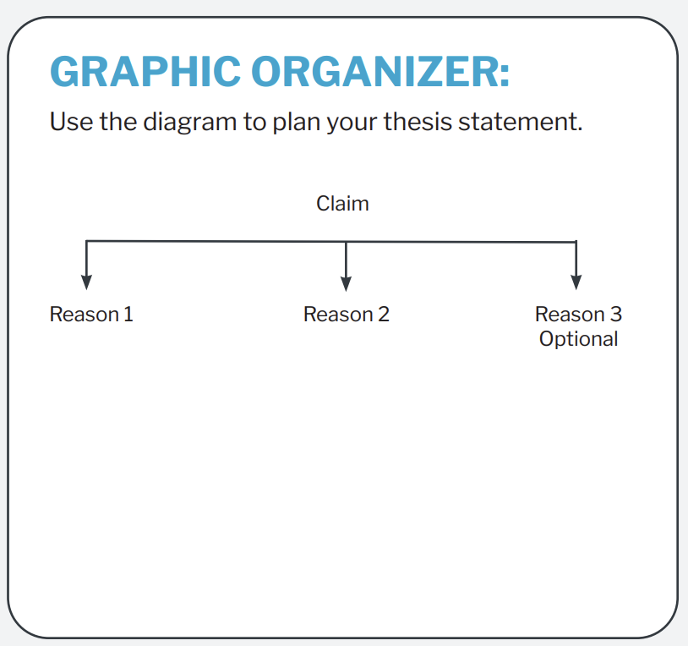
Graphic Organizer

Slide 16
Example 1
Religious communities, traders, and settlers in the American Colonies existed far from England which allowed them to
establish self-government, like in the Charter of Maryland
and practice self-government, like in the Mayflower Compact.
Optional Reason 3

Slide 17
Frame your thoughts
Creating their own laws
Forming representative assemblies
Making agreements
First Charter of Virginia​
Charter of Maryland
Frame of Government of Pennsylvania​
First Charter of Virginia
Mayflower Compact
Notes:
This slide is hidden. It contains another way to sort the sources with three new categories. Use this with more advanced students that are ready for more nuanced examples.

Slide 18
Example 2
and making agreements like the Mayflower Compact to ensure order and cooperation.
Religious communities, traders, and settlers in the American colonies established self-government by
creating their own laws,
forming representative assemblies,
Notes:
An example organizer using the 'frame your thinking' example from slide 16.

Slide 19
Peer Review
Does the thesis answer the question?
Is the claim clear and defensible?
Does it establish a logical line of reasoning?

