Slide 1
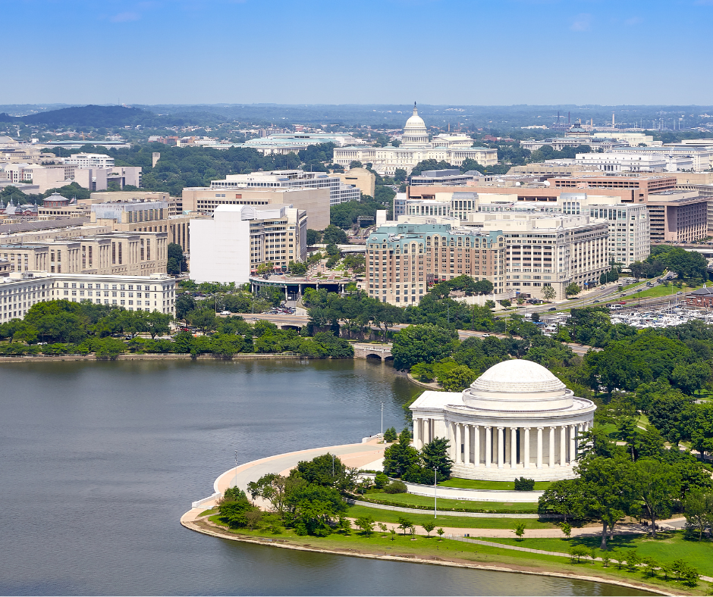
BRANCH BATTLE
A Whole-Class Branches of Government, Separation of Powers, and Checks and Balances Game.

Slide 2


Objectives
Goal
A whole-group classroom game that challenges students to successfully navigate the policy-making process by passing laws, executing orders, and reviewing actions — while maintaining the balance of power among the three branches of government.
The branch with the most points at the end wins.
Winning Condition

Slide 3

Setup
To begin:
  Divide into three teams
    Legislative
    Executive
    Judicial
  Hand out Branch Reference Cards to each group.
  Review the game materials (dice, board score tracker, action slides, crisis cards)
  Choose a score keeper

Slide 4
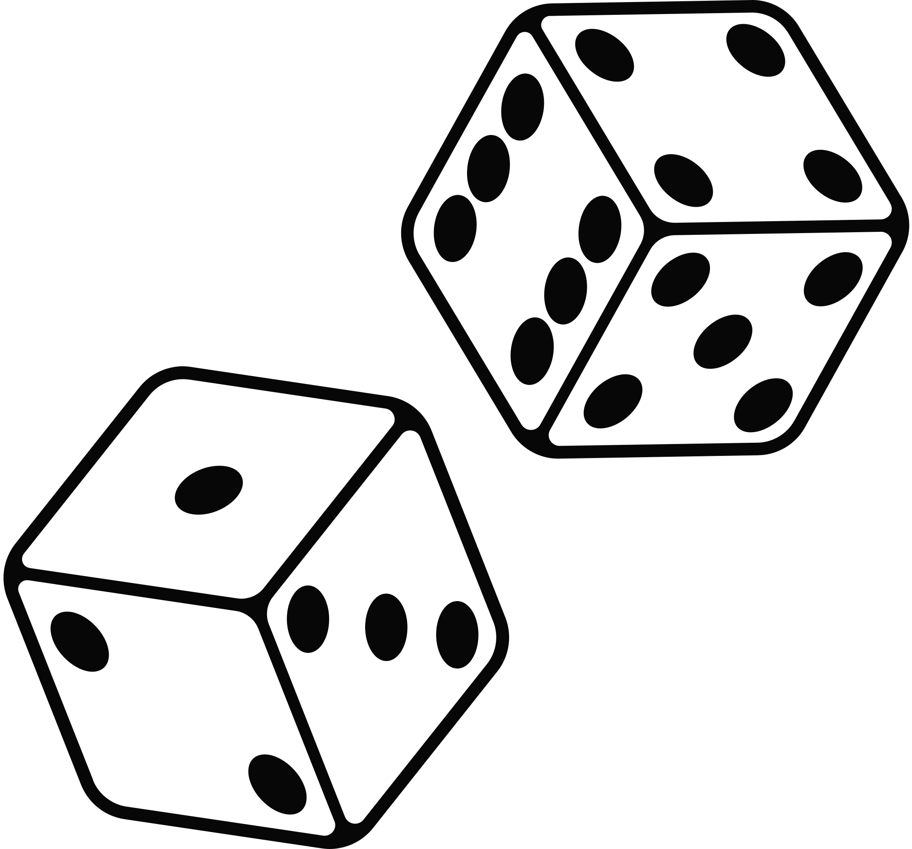
Rules
Each Round Includes:
  Reveal Action Slide
  Relevant branch responds
    (-1 point for responding as the incorrect branch)
  Other branches can check using appropriate powers
  Score based on success/failure through a roll of the dice.
  Every 4 Action Slides, there is a CRISIS that must be addressed by the whole government.

Slide 5
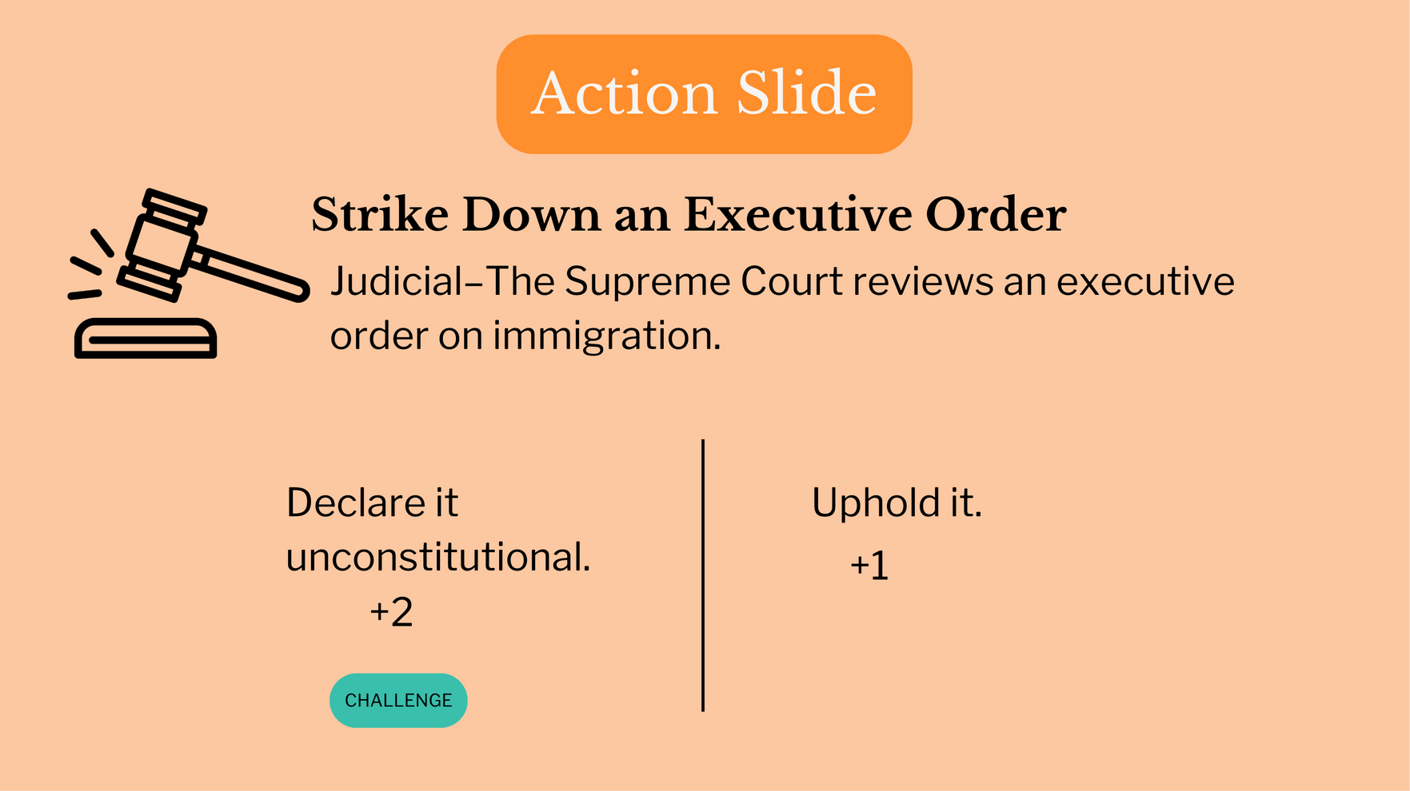

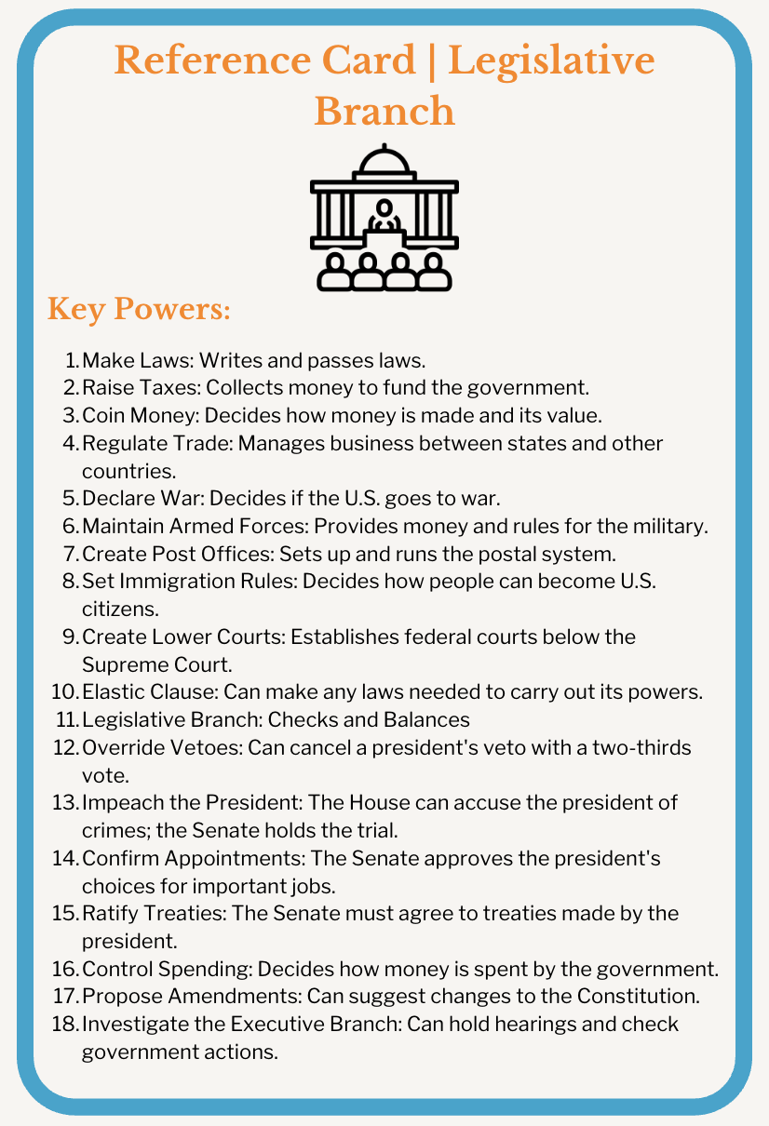

Example Turn
  The action slide is revealed.
  The Legislative Branch tries to respond, but it is not their role (-1 point.)

Slide 6
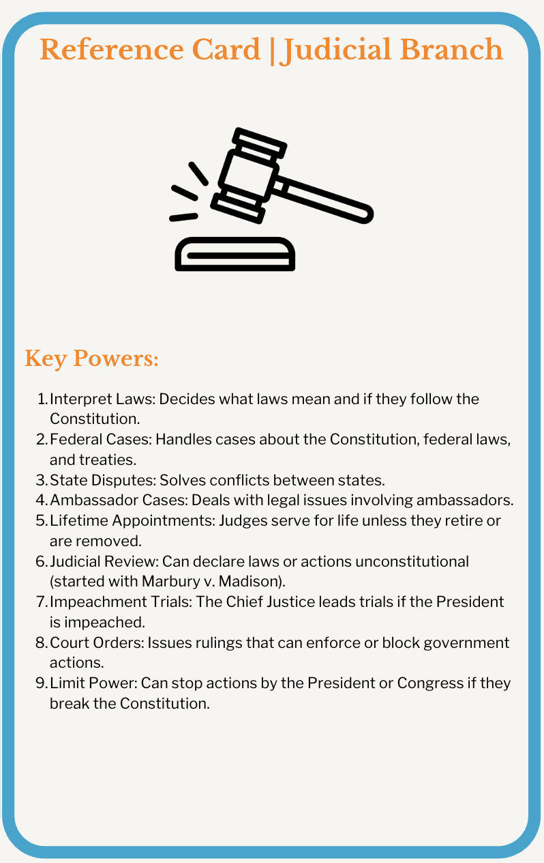
Example Turn
2. The relevant branch responds.
  The Judicial Branch team chooses to “Declare it unconstitutional” (+2 points.)
  If no one challenges, move to the next action slide.

Slide 7
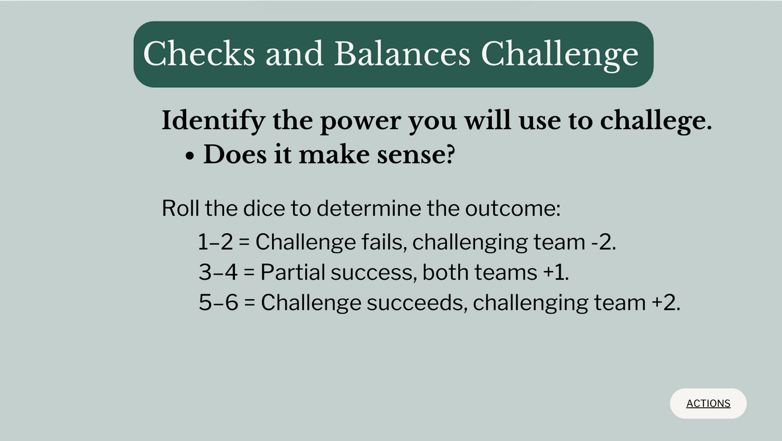
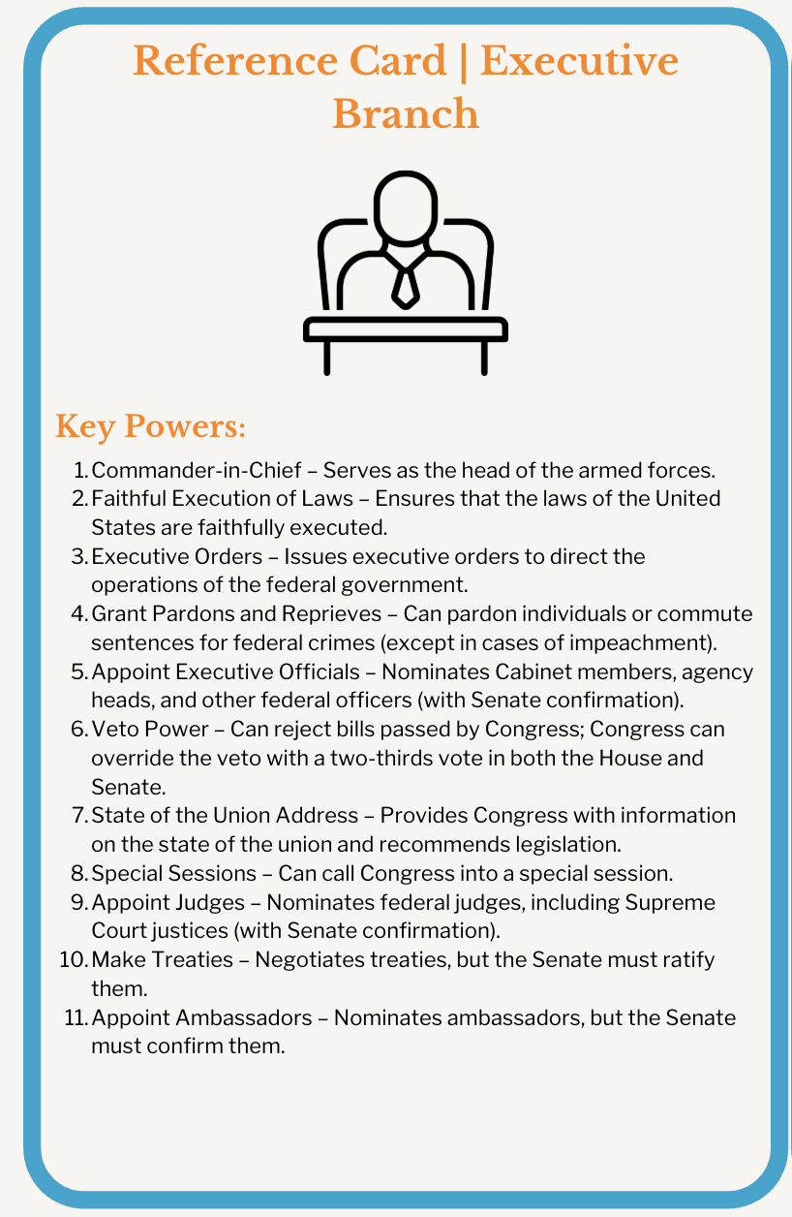

Example Turn
3. The Executive Branch chooses to check.
  They use the power to veto, but that does not make sense. So they do not roll to challenge.
Hint: You can’t challenge if you don’t have the power to do so! Check your reference card.

Slide 8
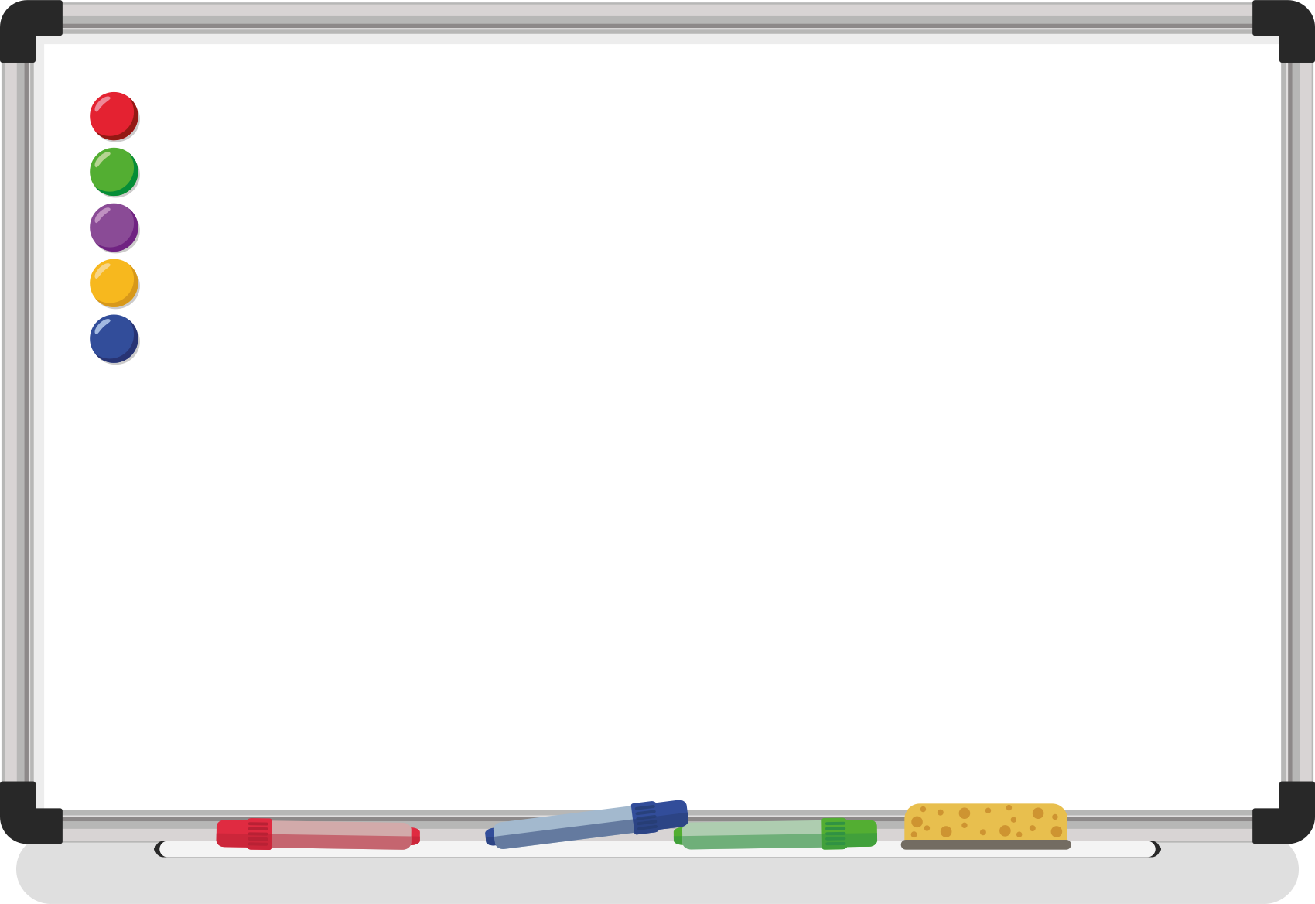

Example Turn
4. The turn is resolved with the Judicial team scoring 2 points and the Executive team losing 1 point.
  A new action slide is revealed to start the next turn.
Legislative
Judicial
Executive

Slide 9
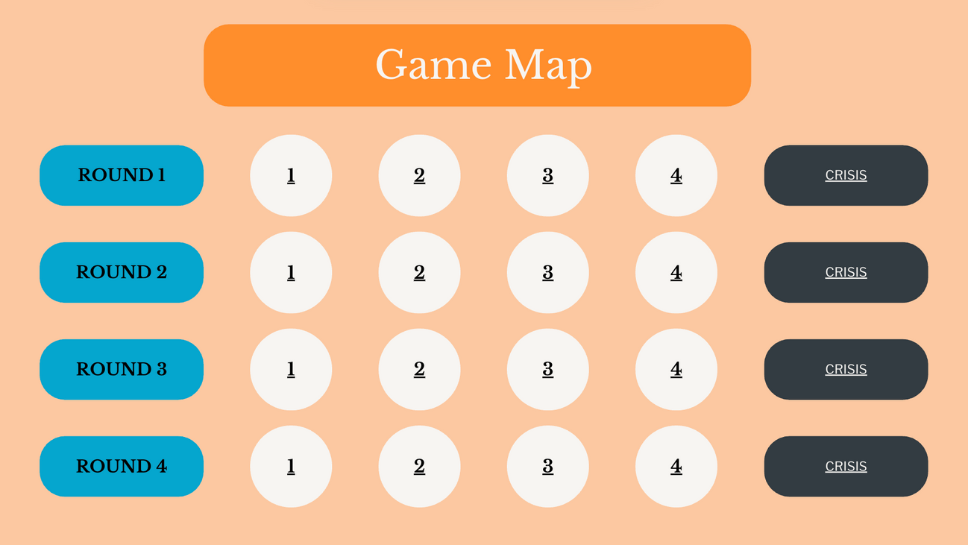
Example Turn
5. Every 4 rounds there will be a CRISIS.
  The whole government works together to solve the crisis.
  If the government fails, the game ends!

Slide 10

Ready to Play?

Slide 11
Game Map
1
2
3
4
CRISIS
ROUND 1
1
2
3
4
CRISIS
ROUND 2
1
2
3
4
CRISIS
ROUND 3
1
2
3
4
CRISIS
ROUND 4

Slide 12

Action Slide
Introduce a Bill
Legislative- The Senate introduces a healthcare bill.
Pass it.
Block it.
+2
+1
CHALLENGE
GAME MAP

Slide 13

Action Slide
Issue an Executive Order
Executive- The president considers an executive order on environmental policy.
Sign it.
Make recommendations to Congress.
+2
+1
CHALLENGE
GAME MAP

Slide 14

Action Slide
Rule on a Law’s Constitutionality
Judicial– A new healthcare law is challenged in the Supreme Court.
Declare it unconstitutional.
Uphold it.
+1
+2
CHALLENGE
GAME MAP

Slide 15
Action Slide
Pass a Budget
Legislative- Congress must pass the annual budget.
Pass it.
Block it.
+2
+1
CRISIS
CHALLENGE

Slide 16
Action Slide
Veto a Bill
Executive- The president must decide whether to veto a controversial immigration bill.
Veto
Make recommendations to Congress.
+2
+1
CHALLENGE
GAME MAP

Slide 17
Action Slide
Strike Down an Executive Order
Judicial–The Supreme Court reviews an executive order on immigration.
Declare it unconstitutional.
Uphold it.
+1
+2
CHALLENGE
GAME MAP

Slide 18
Action Slide
Override a Veto
Legislative- The president vetoes a bill—will Congress override?
Override it.
Allow it.
+2
+1
CHALLENGE
GAME MAP

Slide 19
Action Slide
Hear a Case on Civil Rights
Judicial– The Supreme Court must decide whether to consider a case about voting rights.
Hear the case and issue a ruling.
Uphold lower court ruling.
+1
+2
CRISIS
CHALLENGE

Slide 20
Action Slide
Negotiate a Treaty
Executive- The president decides whether to sign a peace treaty with a foreign nation.
Create Treaty.
Send an ambassador.
+2
+1
CHALLENGE
GAME MAP

Slide 21
Action Slide
Declare War
Legislative- Congress is considering a declaration of war.
Declare War
Wait and see.
+2
+1
CHALLENGE
GAME MAP

Slide 22
Action Slide
Grant a Pardon
Executive- The president decides whether to pardon a high-profile political figure.
Issue Pardon.
Allow the Justice Department to investigate.
+2
+1
CHALLENGE
GAME MAP

Slide 23
Action Slide
Decide on Federal vs. State Power
Judicial– Does a state law contradict a federal regulation?
Hear the case and issue a ruling.
Uphold lower court ruling.
+1
+2
CRISIS
CHALLENGE

Slide 24
Action Slide
Approve a Treaty
Legislative- The Senate votes on a trade treaty with another nation.
Approve it.
Reject it.
+2
+1
CHALLENGE
GAME MAP

Slide 25
Action Slide
Rule on Freedom of Speech
Judicial– A new law limits protests—constitutional or not?
Declare Unconstitutional.
Uphold lower court ruling.
+1
+2
CHALLENGE
GAME MAP

Slide 26
Action Slide
Declare a National Emergency
Executive- The president declares a state of emergency due to natural disaster.
Issue declaration.
Allow the states to decide.
+2
+1
CHALLENGE
GAME MAP

Slide 27
Action Slide
Impeach a President
Legislative- The House of Representatives votes on articles of impeachment. What will the Senate do?
Impeach.
Reject it.
+2
+1
CRISIS
CHALLENGE

Slide 28

Checks and Balances Challenge
Identify the power you will use to challege.
  Does it make sense?
Roll the dice to determine the outcome:
1–2 = Challenge fails, challenging team -2.
3–4 = Compromise achieved, both teams +1.
5–6 = Challenge succeeds, challenging team +2.
ACTIONS

Slide 29
CRISIS
Natural Disaster- A hurricane devastates a coastal city. Immediate government response is needed.
  Roll a die.
  Multiply the roll by the total number of points scored by all 3 teams.
<4 = Failure of Government, the game ends.
5-18 = Compromise achieved, all teams +1
>18 = Major success, all teams +3
SUCCESS
FAILURE

Slide 30
CRISIS
Economic Recession – The stock market crashes, unemployment skyrockets.
  Roll a die.
  Multiple by the total number of points scored by all 3 teams.
<24 = Failure of Government, the game ends.
24-36 = Compromise achieved, all teams +1
>36 = Major success, all teams +3
SUCCESS
FAILURE

Slide 31
CRISIS
Diplomatic Conflict – An allied nation breaks a trade agreement.
  Roll a die.
  Multiple by the total number of points scored by all 3 teams.
<32 = Failure of Government, the game ends.
33-49 = Compromise achieved, all teams +1
>50 = Major success, all teams +3
SUCCESS
FAILURE

Slide 32
CRISIS
Military Conflict- A foreign nation launches a military strike. The government must respond.
  Roll a die.
  Multiply by the total number of points scored by all 3 teams.
<50 = Failure of Government, the game ends.
50-65 = Partial success, all teams +1
>65 = Major success, all teams +3
SUCCESS
FAILURE

Slide 33

Conclusion
Game Over
  Announce the Winning Team
Reflection Questions:
  What was challenging about maintaining the balance of power?
  How did the powers of your branch affect the game?
  How did the branches work together (or not)?
GAME MAP

