Slide 1
Modified Fed-Up
Whole-Class Version

Slide 2
Federalist v. Anti-Federalist: Crash Course
Federalist
  Supported the new Constitution
  Stronger national government
  Energetic executive
  Extend the sphere of government, limit the power of factions
Anti-Federalist
  Concerned about the new Constitution
  Stronger state governments
  Weak or no executive
  Only small republics can represent the people/preserve liberty
  Wanted a bill of rights

Slide 3
Game Overview
This version of Fed Up is a digital game for a classroom of students, lasting 10-30 minutes.
The game is played over five rounds.
Students compete to collect the highest score.
Game simulates the debate between Federalists and Anti-Federalists during the formation of the Constitution

Slide 4



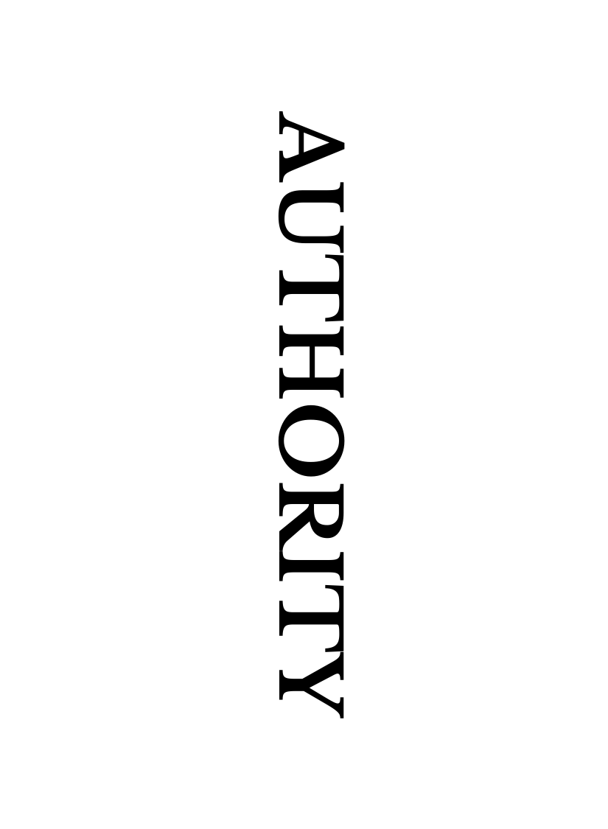
Components
Federalist Role Card
Anti-Federalist Role Card
Prompt Card
Ordering Cards
Notes:
Federalist Role Card (Blue Feds): Indicates students will be ranking cards based on the Federalist point of view.
Anti-Federalist Role Card (Orange Anti-Feds): Indicates students will be ranking cards based on an Anti-federalist point of view.
Prompt Card (Yellow double-sided arrow): Gives a category to rank the cards based on.
Ordering Cards (White card with blue outline): The cards that students are tasked with ranking. There are three on each slide.

Slide 5

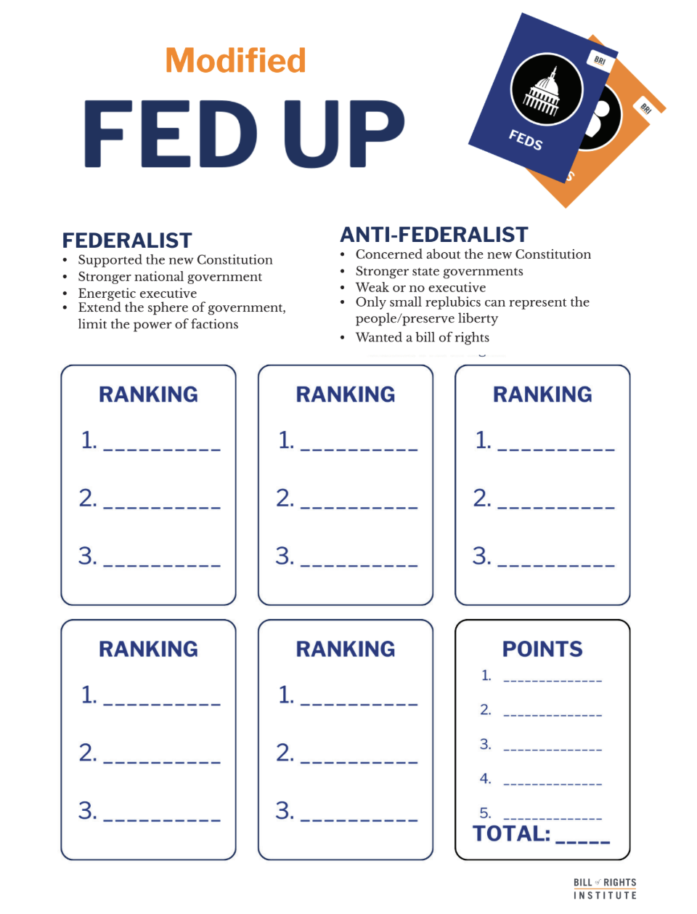
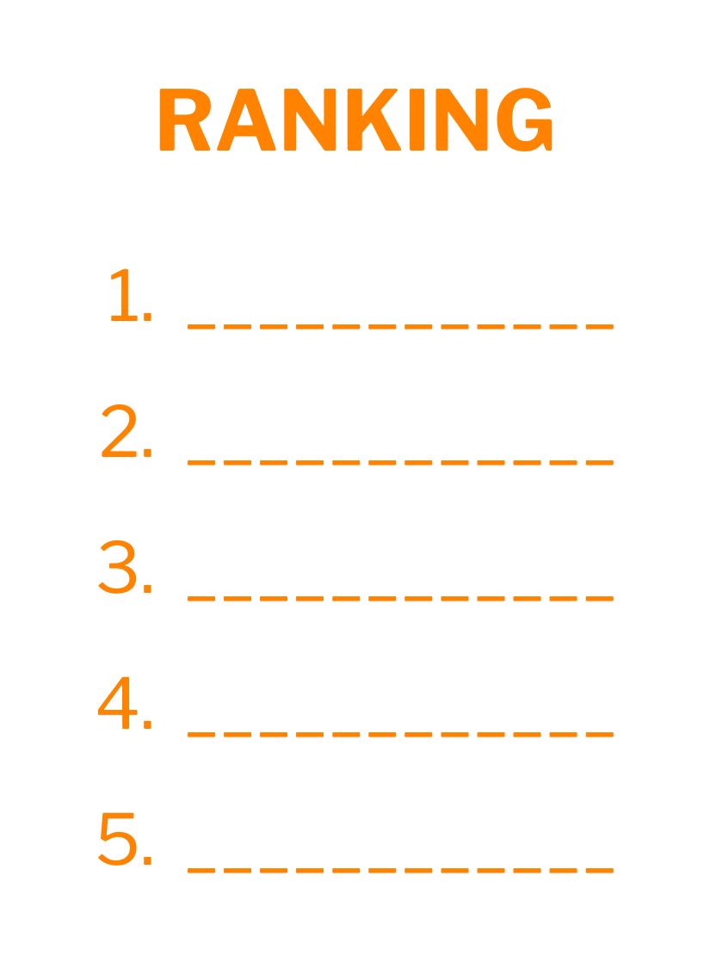

Scoring
Interesting
RANK THE CARDS FROM MOST TO LEAST…
___________________________
Liberty
Justice
Liberty
Happiness
Happiness
1
Justice
Notes:
Sample scoring: To score, students count up the words in the correct positions and then out their score in the “points” box. The student with the most points at the end of the game wins.

Slide 6
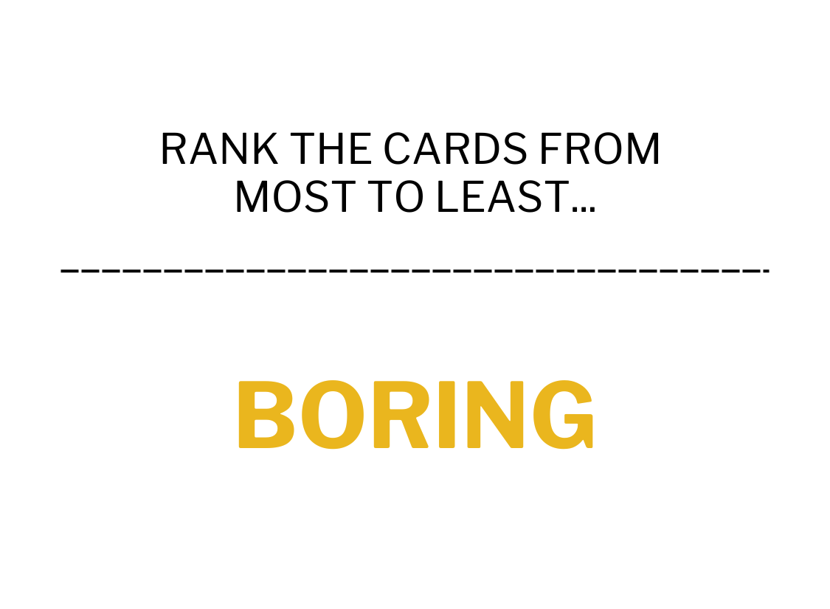




People
Ownership
Authority
Notes:
Teacher reveals the prompt card by moving the yellow card over manually. Tell students: “Rank the ordering cards (blue outline) from most to least Boring from the perspective of an Anti-Federalist.” Move the Orange "Anti-Feds" card to reveal a ranking. Edit the ranking as you see fit.

Slide 7

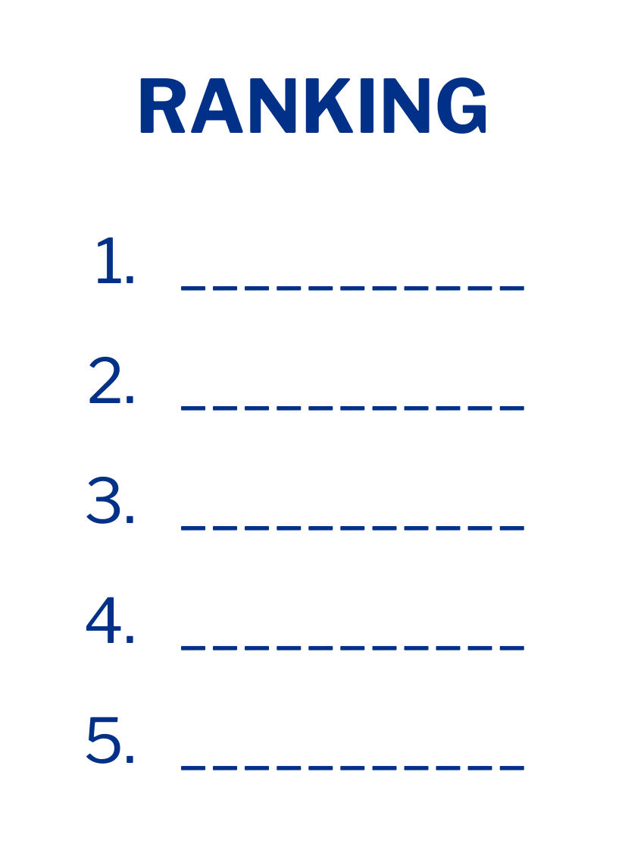



Union
Injustice
Tyranny

Slide 8
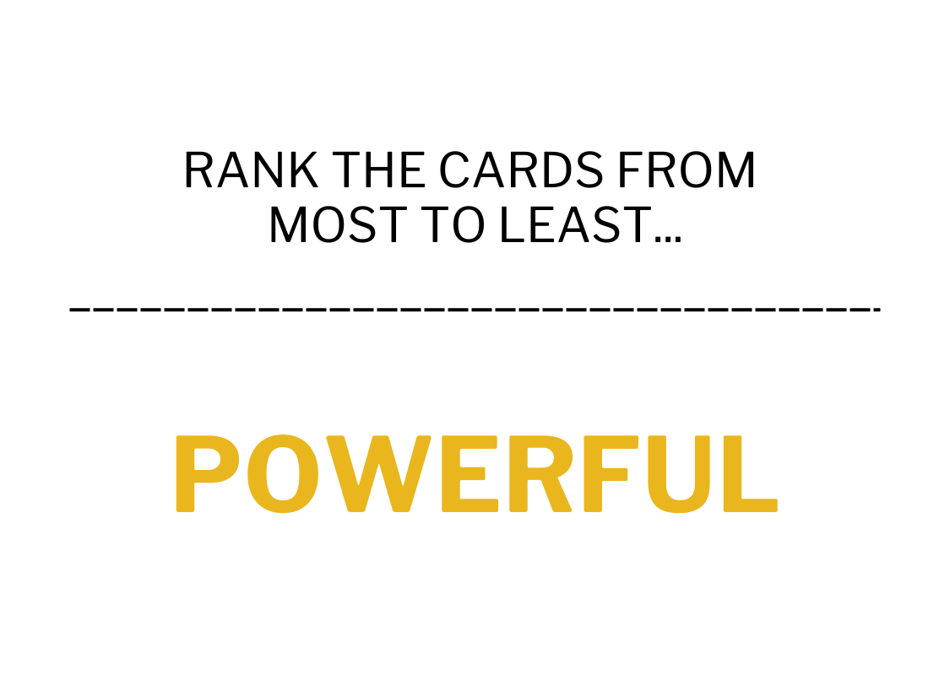



Peace
Liberty
Party

Slide 9
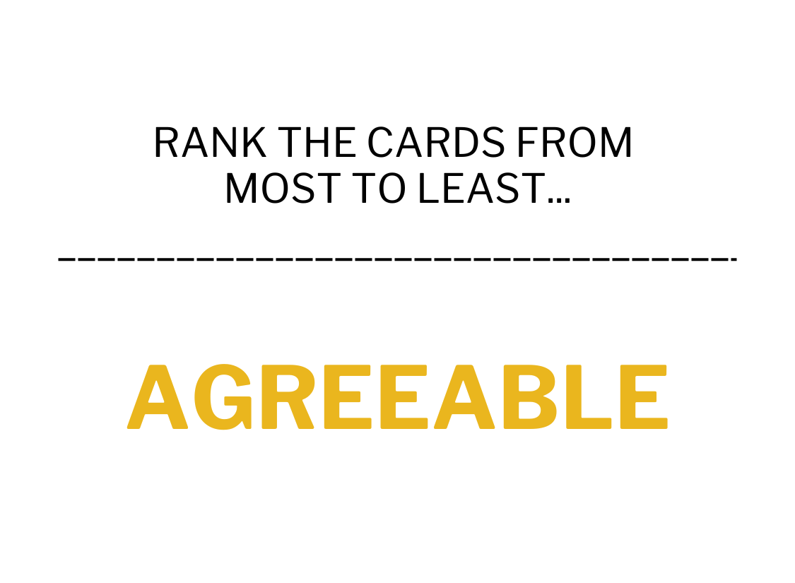



Laws
Faction
Passions

Slide 10
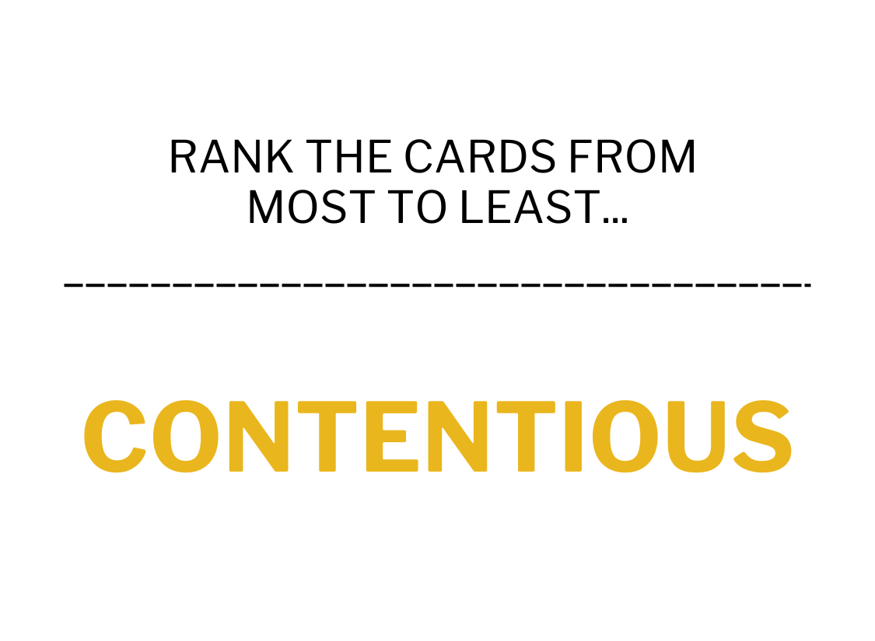

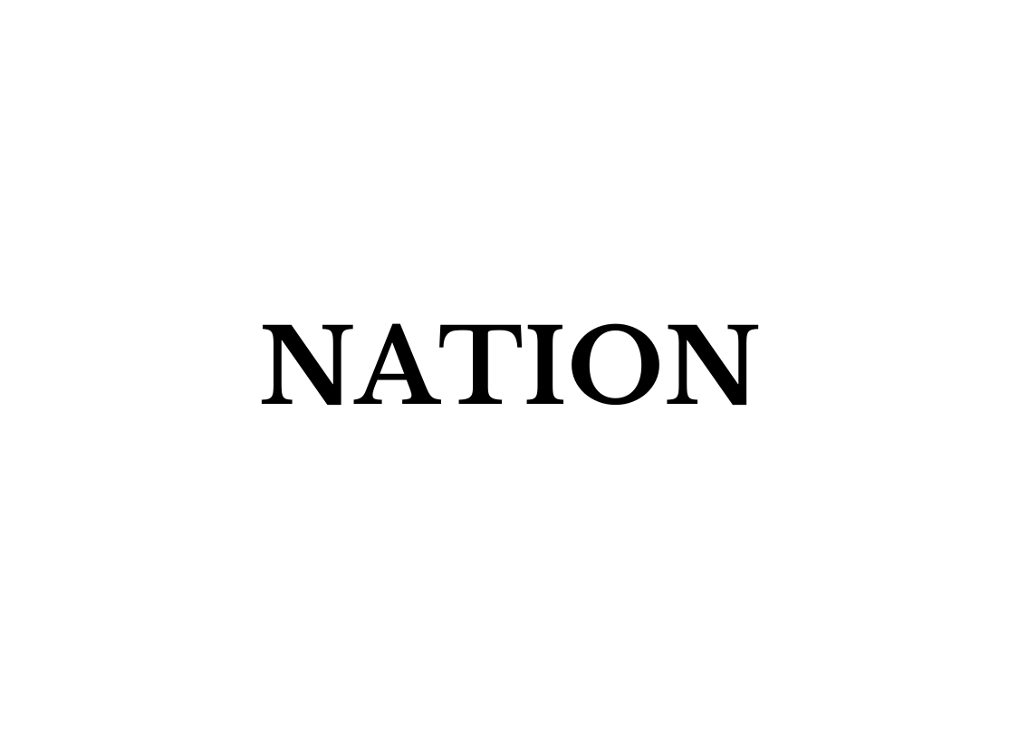

Nation
Ambition
Happiness

Slide 11
Final Scoring
Total up points
The student with the most points wins.
Notes:
After this whole group introduction, students may be interested in playing the full card game available at mybri.org.

Slide 12
Reflection & Connections
What decisions did you make during the game, and why?
How did the game illustrate principles of civics?
What emotions or thoughts did the gameplay evoke?

Slide 13
WORD HERE
RANK THE CARDS FROM MOST TO LEAST…
___________________________
Notes:
Create your own ”FED” Slide

Slide 14
WORD HERE
RANK THE CARDS FROM MOST TO LEAST…
___________________________
Notes:
Create your own ”ANTI-FED” Slide

