Slide 1
Origins of Slavery, Resistance to Slavery
Slide Deck

Slide 2
Objectives
I can explain how free and enslaved Blacks resisted the institution of slavery
I can summarize the main idea of primary source texts

Slide 3
Slavery in the Colonies
•Throughout the colonial era, many white colonists in British North America slowly established a system of unfree and forced labor upon Africans in all the colonies.
•Throughout the colonies, enslavement of Africans became a racial, lifelong, and hereditary condition.

Slide 4
Slavery in the Colonies
•The institution was tied to the larger Atlantic System of trade.
•The common thread running throughout the experience of slavery was injustice, and free and enslaved Blacks resisted this injustice in a variety of ways.

Slide 5
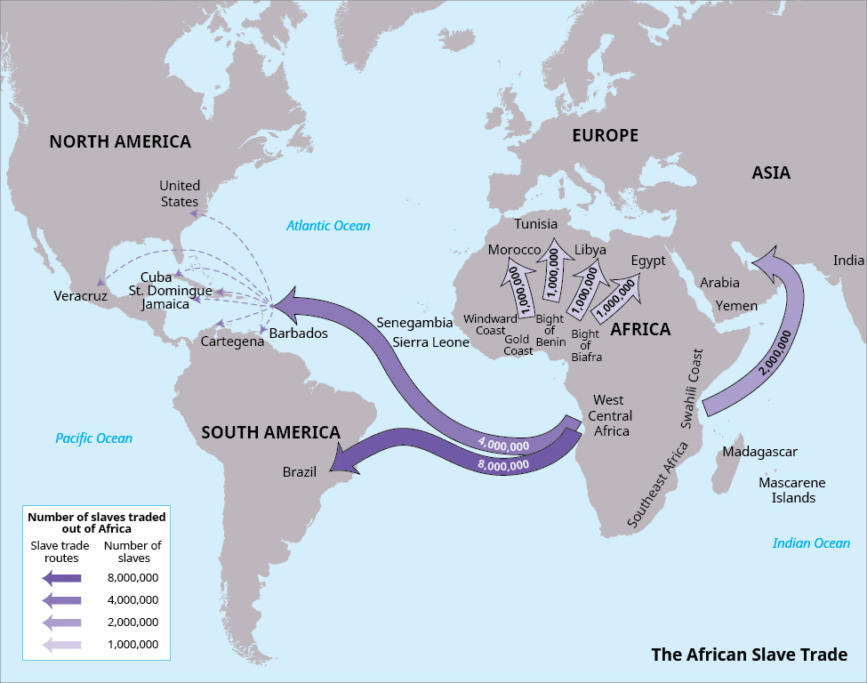
Atlantic Slave Trade
From the 15th to 19th century, European slave ships carried 12.5 million Africans mostly to the New World.
Almost 2 million individuals died before arriving in the New World.
The majority of enslaved people went to South America and the Caribbean.
About five percent of the human cargo in the slave trade landed in British North America.
This map shows the routes that were used in the Atlantic slave trade. The majority of slaves were sent to the plantations and mines of Brazil. (attribution: Copyright Rice University, OpenStax, under CC BY 4.0 license)

Slide 6
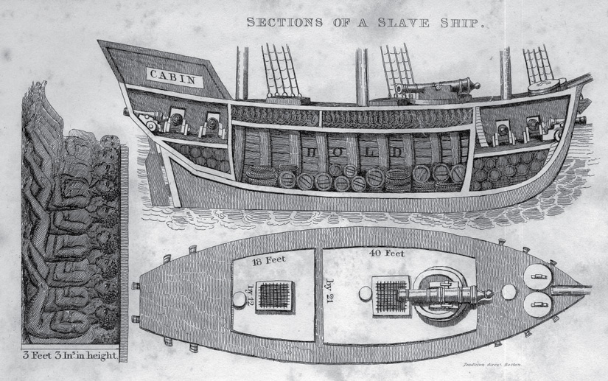
The Middle Passage
Conditions on board slave ships were crowded, dirty, and full of disease.
Some refused to eat or jumped overboard to die by suicide rather than face the unknown.

Slide 7
Enslaved Blacks in the Colonies
The experiences of African Americans in the 13 colonies were different based on region.
The climate, geography, agriculture, laws, and culture shaped enslavement.
However, slavery throughout British North America was a racial, lifetime, and hereditary condition.
Slavery was a system of coerced or forced labor that violated the enslaved person’s natural rights of liberty and consent.

Slide 8
Graphic Organizer
Fill in the graphic organizer as you read each primary source. Use question stems “Who, What, When, Where, Why, and How” to help you think of questions you may have about the primary sources. You may not have a question for each stem. However, the goal is to think of additional information you would like to have about the person(s) described in the source. The first source is done for you as an example.
Source | Shrink the text: What does this source tell us about slavery in colonial Virginia? | What questions do I still have about this source?
Virginia Governor’s Council reply to the petition of Matthew Ashby, November 27,1769 |  | What jobs did Matthew Ashby have as a freeman? When and where did Matthew Ashby get to see his family when they were enslaved? How was Matthew Ashby treated as a free man?
Runaway ad for Jude, October 28,1768
Runaway ad for Frank, August 27,1771
Runaway ad for Walton, 1774

Slide 9
Background Information: Source 1
In 1619, the first Africans arrived in the colony of Virginia. Slavery was written into law over the next few decades. By 1662, the colony of Virginia passed a hereditary slave law declaring the child of an enslaved mother, regardless of the status of the father, would follow the enslaved status of his/her mother. This law (and others over the next 40 years) created a hereditary, race-based system of forced labor in the colony: Black skin color became equal with enslavement and inferiority.
Matthew Ashby was born to a white mother, an indentured servant named Mary Ashby, and an unknown man of African descent. As a mulatto child born to a white mother, Matthew Ashby was required by law to serve as an indentured servant until the age of thirty-one. His mother was also required to pay a fine of 15 pounds to the church. After being indentured for 30 years, Matthew Ashby worked in Williamsburg, Virginia, as a free man.

Slide 10
Source 1 Vocabulary
Virginia Governor’s Council reply to the petition of Matthew Ashby, November 27, 1769
Petition | A formal written request, typically to a government or government official.
Indentured servants | Men and women who signed a contract or were required to work for a certain number of years in return for transportation to the American colonies and food, clothing, and shelter once they arrived. After completion of their contract, they were given their freedom.
Mulatto | A person of mixed African and European descent.
Pounds | The pound was a unit of British money. One pound equaled 20 shillings or 240 pence. Click here to find out how much this equals in today’s currency.
Manumit | To release legally from slavery.

Slide 11
Source 1
Virginia Governor’s Council reply to the petition of Matthew Ashby, November 27, 1769
On the Petition of Matthew Ashby, a free Mulatto setting forth that he had two Children by his present wife Ann Ashby, while she was a Slave to Samuel Spurr, that he brought her and the two Children of the said Spurr for one hundred and fifty pounds, that he now has two children alive by her John and Mary, that she has been a faithful and diligent Wife ever since marriage, and praying that he may be permitted to set her and his Children free; the Board being satisfied therein, were of opinion, that the said Ann, John and Mary were deserving of their freedom, and it was order’d that the said Matthew Ashby have leave to manumit and set them free.
Notes:
Bolded words are defined on the previous slide

Slide 12
Source 1​
Reading Comprehension Questions
What do you know about the family of Matthew Ashby, based on their petition?
What was Matthew Ashby’s status according to the law? What does this reveal about the law?
Why were Ann and Matthew Ashby’s children enslaved?
What did Matthew Ashby have to do to free his family?

Slide 13
Background Information: Sources 2-4
When enslaved men, women, or children ran away to seek freedom from their unjust condition, enslavers often published advertisements offering rewards for their return. Though the level of detail varies, these advertisements provided small insights into the lives of enslaved individuals. These featured descriptions of the person’s physical appearance, details surrounding their disappearance, and a reward for their return. Running away to freedom was a dangerous choice. Many were not successful and faced cruel physical punishments if they were caught.

Slide 14
Source 2 Vocabulary
Runaway advertisement for Jude, October 28, 1768
Mulatto | A person of mixed African and European descent.
Wench | An insulting term for a woman.

Slide 15
Source 2
Runaway advertisement for Jude, October 28, 1768
RUN away from the subscriber in Chesterfield, the Wednesday before Easter last, a bright mulatto wench named JUDE, almost thirty years old, is very remarkable, has lost one eye, but which I have forgot, has long black hair, a large scar on one of her elbows and several other scars on her face, and has been subject to running away ever since she was ten years old. I have great reason to believe she will pass for a free woman, and endeavor to make it into South Carolina. She is very knowing about house business, can spin, weave, sew, and iron, well. She had on when she went away her winter clothing…Whoever conveys the said slave to me shall be well rewarded for their trouble. MARY CLAY

Slide 16
Source 2
Reading Comprehension Questions
What details do we know about Jude from this advertisement?
Why might Mary Clay think Jude can pass for a free woman?

Slide 17
Source 3 Vocabulary ​
Runaway advertisement for Frank, August 27, 1771
​
Pamunky (Pamunkey) | Virginia Indian tribe in the coastal area of southeastern Virginia. The Pamunkey River is named for the tribe.

Slide 18
Source 3
Runaway advertisement for Frank, August 27, 1771
Run away from the subscriber … a NEGRO FELLOW named Frank, twenty seven Years of Age, five Feet five or six inches high … He has run away several Times, and always passed for a Freeman. As he may possibly try to get out of the country, I hereby forewarn all Matters of Vessels from carrying out the said Slave, at their Peril. I imagine he is [sulking] about Indian Town on Pamunky among the Indians, as one of his former Trips he got himself a Wife amongst them. Whoever brings the said Slave to me shall be handsomely rewarded. DAVID SCOTT.

Slide 19
Source 3​ ​
Reading Comprehension Questions
What details do we know about Frank from this advertisement?
Why might the Pamunkey Indians be willing to help Frank secure his freedom?

Slide 20
Source 4 Vocabulary ​
Runaway advertisement for Walton, 1774
Countenance | Appearance
Waitingman | Person who waits on customers in an inn or a place of lodging or in the home of a family
Endeavor | To try

Slide 21
Source 4 ​​
Runaway advertisement for Walton, 1774
RUN away from the Subscriber, a Virginia born Negro Fellow named WALTON, 23 Years of Age, of a light Complexion, middle Size, has a pleasing Countenance … he carried with him four Shirts … two Suits of Clothes … Velvet Cap, Hat, and every Thing else suitable for a Waitingman. As he is a very artful and likely fellow, he may endeavor to pass for a free Man, and I am doubtful has got a Pass from a Negro of mine who can write a good Hand. This fellow has waiting on me for three Years past, and always rode with me, so that he has a general Acquaintance, but as he was raised in [Nansemond?], near the old Town, it is probably he is gone there, as his Friends live in that Neighbourhood. Whoever takes up the said Runaway, and brings him home, shall have 3 pounds reward, or 3 shillings if committed to Jail. All persons are forbid harboring or carrying the said Slave out of the Colony. PETERFIELD TRENT.
*As the said Fellow ran away without receiving any Abuse, the Taker up is desired to give him ten Lashes every ten Miles.

Slide 22
Source 4​
Reading Comprehension Questions
Peterfield Trent wrote that Walton “may endeavor to pass for a free Man.” What might allow Walton to pass as free?
Walton is said to carry a variety of clothing with him. What does that reveal about his role as a waitingman?
How was Walton assisted by others in his attempt to secure his own freedom?
What does the postscript reveal about Walton’s status as an enslaved person?

Slide 23
Now that you have read all the sources...
What are two different ways of resisting enslavement?
How did the laws regarding enslavement in Virginia demonstrate injustice, or damage to another's rights and dignity?

Slide 24
Resistance to Enslavement
Resistance to the injustice of slavery took a variety of forms:
○Refusing to work or slowing the pace of work
○Breaking tools
○Stealing food or drink
○Music (Spirituals)
○Learning to read
○Running away
○Connections with free Black communities to transmit news and hide runaways

